Slide 1

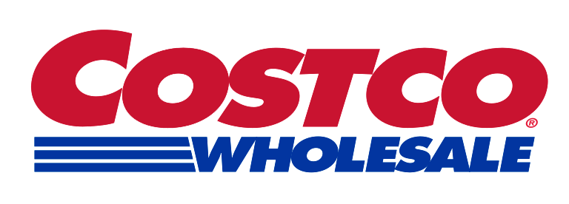
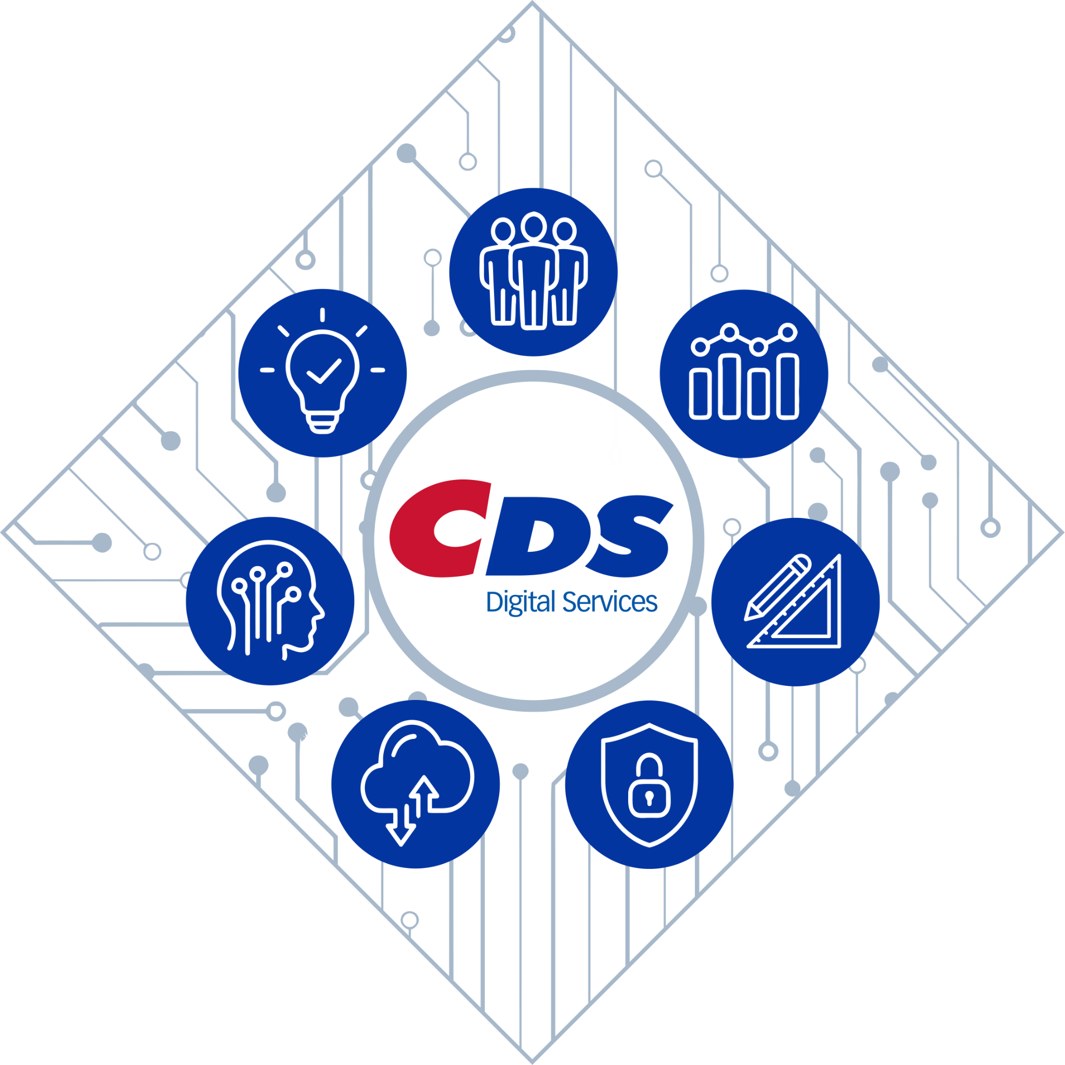
Agentic Architecture
Enterprise Agentic AI Platform Architecture Blueprint
February 2026

Slide 2

Guiding Principles
Contents
Overarching Costco principles
Key imperatives driving Agentic AI in the enterprise
Enterprise Agentic AI principles
Nexus Architecture
High Level Architecture
Enterprise Agentic AI platform capabilities
Technology considerations at each capability layer
Capability design principles
5-year roadmap
Detailed Architecture
Design patterns catalog
Architecture Recommendations for Priority Use Cases
Call Center
Personalized Search
Knowledge Assist
GEO
MVP Scoping & Implementation Plan
MVP capabilities
6 month MVP implementation plan

Slide 3

Guiding Principles

Slide 4
Overarching Costco Guiding Principles
Informs agentic AI operating and architecture principles
Source | Guiding Principle
Enterprise Architecture | Business and IT Alignment with Measurable Value
 | Customer-Centric Design
 | Security, Compliance, and Privacy by Design
 | Simplicity and Scalability
 | Modular and API-Driven Architecture
 | Reuse Over Build or Buy
 | Global Availability and Resilience
 | Data-Driven Decision Making
 | Adaptive Governance
 | Innovation and Continuous Improvement & Automation
AI Architecture | Lead from the Top
 | Responsible development & deployment
 | Composable AI Architecture with GCP First
 | Interoperability
 | Empower the Workforce
 | Partner for Acceleration

Slide 5

Key imperatives driving Enterprise AI
1
2
3
Take a platform-based approach to maximize reusability & consistency of agentic architecture
Prioritize ecosystem interoperability to avoid siloed developments
Leverage pre-built agents to accelerate time-to-value
4
5
Drive persona-based adoption with tailored experiences across user types
Embed governance and evaluation frameworks to ensure trustworthy agents

Slide 6
Agentic AI Architecture Design Principles
Agentic AI Architecture Guiding Principles
1
Knowledge-first approach for context engineering
2
Federated deployment, centralized governance
3
Standards driven and governance by design
4
Composable design to adapt to rapid innovation
Semantic data modeling
Context isolation
High quality data preparation and normalization
Continuous knowledge governance and lifecycle Mgmt..
Domain autonomy, Platform consistency
Shared reference architecture with local extensions
Common Guardrails, enforced through a central policy
Unified Agent registry and identity
Automated deployment tooling
Standardized agent lifecycle management and certification
Governance embedded into workflows
Standardized interfaces and protocols
Global safety and risk framework
Unified observability, telemetry and auditability
Service-Oriented design approach
Loose coupling via abstractions
Declarative orchestration
5
Design for elasticity and scaling for high-volume processing
6
High-performance, safety-first agent operations
7
Cost efficient by design
Elastic, on-demand orchestration
Resilient and fault tolerant execution
Inferencing through request batching
High throughput, low latency
Standardized red teaming and AI judge framework
Tunable agent reasoning levels based on task complexity
Defensive UI for agentic experience
Network isolation
Right sized models and adaptive routing
FinOps by design: Cost visibility and guardrails
Operational simplification through platform consolidation
Semantic caching

Slide 7
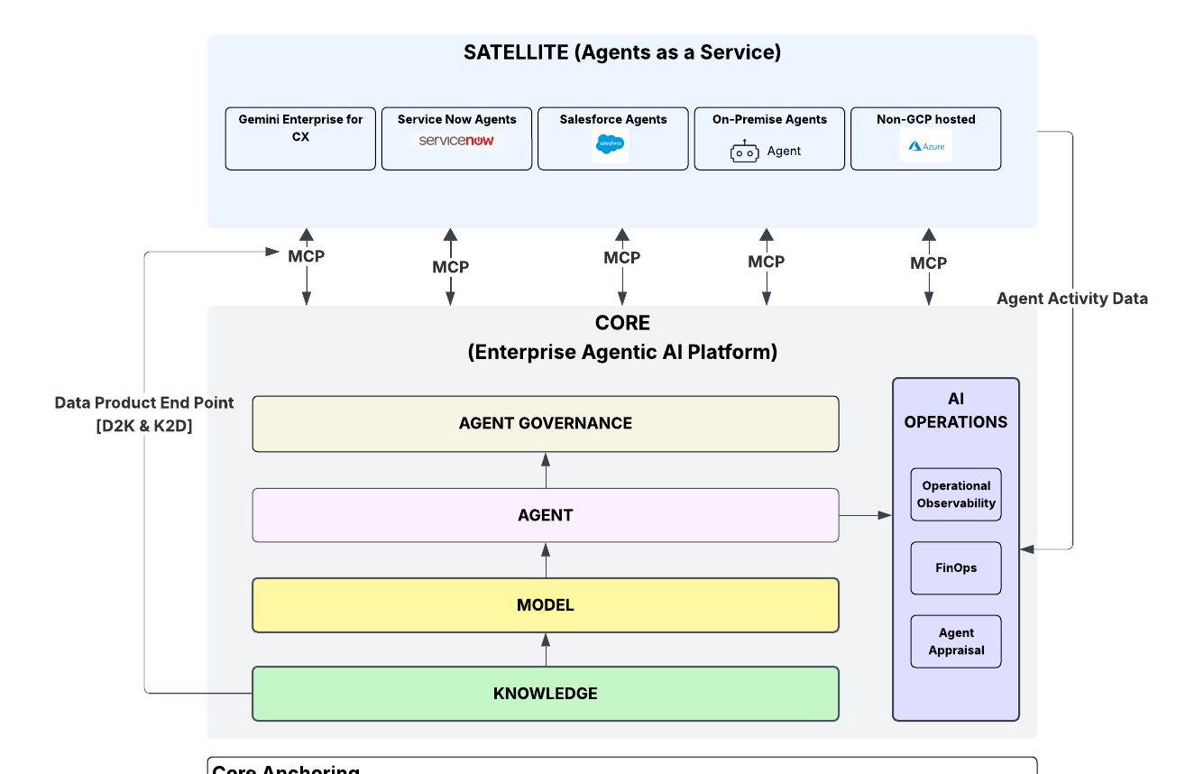
Agents will be federated in an organization
  Core Anchoring
  The core represents the solutions developed as foundational and differentiated capabilities of the organization, which will primarily include the knowledge layer, utility agents, Centralized governance and AI operations
  Satellite Autonomy
  Satellites represent the non-differentiated or commodity agentic capabilities that are developed by ecosystem products (Salesforce, SAP, ServiceNow) and solutions for faster time to market. Satellites enables “agents as service” where agents stay close to the data, process and experience affinity.
The core enables centralized governance for both differentiated custom as well as commodity agents
Go to Lucidchart

Slide 8
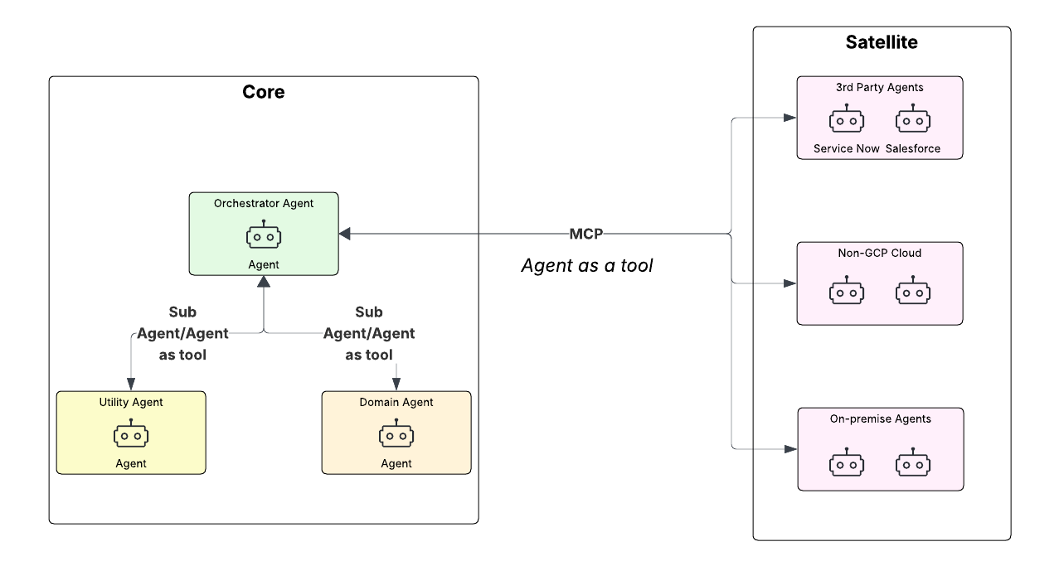
Agents will leverage communication protocols
Agent Interaction: Agent2Agent Protocol (A2A)
  Remote Agents publish an Agent Card describing the agent’s capabilities/skills and authentication mechanism
  Communication between a Client and a Remote Agent is oriented towards Task completion
  Tasks are used to transmit Artifacts (results) and Messages (thoughts, instructions, anything else)
  Agents accomplish tasks for end-users without sharing memory, thoughts, or tools
Agent as Tool : Model Context Protocol (MCP)
  3rd party agents which may not be A2A complaint can be exposed as tools
  A2A compliant agents connects to those agents through MCP protocol
  MCP protocol also connects Agents to Tools, Resources, and Prompts
  Standard Client-Server architecture built upon structured messages with well-defined schemas
Within the platform, we will leverage Sub Agent or Agent as tool pattern for inter agent communication. For 3rd party agents, we will leverage MCP and Agent as tool pattern for agent communication. A2A and other emerging patterns will be explored based on applicability and maturity of the protocols

Slide 9
Enterprise Agentic AI Platform Capabilities

Slide 10
AI Capabilities View
AI STRATEGY & TECH BUSINESS MANAGEMENT
Establishes AI technology strategy and standards and governs investments and organizational behavior to ensure alignment with organizational priorities and responsible behaviors.
SOLUTION DELIVERY & MANAGEMENT
Designs, delivers, and manages AI use cases end-to-end, ensuring solutions are built, deployed, and continuously improved to deliver measurable business value.
1
2
AI PLATFORM
Creates shared enterprise platform that supplies the core orchestration, tooling, integration, technical governance, and operational services needed to enable AI agents.
3
DATA & ANALYTICS
Delivers and governs high-quality, trusted data to power AI agents, while providing data and analytics capabilities that inform and continuously shape the enterprise AI strategy.
4
INFRASTRUCTURE, OPERATIONS, & SECURITY
Provides resilient, secure, and optimized cloud and infrastructure services to continuously run AI solutions responsibly across the enterprise
5
CLOUD & INFRA
PLATFORM
DATA

Slide 11
Agentic AI Platform Capabilities - Level 1/2
*Existing capabilities will need enhancements during use case enablement
Agent
Governance
Artificial intelligence and Management
AI Operations
Agent Intelligence
(Agent Certification, Agent Registry, Agent Evaluation, Human Feedback, Agent Security)
Artificial intelligence and Management
Agent
Artificial intelligence and Management
Model Operations
(Experimentation, Serving)
Agent Intelligence
(Agent Orchestration, Agent Memory, Agent Explainability, Agent Tools and Protocols)
Prompt Management
(Prompt Registry)
E
Model
Artificial intelligence and Management
Agent Operations
(Agent Deploy, Agent Observability, Agent Improvement)
Model Operations
(Model Registry, Model Finetuning, Model Security, Model Benchmarking)
Knowledge
Enterprise Knowledge Management
Context Engineering
(Knowledge Ingestion, Knowledge Retrieval)
Ontology Management
(Ontology creation, curation & management)
Metadata Schema definition and mapping
(Metadata Management)
Knowledge Stores
(Vector Stores, Knowledge Graphs)
Taxonomy Management
(Taxonomy creation, curation & management)
Knowledge Operations
(Knowledge Synthesis & Graph Builder )
Application Technology Management
Integration Management
(AI Gateway, MCP Gateway)
Data
E
Data Management
Application Technology Management
E
Data Quality Management
(Ent. Data Governance)
Data Base Management
(ODS)
Data Warehouse Management
(Analytical Data Store)
Data Lake Management
(Object Storage)
Data Protection
(Data security management)
Integration Management
(Data Integration Mgmt.)
Cloud and Infrastructure
E
E
E
E
E
E
Infrastructure & Cloud Management
Server, Container
IT Security Mgmt.
IAM, Stds & Policies, Vulnerability Mgmt.
Infrastructure & Cloud Management
Cloud Management
(Cost Control)
IT Operation Mgmt.
Observability
Network Management
Segmentation
Application Technology Management
API Gateway
Level 1 Capability
Level 2 Capability
EXISTING CAPABILITY
CLOUD & INFRA
PLATFORM
DATA

Slide 12
Agentic AI Platform Capabilities - Level 3
*Existing capabilities will need enhancements during use case enablement
Agent
Governance
Agent Certification
(Certified 1P and 3p Agents)
Agent Registry
(Agent registration – 1P and 3P agents)
Agent Evaluation
(LLM as judge, statistical metrics)
AI Operations
Human Feedback
(Thumbs up/down, structured feedback)
Agent Security
(Identity management, Data and Tool controls)
Agent
Agent Orchestration
(no code, low code, pro-code)
Agent Explainability
(Agent Activity and Token consumption tracking)
Agent Tools and Protocols
(MCP, A2A, connectors)
Agent Memory
(Memory management)
Prompt Registry
(Prompt Management)
Experimentation
(ML model experiment, Build, deploy, monitor)
E
Model
Serving
(ML Inferencing)
Model Registry
(Registry of approved Foundation models)
Model Benchmarking
(Identifying the right-fit model for the use case)
E
Model Fine Tuning
(Domain Adaptation of foundation models)
Model Security
(Guardrails, Content Filter)
Agent Deploy
(Agentic Application development and operations)
Knowledge
Knowledge Ingestion
(Semi structured, Unstructured and Structured data)
Knowledge Retrieval
(Retrieval strategies)
Knowledge Synthesis
(Synthetic data generation)
Metadata Management
(metadata for unstructured content)
Taxonomy Management
(Create, curate and manage taxonomy)
Ontology Management
(Create, curate and manage ontologies)
Knowledge Graph
(KG creation using taxonomy and ontology)
Vector Stores
(Embedding Persistence)
Agent Observability
(Model, Application, Agent, Prompts, Ingestion pipelines)
Data
Enterprise Data Governance
(Data Catalog)
Analytical Data Stores
(Analytical Data Product)
Operational Data Stores
(Near | Real time Data Product)
Object Storage
E
E
E
E
Agent Improvement
(Feedback Integration)
Data Security Management
(Masking, Encryption)
Data Integration Management
(ETL, Pub/Sub, CDC)
E
E
AI Gateway
(Model, Agent)
Cloud and Infrastructure
Server, Container
(Agent Run Time)
Cost Control
(Tagging, Budgets and Alerts)
Observability
(Telemetry)
Standards and Policy Mgmt.
(NIST Controls)
E
E
E
E
MCP Gateway
(Tools)
E
Identity and Access Mgmt.
(Identity Access Management)
Network Management
(VPC,Subnets, Routes)
API Management
(API access)
Vulnerability Management
E
E
E
Level 2 Capability
Level 3 Capability
EXISTING CAPABILITY
CLOUD & INFRA
PLATFORM
DATA

Slide 13
Agentic AI Platform - Layer Maturity Stages
Knowledge
Model
Agent and Agent Governance
AI operations
Optimized(O)
Rich semantic modeling leveraging ontology and taxonomy management tools
Knowledge Layer acting as the central knowledge index for the organization
Dynamic model routing
Capability established for adapting foundational models for costco context
Agent certification process has been established
Agent onboarding is enabled through the certification process and agent registry
Agents in the organization are discoverable through Agent registry
Correlation of logs and agent activity traces to proactively identify agent activity anomalies
Ability to apply kill-switch to proactively suspend an agent
Defined(D)
Standard patterns established for ingestion and retrieval
Automated and scalable ingestion and retrieval pipelines
Unified knowledge serving layer with documented design choices
Governance is in place for metadata curation, PII tagging
Process established for onboarding models
Unified model access layer via model gateway
Monitoring and security controls applied
Agent orchestration patterns are defined
Agent activity is collected and analyzed via OTEL compliant solution
Realization of Nexus architecture to orchestrate across 1st party and 3rd party agents
A central control plane exists to monitor and track model and tool access by the agents
Prompt and Tool deployment is integrated with CI/CD
Initial(I)
No reference architecture or repeatable patterns
Adhoc ingestion and retrieval
Little to no governance: weak metadata and access controls
No consistent model access layer via model gateway
No model usage observability
Minimal model security controls
Agent orchestration patterns are not defined
Capability to collect and analyze agent activity not enabled
Memory management patterns are not defined
Limited visibility into Agent Activity
No cost tracking of the agent activity
No central control plane for model and tool access
Notes:
managed - level 2
defined - 3

Slide 14
Agentic AI Platform Capabilities - MVP
*Existing capabilities will need enhancements during use case enablement
Agent
Governance
Agent Certification
(Certified 1P and 3p Agents)
Agent Registry
(Agent registration – 1P and 3P agents)
Agent Evaluation
(LLM as judge, statistical metrics)
AI Operations
D
O
Human Feedback
(Thumbs up/down, structured feedback)
Agent Security
(Identity management, Data and Tool controls)
D
O
Agent
Agent Orchestration
(no code, low code, pro-code)
Agent Explainability
(Telemetry)
Agent Tools and Protocols
(MCP, A2A, connectors)
D
O
Agent Memory
(Memory management)
Prompt Registry
(Prompt Management)
Experimentation
(ML model experiment, Build, deploy, monitor)
E
Model
E
Model Registry
(Registry of approved Foundation models)
Model Fine Tuning
(Domain Adaptation of foundation models)
Model Security
(Guardrails, Content Filter)
Model Benchmarking
(Identifying the right-fit model for the use case)
Serving
(ML Inferencing)
D
O
Knowledge
Knowledge Ingestion
(Semi structured, Unstructured and Structured data)
Knowledge Retrieval
(Retrieval strategies)
Knowledge Synthesis
(Synthetic data generation)
Metadata Management
(metadata for unstructured content)
Agent Deploy
(Agentic Application development and operations)
D
O
Taxonomy Management
(Create, curate and manage taxonomy)
Ontology Management
(Create, curate and manage ontologies)
Knowledge Graph
(KG creation using taxonomy and ontology)
Vector Stores
(Embedding Persistence)
Agent Observability
(Model, Application, Agent, Prompts, Ingestion pipelines)
Data
Enterprise Data Governance
(Data Catalog)
Analytical Data Stores
(Analytical Data Product)
Operational Data Stores
(Near | Real time Data Product)
Object Storage
Agent Improvement
(Feedback Integration)
E
E
E
E
Data Security Management
(Masking, Encryption)
Data Integration Management
(ETL, Pub/Sub, CDC)
E
E
AI Gateway
(Model, Agent)
Cloud and Infrastructure
Server, Container
(Agent Run Time)
Cost Control
(Tagging, Budgets and Alerts)
Observability
(Telemetry)
Standards and Policy Management
(NIST Controls)
E
E
E
E
MCP Gateway
(Tools)
Identity and Access Management
(Identity Access Management)
Network Management
(VPC,Subnets, Routes)
API Management
(API access)
Vulnerability Management
E
E
E
E
Level 2 Capability
Level 3 Capability
EXISTING CAPABILITY
CLOUD & INFRA
PLATFORM
DATA
MVP Level 3 Capabilities
D
MVP
O
Target State
D - Defined
O - Optimized

Slide 15
Technology Considerations at each layer

Slide 16
Knowledge Layer | Technology Decisions (1/5)
Knowledge Ingestion
Scalable capabilities to process semi-structured, unstructured and structured enterprise data (documents, images, audio, video, relational data).
Includes modules for extraction of key entities, metadata and data classification tags,, chunking for embeddings, and enrichment for downstream retrieval.
Knowledge Retrieval
Ability to optimize the search space by combining one or more retrieval/reranking strategy to identify the most optimal and relevant context to be passed to the language model for response generation
Knowledge Synthesis
Services for generating, validating, and integrating synthetic data to support prompt tuning, scenario generation, and evaluation of agent behaviors.
Provides broad coverage of diverse data types, including edge-case and safety scenarios.
Metadata Management
Defines, organizes, and governs metadata across knowledge assets.
Covers data access rules, categories, timestamps, lineage, and quality attributes.
Enables retrieval filtering and context isolation by supplying high-precision descriptors.
3rd Party Services
None
3rd Party Services
None
GCP Services
Gemini Enterprise
Vector Search
Alloy DB
Cloud run
Non-GCP services
None
GCP Services
Gemini Enterprise
GKE
Redis Cache/Cloud memory store
Non-GCP services
None
GCP Services
None
Non-GCP services
Python
RAGAS/DeepEvals
GCP Services
Dataplex
Non-GCP services
None
*
*
*
Taxonomy Management
Taxonomy is a structured classification system that organizes knowledge into categories, hierarchies, and relationships. Creates a consistent vocabulary that both humans and AI models can interpret reliably.
Ontology Management
Ontology is a semantic representation of the business domain capturing entities, attributes, relationships, constraints, and interactions. Provides LLMs and agents with structural understanding of the domain to improve grounding and reasoning.
Knowledge Graph
A knowledge graph is a dynamic representation of knowledge that models the concepts within a particular domain and the relationships between those concepts. It acts as the digital brain of the AI agent.
Vector Store
Vector stores are specialized databases for storing and searching high-dimensional numerical representations of data, enabling AI systems to find semantically similar items.
GCP Services
Dataplex
Non-GCP services
UI and Backend
GCP Services
Alloy DB
Firestore (Optional)
Non-GCP services
UI and Backend
GCP Services
None
Non-GCP services
Neo4J
UI and Backend
GCP Services
Alloy DB
Non-GCP services
None
*
*
Assessment
Technology Decision | POC & KAD
*
GCP Native
Build
3rd party

Slide 17
Model Layer | Technology Decisions (2/5)
Model Registry
Model registry refers to the set of approved models from different providers which are approved to be used by the organization. The models in this registry are exposed via the AI gateway. Model registry provides scoped access to the approved models.
Model Fine Tuning
Capability to train or adapt foundation models with domain-specific Costco data so the model internalizes the vocabulary, semantics, and constraints of the problem space.
Model Security
Mechanisms to enforce safety constraints, prohibited topics, refusal behavior, and output filtering at the model level
Model Benchmarking
Suite of services for testing and evaluating base models and custom models against a well- defined set of metrics and create benchmarks for business related functional areas.
*
3rd Party Services
None
3rd Party Services
None
GCP Services
APIGEE
Non-GCP services
Kong
LiteLLM
GCP Services
Vertex AI Fine Tuning
Non-GCP services
None
GCP Services
Model Armor
Non-GCP services
None
GCP Services
Vertex AI Evaluation Service
Non-GCP services
Front end and backend service
Technology Decision | POC & KAD
*
GCP Native
Build
3rd party

Slide 18
Agent Layer | Technology Decisions (3/5)
Agent Orchestration
A highly customizable, low-code and pro-code , scalable framework with chain-of-thought reasoning, dynamic task decomposition and management. Agents are designed to collaborate seamlessly through an integrated memory system, and multi-agent collaboration is facilitated via a 3-layer orchestrator/super/utility agent topology.
Agent Explainability
The continuous stream of spans and traces that captures agent interactions, prompts, tool usage, latency, cost, errors and action outcomes from execution of the agentic flows providing observability into agent execution.
Agent Tools and Protocols
Agent tools and connectors provides pre-built services that allows the agents to integrate securely to enterprise data and systems ecosystem (CRM, ERP, ITSM tool etc.)
Agent Memory
A secure, governed and persistent layer that allows agents to store specific episodes of its interactions which can later be retrieved so that it can learn from past interactions. It stores key facts, preferences, actions an outcomes – across semantic, episodic and entity dimensions
*
3rd Party Services
None
3rd Party Services
None
GCP Services
Vertex AI Agent Engine
Google ADK
Non-GCP services
None
GCP Services
Cloud Trace
Cloud Logging
Cloud Monitoring
Non-GCP services
GCP Services
APIGEE
Non-GCP services
Kong
LiteLLM
GCP Services
Vertex AI Agent Engine Memory Bank
Non-GCP services
Langmem
mem0
All options will be available through a memory abstraction
Prompt Registry
A prompt registry is a centralized, version-controlled catalog where all prompt templates are managed and stored. It ensures that prompts are treated as first class artifacts, which are reviewed, tested, tagged and versioned. It becomes the single source of truth that tracks the evolution of prompts as they mature through review, testing and optimization
GCP Services
Vertex AI Prompt Management
Non-GCP services
GitHub/CICD
Technology Decision | POC & KAD
*
GCP Native
Build
3rd party

Slide 19
Agent Governance | Technology Decisions (4/5)
Agent Certification
Agent certification is the process of assessing agents against a capability maturity and agent readiness dimension. The capability maturity define the autonomy/agency level of the agent, and the readiness dimension is measured by security, effectiveness and interoperability aspects.
Agent Registry
Agent registry is SOR for all certified agents-capturing their identity, owner, purpose, versions, allowed tools/data, and policy constraints. Each agent is documented through a A2A compliant Agent Card, a standardized profile that captures the agent skills, capabilities, its hosting location etc.
Agent Evaluation
Measurement systems that evaluate how well an agent reasons, retrieves, and acts. Evaluation ensures continuous reliability and tracks drift over time
Human Feedback
A structured human-in-the-loop (HITL) mechanism that guides agent behavior toward safe, aligned outcomes.
Human input—approvals, feedback, corrections, and reinforcement
3rd Party Services
None
3rd Party Services
None
GCP Services
None
Non-GCP services
Custom Developed
(Python + REACT)
GCP Services
None
Non-GCP services
Custom Developed
(Python + REACT)
GCP Services
Vertex AI Evaluation
Non-GCP services
RAGAS
Trulens
GCP Services
None
Non-GCP services
Custom Developed
(Python + REACT)
All options will be available through a abstraction
Agent Security
Agent security ensures every AI Agent treated like non-human entity with strong control over what it can access and what it can do. It starts with agent identity - each agent has a unique, verifiable identity used for authentication, authorization, and full audit logging of actions and tool calls.
GCP Services
Vertex AI Agent Engine Identity
Non-GCP services
None
Technology Decision | POC & KAD
*
GCP Native
Build
3rd party

Slide 20
AI Operations | Technology Decisions (5/5)
AI Gateway
AI Gateway is a centralized control plane that sits between agent applications, model providers and MCP servers. It enforces governance and operations at runtime - authentication, rate limits, policy checks, logging/tracing and spend/budget controls. It standardizes access to model and context which makes cost, security and reliability manageable at scale. In addition, it also enables semantic caching and usage analytics
MCP Gateway
A control plane or a proxy layer that manages how agents can securely access tools, data, and other resources through the MCP servers. It acts as the policy enforcing middle layer – validating requests, brokering capabilities, and ensuring that every tool invocation follows enterprise rules around safety, observability and authorization
Agent Deploy
Agent Deploy enhances traditional DevOps practices by adding or enhancing checks and balances that are unique to developing Agentic systems. This includes adding prompt scanning, MCP tool scanning to the pipeline
Agent Observability
Ability to collect, analyze and observe how agents behave in production. It captures end-to-end telemetry across agent runs, model calls, and tool interactions-including latency, errors, quality signals, and cost
3rd Party Services
None
3rd Party Services
None
GCP Services
Non-GCP services
GHEC, Github Actions
GCP Services
GCS
AlloyDB
Non-GCP services
Arize
Dynatrace
Grafana
GCP Services
APIGEE
Non-GCP services
Kong
LiteLLM
GCP Services
APIGEE
Non-GCP services
Kong
LiteLLM
*
Assessment
Assessment
Agent Improvement
Continuous cycle of making agents more accurate , safe, and cost efficient based on real production signals. It uses evaluations, user/human feedback to facilitate reinforcement learning for continuous agent improvement
GCP Services
Vertex AI Finetuning
Non-GCP services
None
Technology Decision | POC & KAD
*
GCP Native
Build
3rd party

Slide 21
Capability Design Principles

Slide 22
Knowledge Layer | Design Principles
Controlled Vocabulary
Agentic Systems need to operate on a controlled vocabulary – a standardized, domain-aligned set of terms, definitions and semantic boundaries that describes the concepts, relationships and constraints of the concepts for a particular problem domain
Small World Approach
Agents need to operate on scoped world models – compact, goal-aligned representations of the specific problem space they are designed to solve-rather than relying on a large, all-encompassing world model.
Metadata curation/management
As part of context engineering, metadata must be curated, standardized and governed across knowledge assets with “domain experts(knowledge managers)” in loop.
Context Isolation and Retrieval
Once the scoped world model is defined, the retrieval layer must be designed to deliver precise, high-relevance context to the agents – selecting and tuning retrieval mechanisms that best match the domain and the knowledge structure. This layer will also enable a controlled Knowledge caching - enforcing TTLs, provenance, and invalidation rules so cached context remains accurate, auditable, and aligned to the domain’s knowledge structure
Context Shaping
The context served to the agents must be shaped-filtered, structured and reformatted, so that the final context window reflects only the most relevant tools, conversation history, memory fragments. The context window should not be overloaded with information that may cause context poisoning
Knowledge Management LC
Enterprise knowledge(a major portion is unstructured) need to follow a knowledge management lifecycle – transforming human aligned content into AI aligned assets through systematic curation, metadata enrichment, normalization and context-overlap reduction before making it available for agentic systems
Incremental Knowledge Ingestion
While developing Agentic systems, it is critical to design for incremental knowledge. The system must intercept change triggers and re-ingest the modified knowledge into vector stores. It is also important to log and version such changes for auditability
Evaluation and Guardrails
Agentic systems must include guardrails, evaluation pipelines, and human/automated feedback loops to continuously refine reasoning, detect drift, and enforce safety & compliance.
Additional Details

Slide 23
Model Layer | Design Principles
Model selection based on use case
Design must consider model routing that routes tasks to the most appropriate model based on domain, task complexity, language, and performance constraints.
Model inference acceleration
Uses quantization, batching to reduce latency and compute cost.
Model distillation
Compresses large models into smaller ones without major loss in capability, improving performance and ability to deploy
Quotas and rate limits
A governance layer that enforces execution boundaries such as quotas, rate limits, refusal behavior, and policy controls to keep model usage predictable, compliant, and safe.
Benchmarking recipes
A structured evaluation framework with standardized metrics, datasets, and scorecards to assess model quality, performance, and safety before deployment
Additional Details

Slide 24
Agent Layer | Design Principles (1/2)
Role Based
Agents
When translating a traditional workflow into an agentic flow:
Agent boundaries must be clearly defined around roles or sub‑roles (not around individual tasks).
Each agent should embody a coherent functional responsibility that mirrors how work is naturally partitioned among humans or system roles.
Agent
Identity
  Every agent must possess:
  A verifiable identity (issued, signed, and managed through trusted identity infrastructure) to ensure that all interactions, delegations and executions can be authenticated and trusted end-to-end.
      Intra-domain agents are first-party identities;
      Inter-domain agents require explicit trust agreements and no implicit trust across domains
Input and output
guardrails
Agents must operate within clearly defined input and output guardrails(or the constitution of work) – validating, constraining, and shaping data entering and leaving the agent.
This ensures safe, predictable, and policy-aligned behavior across the agentic system.
Guardrails should be applied based on agent risk tier
    Stateless Agent Services with Externalized Memory Management
Agent services should remain stateless delegating all forms of memory, transient state, checkpoints and conversational history externalized in a durable persistence layer. It is therefore critical to design the state model of the agents to ensure only relevant information is persisted
Memory
as a Service
Agentic systems must externalize long term memory into a dedicated “Memory-as-Service” layer – providing standardized APIs for storing, retrieving and managing agent interactions, user preferences rather than embedding memory logic directly within individual agents
Own
Your Prompts
Prompts must be treated as first-class, governable assets – authored, versioned, evaluated and maintained by the respective project team – rather than being embedded ad hoc within application code or use abstraction layers like DSPY
Interoperability across
Multi-Agent Systems
Agentic applications must be designed to interoperate seamlessly across heterogenous multi-agent systems-supporting shared protocols, common schemas, standardized messaging patterns, and portable capability definitions to ensure agents can collaborate seamlessly across frameworks and platforms
Integrated
Telemetry
Telemetry must be a native, first-class capability of the agent framework – automatically capturing reasoning traces, tool calls, latency, cost and state transitions – so developers are not responsible for manually instrumenting agents through decorators. Manual instrumentation should be an exception when needed
Additional Details

Slide 25
Agent Layer | Design Principles (2/2)
Domain driven MCP Development
MCP servers must be designed and deployed using Domain driven Design(DDD) principles – where capabilities are exposed along bounded contexts rather than as monolithic endpoints . This will enable multi-tenancy, capability isolation and seamless cross domain reuse
Data to Model and Model to Data
In Agentic Architecture, we must accommodate both “data to model” and “model to data” patterns. Data to model is when we ingest the data from source systems and vectorize them in vector stores. Model to Data is when the model retrieves the data from its source.
Configurable Agents
Agent behavior must be configurable – allowing prompts, tools , policies and underlying models to be externally defined and dynamically adjusted – so that the agent can evolve without significant code changes as the AI landscape and enterprise requirements continue to evolve
Protocol Aware Agents
Agent frameworks must natively support standardized interaction protocols such as A2A, so that agents automatically produce protocol-compliant messages, actions, status and tasks without developers manually instrumenting the protocol logic. Where native support is not there, reusable protocol adapters to be provided.
Additional Details

Slide 26
AI Governance | Design Principles
Certification as Pipeline
Agent governance should be a pipeline (dev->stage->prod) with clear “promotion” criteria. Certification is the gate that confirms an agent met required security and evaluation thresholds for its risk tier
Risk-tiered Controls
(Policy Profiles)
Not all agents need the same rigor. Define tiers and scale requirements for evaluation coverage, approval depth and security restrictions accordingly.
Standardized Artifacts
via Agent Card
Every agent must ship with an Agent Card that document's purpose, intended users, tool/data access, guardrails, evaluation results, known
Registry as the Single Source of truth with Immutable Versioning
The Agent registry should hold the canonical, versioned definition of each agent. Treat production agents as immutable releases-changes require a new version + recertification
Identity-first Security with least Privilege by Default
Each agent has a unique agent identity used for authN/authZ, policy enforcement, and audit logs. Grant least privilege(scoped tools, minimal data, time bound credentials) and prefer just-in-time access for sensitive actions
Full Traceability and Auditability End-to End
Every run should produce a trace: inputs, decisions, tool calls, outputs and policy decisions, linked to the agent version in the registry.
Operational Guardrails + Kill Switches
Governance should include runtime controls, rate limits, spend/usage budgets, escalation rules and the ability to immediately disable an agent or revoke credentials if something goes wrong.
Additional Details

Slide 27
AI Operations | Design Principles
Prompt as Code
Prompt templates must live in source control with change history
Model Routing
Route by use-case and risk tier: cheaper models for low-risk tasks , stronger models for complex/high impact tasks with automatic fallback
.
Cost Controls
Budgets, rate limits, caching and unit cost tracking are built into platform observability so that spend scales predictably
Feedback Driven Iteration Loops
Capture human feedback and production traces, convert them into test cases, and continuously improve prompts and agent output efficiency
Feedback Driven Iteration Loops
Capture human feedback and production traces, convert them into test cases, and continuously improve prompts and agent output efficiency
Centralized Policy Enforcement
All model traffic flows through the gateway so auth, content/PII policies, tool/MCP allowlists, and tenant controls are enforced consistently
Additional Details

Slide 28
Agentic AI Platform Roadmap

Slide 29
Platform Capabilities Roadmap
Agentic capabilities with repeatable patterns go into the platform
Milestones
FY26
FY27
FY28
FY29
FY30
FY31
Q3 | Q4
Q1 | Q2
Q3 | Q4
Q1 | Q2
Q3 | Q4
Q1 | Q2
Q3 | Q4
Q1 | Q2
Q3 | Q4
Q1 | Q2
MVP Build 1.0
MVP Build 2.0
Platform Maturity – Operational excellence
Strategic Differentiation
Platform Testing(Pen Testing, Vulnerability testing)
KAD,POCs and Testing
AI Gateway, Observability, Graph DB
AI for BI
Platform Operations. Maintenance and enhancements(Vector Store, Agent Engine provisioning)
AI Operations
Agent Commerce (UCP)
Agent Deploy
AI Gateway Setup Enhancements(A2A integration, Integrate with other 3rd party models like OpenAI, Anthropic)
MCP Gateway setup
Chargeback model
AI Gateway Setup
Fine tuning workbench
Agent Explainability/ Observability
Agent Certification
(Process)
AI Governance
Agent Certification
(Implement)
Agent Onboarding
Agent Security
Agent Registry
Agent Evaluation
Agent and Model
Prompt Registry
Publishing Costco Specific Agents for external marketplace integration (e.g., Generative Engine Optimization(GEO), instant checkout from ChatGPT)
Pre-built pre-built utility Agents
Agent Memory
Adaptive Learning Framework
POCs for strategic differentiation
(Agent Commerce, Agent Marketplace, Agent ECONOMY)
Model Security(Model Armor)
Model Benchmarking
Autonomous agents – Controlled Autonomy
(Continuous Sensing of the environment and perform IT/Business operation actions)
Model Registry Setup
Agent Improvement
(RL Models, Cross Encoder re-rankers)
Agent Pattern Catalog
Knowledge
Taxonomy and Ontology Management
Mind of Costco Ecosystem
(Organizational Knowledge Graph,
Organization Memory Graph)
Knowledge Graph Builder
Vector Stores
Metadata Management
Knowledge Graph Builder Enhancements
Knowledge Retrieval
(Semantic, Hybrid, Graph RAG)
Knowledge Operations
Knowledge Ingestion
(D2K pipeline)
Certify D2K with Knowledge Assist
Cloud and Infrastructure
Cloud Foundation setup for Agentic AI
Ongoing Support and Maintenance
KNowledge Assist
Platform consumption
AI for BI

Slide 30
Detailed Architecture

Slide 31
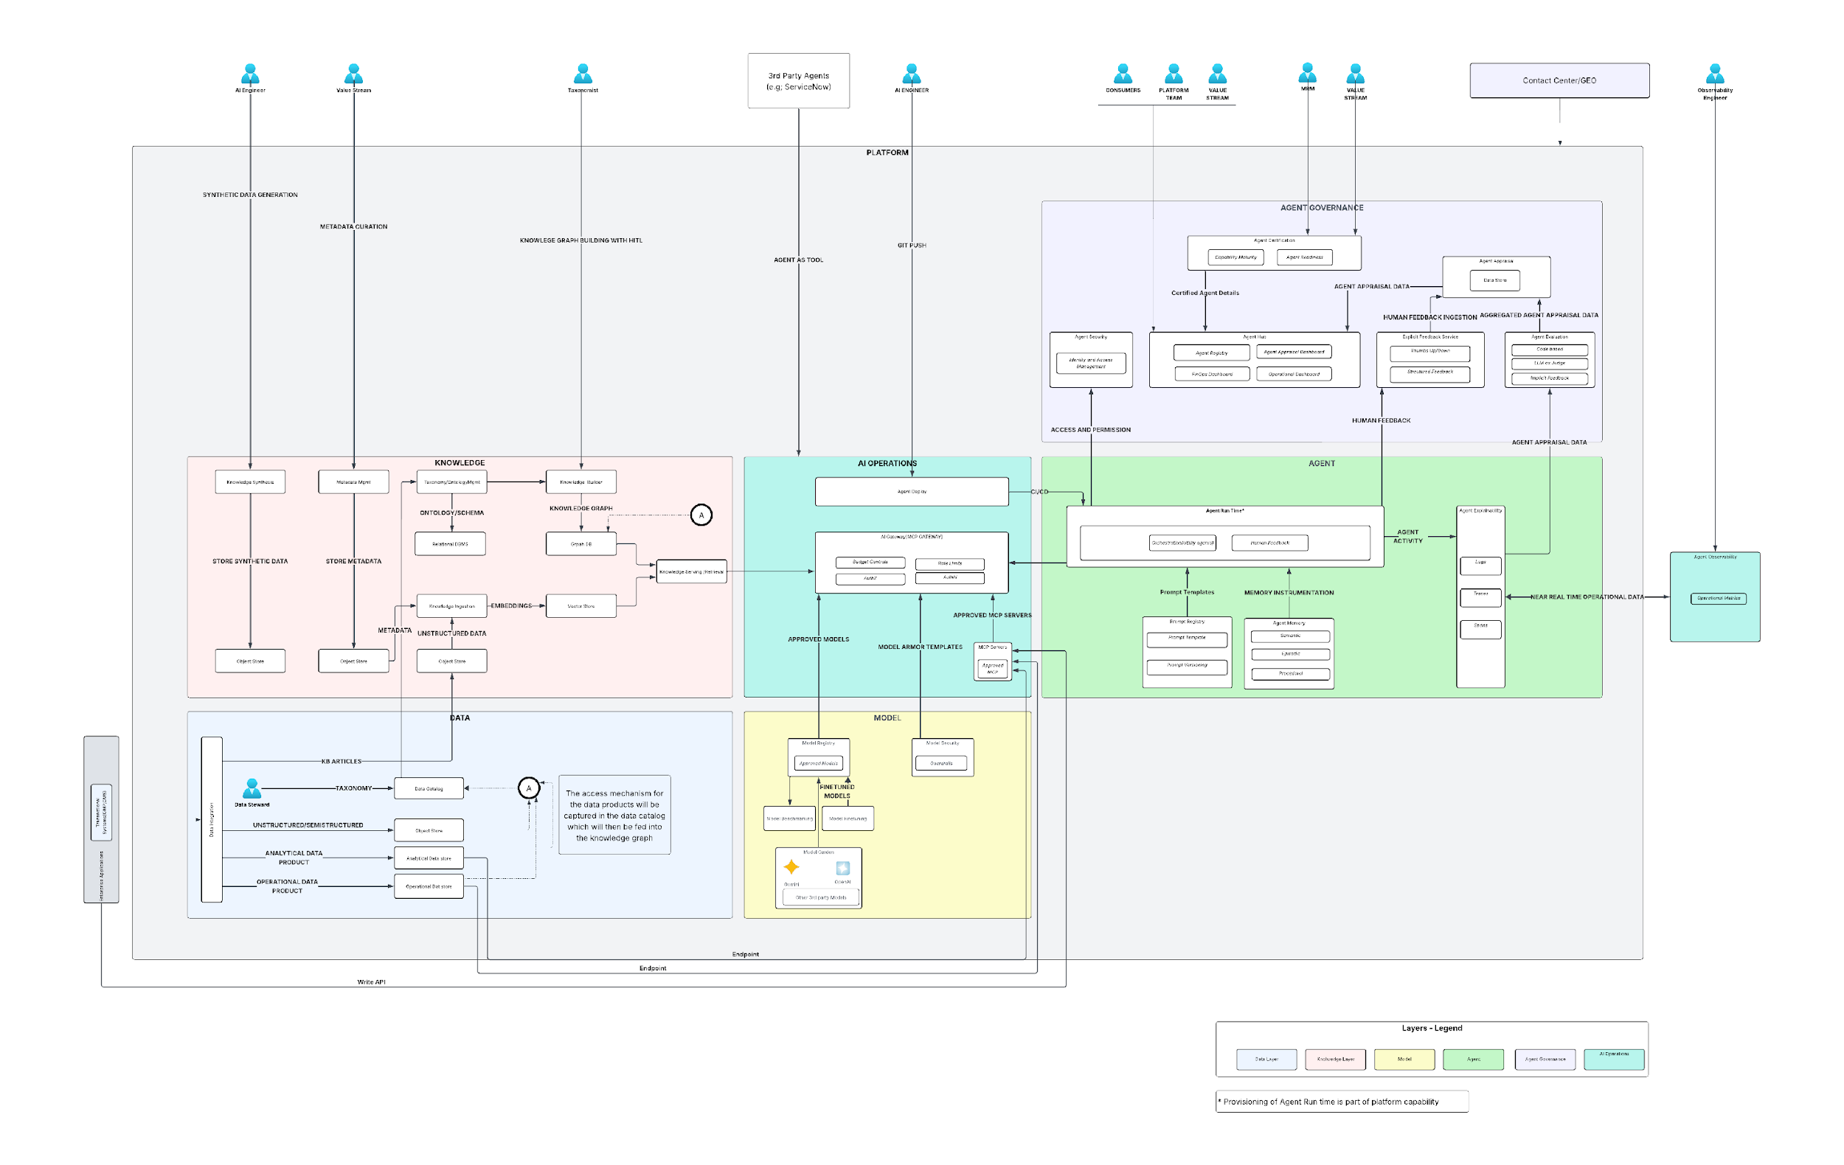
Enterprise AI Agentic Platform | Logical Architecture
Go to Lucid Chart

Slide 32
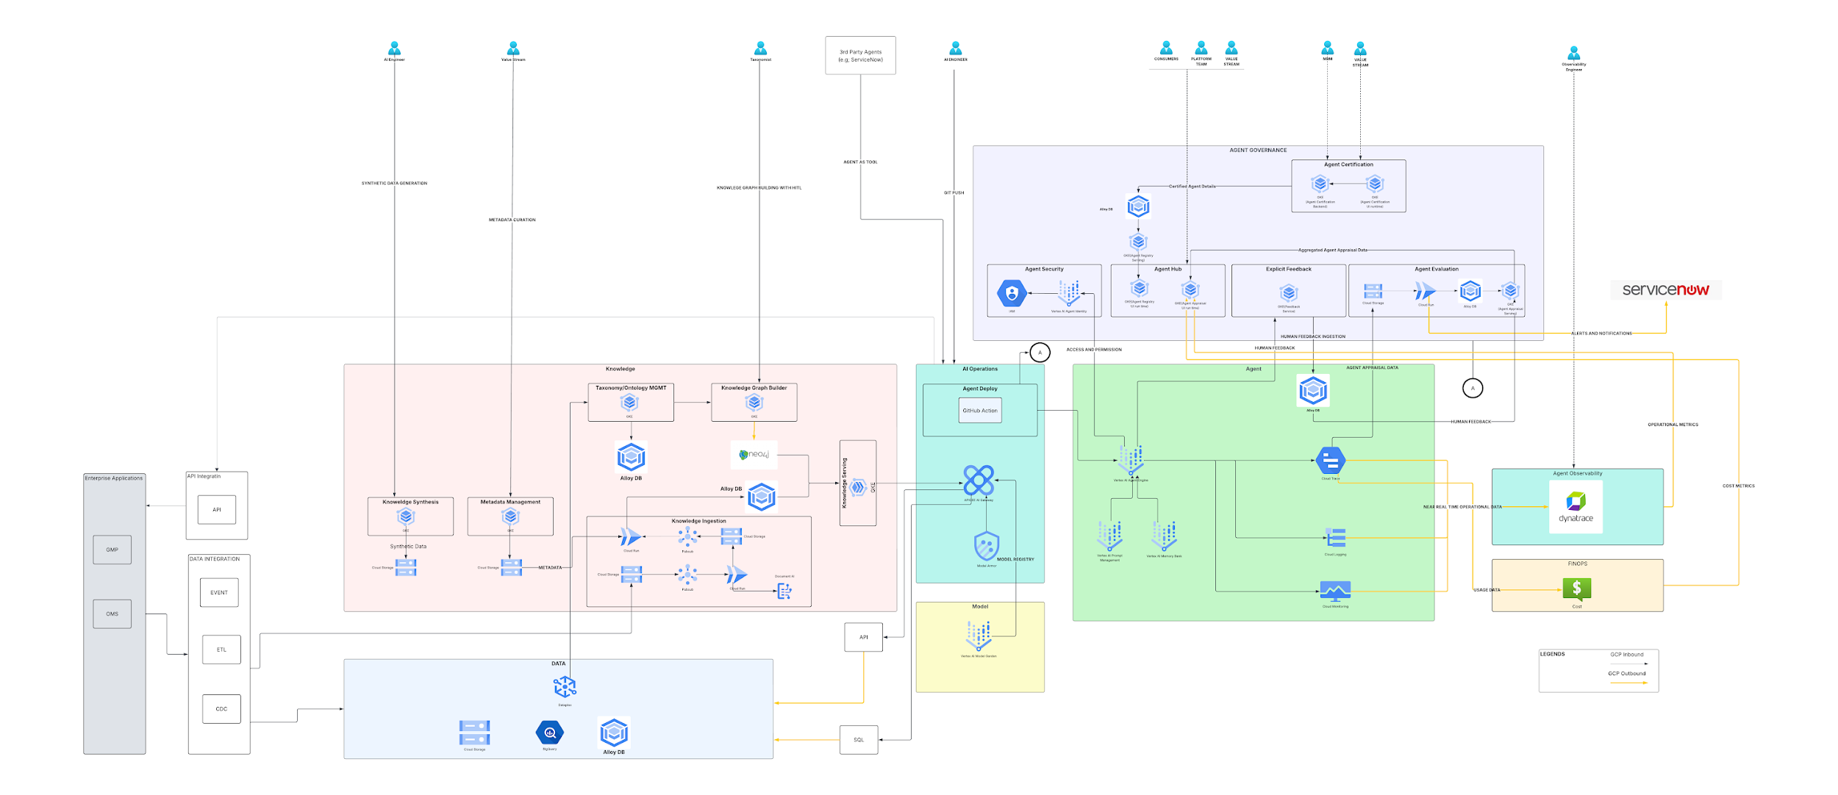
Enterprise AI Agentic Platform | Technical Architecture
Go to Lucid Chart

Slide 33
Architecture Pattern Catalog

Slide 34
Pattern Catalog (1/2)
Knowledge (2)
Model Deployment (2)
Context Caching (2)
Agent Orchestration (3)
Prompt (6)
z
Deterministic(RPA)
Basic
Reasoning
Data to Knowledge
Public
Explicit
Controlled Flow
Interactive
Structural
Knowledge to Data
Private
Implicit
Controlled Autonomy
Quality
Output
Memory (3)
Gateway (4)
Agent Registry (2)
Evaluation (3)
Agent Observability(2)
Semantic
1st Party Agents
Code
Operational
External - Public
Internal Core - Internal
Episodic
Model
Agent Appraisal
External - Confidential
Internal Core - Restricted
3rd Party Agents
Procedural
Human

Slide 35
Pattern Catalog (2/2)
Agent Security (14)
Defensive UI (7)
Prompt Injection
Insecure Model output
Inaccurate Model output
Plan Preview
Bounding controls
Auto-Pause checkpoints
Sensitive Data Disclosure
Denial of Service
Privilege Escalation
Evidence Chips and Citations
Live thought trace
Interruptible Generation
Rogue Actions
Insecure Integration
Turn Lock (Single In-Flight request)
Model Source Tampering
Model Reverse Engineering
Model Exfiltration
Model Deployment tampering
Unauthorized Training Data
Data Poisoning
RAI Controls
Multi Tenancy Patterns
Vector Store
Knowledge Store
AI Gateway
RAI Controls

Slide 36
Knowledge Layer Patterns

Slide 37


Knowledge Layer | Small World Model for the Agents
Shared World Model
Shared World Model
Language
Language Models lacks a shared world model
?
LLM
When two human interact with each other both have the same shared world model. Hence they can communicate efficiently
Language models lack that world model. Knowledge engineering is the technique through which we provide that small world model to the agents powered by the language models

Slide 38
Knowledge Layer | Knowledge Integration Patterns
Data to Knowledge(D2K
Source data is extracted, chunked, contextualized and embedded into a vector store to enable semantic retrieval for grounding the language model with organization specific knowledge. This pattern requires to build an incremental ingestion pipeline to ensure any change in the source data is reflected in the vector store.
Data to Knowledge(D2K)
Knowledge to Data (K2D
Data remains in the source systems, with only the knowledge representation of the data in the form of metadata, knowledge graph is persisted in the knowledge layer. Retrieval returns references and query intent, with required data fetched from the source at run time.
Knowledge to Data (K2D)*
* K2D Pattern leverages Graph Database for capturing the knowledge representation. It acts as the Knowledge Index for the Agents as a service. It is not a “Graph Database” as a service for the organization.

Slide 39
Data to knowledge
> Return To Catalog

Slide 40
Data to knowledge | Two patterns
Data to Knowledge(D2K
In custom RAG, chunking and(or) retrieval strategies are custom developed for finer control over context engineering for achieving better retrieval and response accuracy
Data to Knowledge(D2K
Leverages Gemini Enterprise as a single and unified platform to orchestrate the end-to-end RAG dataflow
Custom RAG
Gemini Enterprise/Fully Managed
Data to Knowledge(D2K
A custom way to extract, chunk and contextualize source data and load into Alloy DB for vector indexing
Data to Knowledge(D2K
Leverages Vector Search(managed vector database) for indexing the documents. Extraction and chunking is done in a programmatic way
Alloy DB(PG Vector)
Managed Index

Slide 41
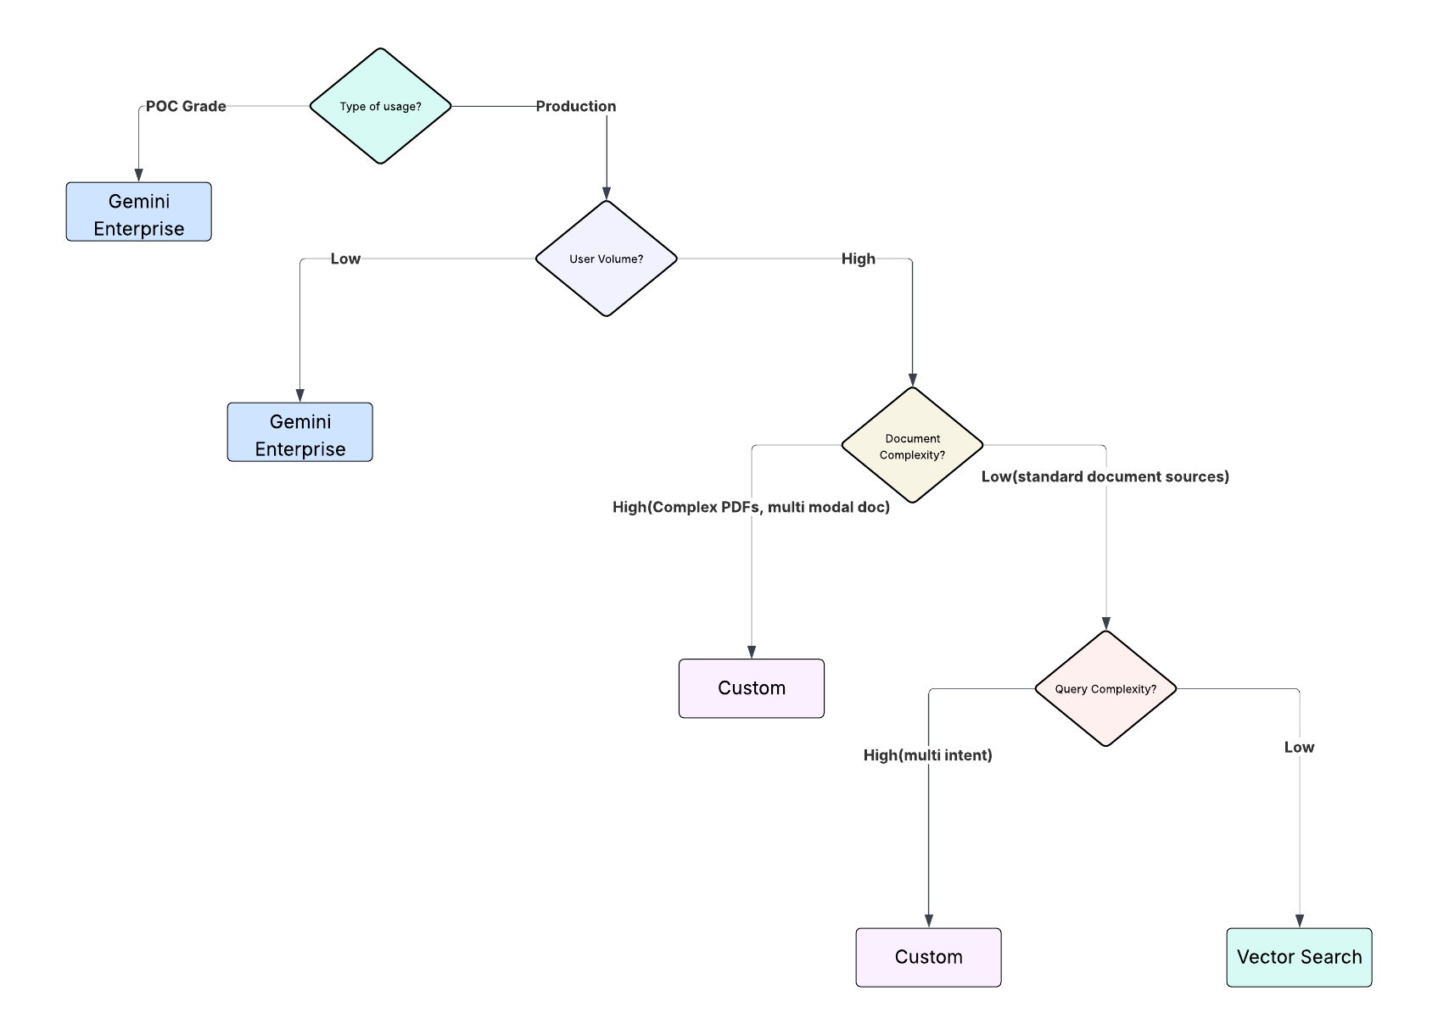
Data to knowledge | Decision Criteria
This is an initial decision criteria to select the D2K pattern. However, based on the accuracy of the response, multiple experiments with all the patterns may need to be done to reach the goldilocks zone of cost , accuracy and latency
Go to Lucidchart

Slide 42
Managed RAG

Slide 43
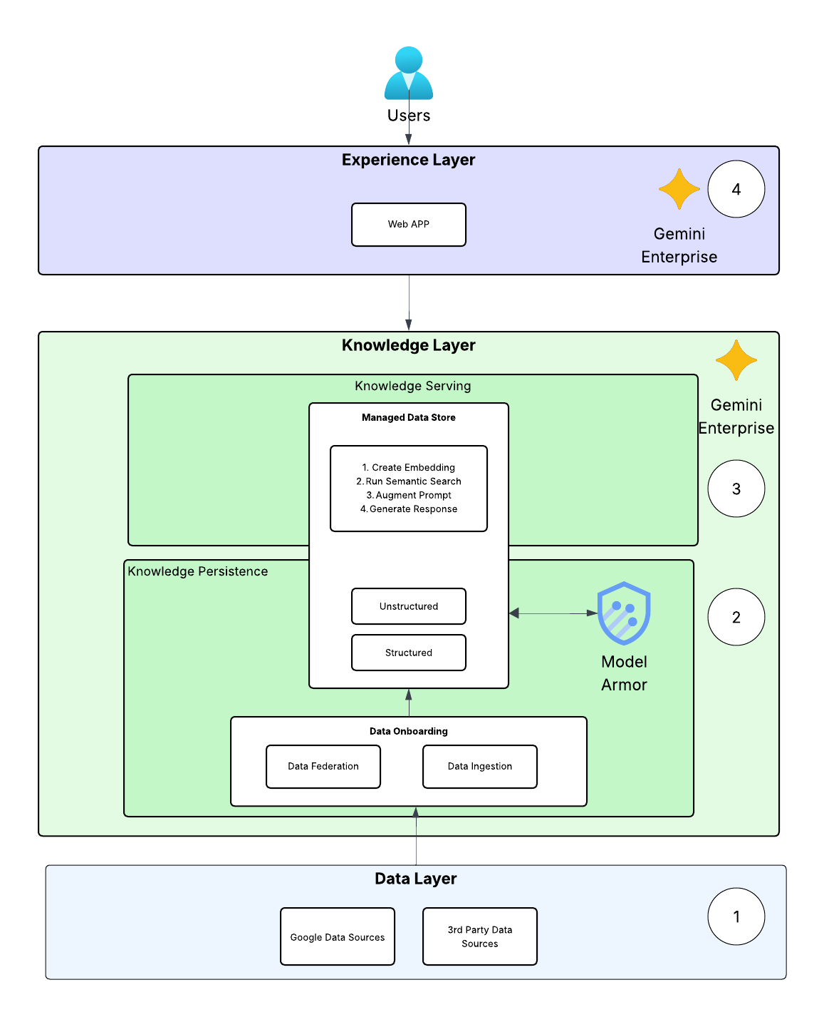
Data to knowledge | Gemini Enterprise - Managed RAG
This pattern is a fully managed RAG solution which is a no-code and configuration driven approach to access 3rd party or Google data sources either through data federation or data ingestion. Built in data connectors allows to bring in the data (ingestion) or the identity data such as roles, permissions or users (federation) into the managed data store of Gemini Enterprise. The manage data store also provides semantic retrieval services to retrieve contextual data based on user query
1
Platform support team configures the required data sources based on user requirements
2
Platform support team configures model armor guardrails for input and output moderation
3
Data is automatically ingested or federated in the managed data store
The solution is wrapped as a web app and exposed to user to talk to the data
4
Go to Lucidchart

Slide 44
Custom RAG

Slide 45
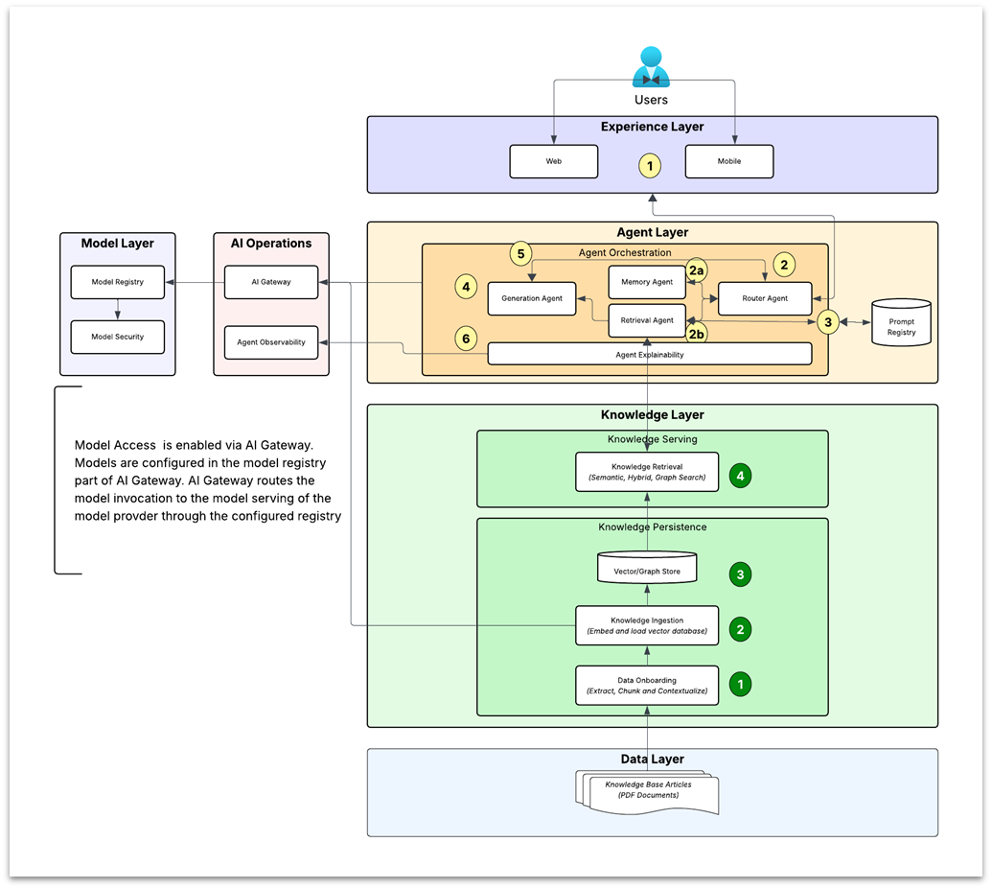
Knowledge Layer | Data to Knowledge | Logical Architecture
1
User logs on through the experience layer which can be either a web or a mobile channel
Router agent routes the user query to
Memory Agent – Memory Agent accesses memory store and determines if response can be retrieved from memory. If yes, provides the response to router, which then sends back to the user
If response is not available in memory, router routes the query to retrieval agent which retrieves the relevant context from the knowledge layer through the retrieval services
2a
2b
3
The retrieval agent extracts the prompt from registry and augments it with retrieved context, sends to Generation agent
Model Access is enabled via AI Gateway.
Models are configured in the model registry part of AI Gateway.
AI Gateway routes the model invocation to the model serving of the model provider through the configured registry.
The Generation agent calls the language model through AI gateway to get the response
4
5
Response is sent to the router which then sends the response back to the user
6
Agent Explainability captures telemetry information and routes to Agent Observability
Data Onboarding process extracts, chunks and contextualizes the raw data for AI consumption
1
2
Knowledge Ingestion process embeds the contextualized data
3
The embedded and contextualized data is stored in a vector or a Graph store
4
The ingested contextualized data (knowledge) is exposed in the serving layer through knowledge retrieval process
Go to Lucidchart

Slide 46
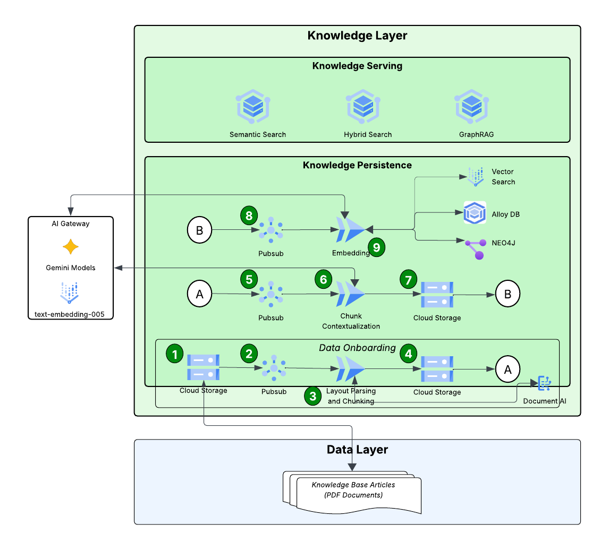
Knowledge Layer | Data to Knowledge | Technical Architecture(1/2)
The knowledge serving Layer exposes the embedded knowledge in Alloy DB or Neo4J through retrieval services (Semantic Search, Hybrid Search and Graph Search)
1
Raw PDF based documents are pushed to cloud storage
2
Pub/Sub triggers layout parsing and chunking process
3
Layout chunking and parsing process uses Document AI for layout parsing and chunking
4
The chunks are stored in cloud storage bucket
5
Pub/Sub triggers the embedding process
6
Chunk contextualization process calls Gemini model to create the context summary for the chunk*
7
Chunk context are stored in Cloud storage bucket
8
Pub/Sub triggers the embedding process
Embedding process embeds each chunk and stores in Alloy DB. For Graph RAG, the embedding process uses the layout configuration to create a document graph and then creates embedding for each document node. The chunks can also be ingested into Vertex AI Vector Search which is a managed vector store
9
Go to Lucidchart

Slide 47
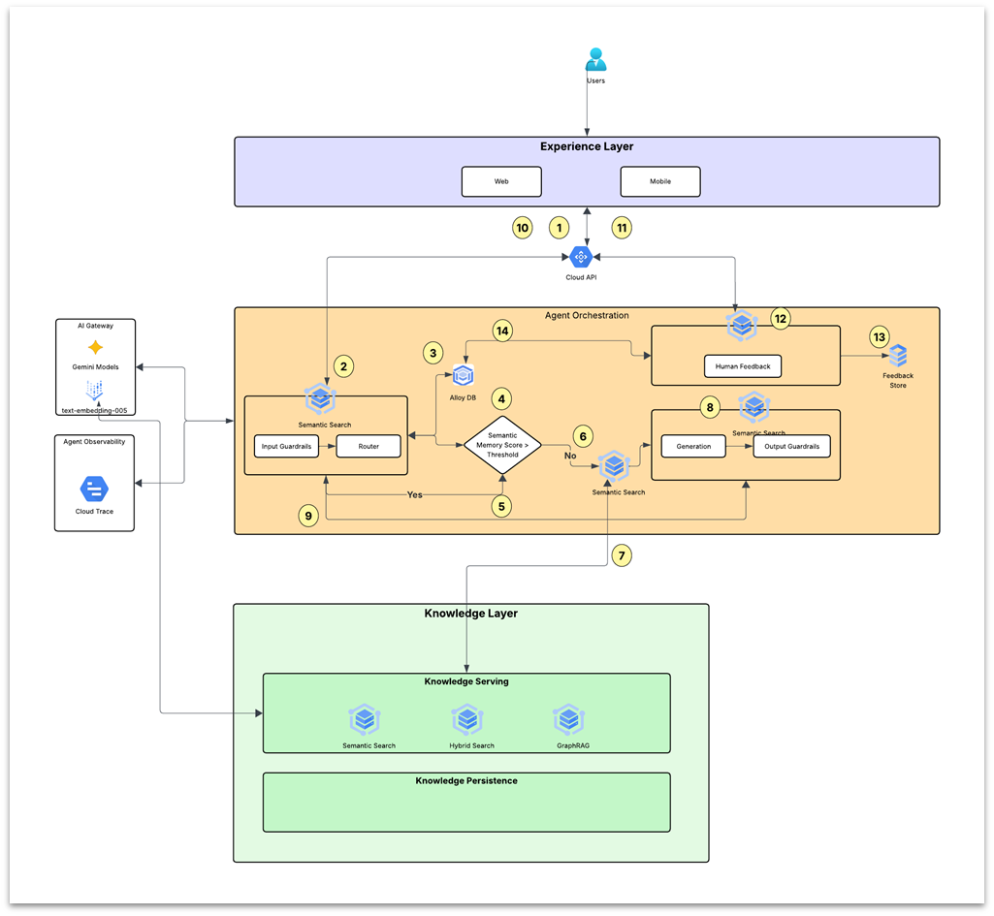
Knowledge Layer | Data to Knowledge | Technical Architecture(2/2)
Go to Lucidchart
1
User logs in through web or mobile channel and sends a query which is routed to Cloud API. Cloud API routes the request to the Agent Orchestration layer
2
The router process applies any domain specific input guardrail and then routes the query to memory store to retrieve a matching response from memory store
3
If yes, response is sent to router agent
4
Memory store returns matching responses with a similarity score
5
If no, the query is routed to the retrieval agent
6
Checks if the similarity score is more than the configured similarity score
7
Retrieval agent calls the configured knowledge service (semantic, hybrid or Graph search) to get relevant context/documents from the knowledge layer
8
The relevant context is passed to the generation agent which calls Gemini language model to get the response. The response is passed through an output guardrail
9
The response (if passes output guardrail check) is then sent to the router agent
11
10
Router Agent sends back to the API layer and then to the user through the experience layer
11
User provides feedback to the response
12
The feedback is processed by the Feedback agent
13
The feedback is stored in the feedback store
14
The feedback is also stored in the memory (in case of thumbs up feedback) to be used for subsequent similar queries

Slide 48
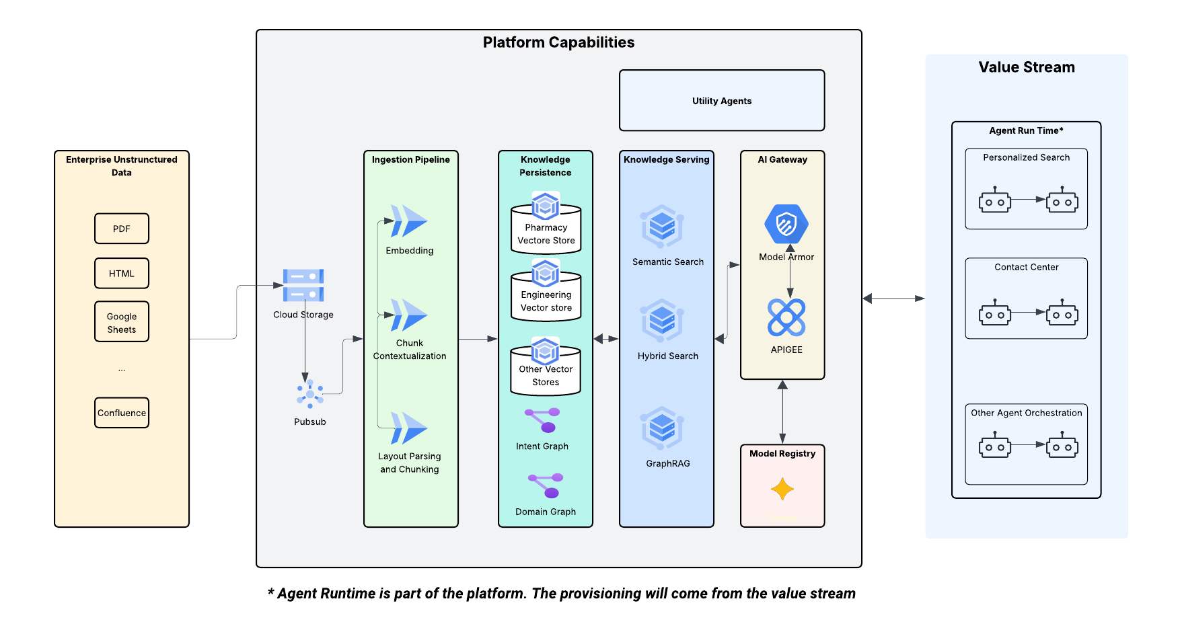
Hub and Spoke Model
Go to Lucidchart
* Agent Runtime is part of the platform. The provisioning will come from the value stream
Notes:
agent run time that is platform - provisioning come from the value stream

Slide 49
Semantic Search : Conceptual View
Ingest Knowledge
Semantic Search based Generation
Leave Policy Document
POLICY
The following leave policy will apply:
1)....
2)...
Categories of leave
Leave of absence shall be classified as -
….
What are the leave Policies?
Extract Metadata
Chunk Document
Create Embedding
Create Prompt
Embedding Vector Spaces
You are a helpful chatbot. Answer based on provided context
question: What are the leave Policies?
context : POLICY\n The following leave…
source_doc | HR leave policy
access_level | PUBLIC
doc_type | POLICY
… | …
chunk_id | chunk_text
1 | POLICY\n The following leave…
2 | Categories of leave…
… | …
Chunk Texts
POLICY\n The following leave…
Generate Response
…
Embedding
ID | EMBEDDING | METADATA
1 | [0.11,0.1,0.13…] | {chunk_text:”POLICY..”,access_level:”PUBLIC”,...}
2 | [0.12,0.11,0.14…] | …

Slide 50
Hybrid Search : Conceptual View
What are the leave Policies?
Semantic Search
Keyword Search
Create Prompt
Generate Response
ID | EMBEDDING | METADATA
C1 | [0.11,0.1,0.13…] | {chunk_text:”POLICY..”,access_level:”PUBLIC”,...}
C2 | [0.12,0.11,0.14…] | {chunk_text:”xxx..”,access_level:”PUBLIC”,...}
C3 | [0.12,0.11,0.14…] | {chunk_text:”xxxx..”,access_level:”PUBLIC”,...}
C4 | [0.12,0.11,0.14…] | {chunk_text:”xxx..”,access_level:”PUBLIC”,...}
C5 | [0.12,0.11,0.14…] | {chunk_text:”xxx..”,access_level:”PUBLIC”,...}
C1
C2
Weighted Reciprocal Rank Fusion
C2
C3
C5
C5
C3
C1
C5
C1
C2
C2
C5
C3

Slide 51
Hybrid Search : Conceptual View
Weighted RRF Score = Σ [w_r * (1 / (k + rank_r))]
K(Smoothing Constant) = 60
Weight of Semantic Search = 0.7
Weight of Keyword Search = 0.3
PG Vector – Hybrid Search Query
WITH semantic_search AS (
SELECT id, RANK () OVER (ORDER BY embedding <=> %(embedding)s) AS rank
FROM documents
ORDER BY embedding <=> %(embedding)s
LIMIT 20
),
keyword_search AS (
SELECT id, RANK () OVER (ORDER BY ts_rank_cd(to_tsvector('english', content), query) DESC)
FROM documents, plainto_tsquery('english', %(query)s) query
WHERE to_tsvector('english', content) @@ query
ORDER BY ts_rank_cd(to_tsvector('english', content), query) DESC
LIMIT 20
)
SELECT
COALESCE(semantic_search.id, keyword_search.id) AS id,
COALESCE(1.0 / (%(k)s + semantic_search.rank), 0.0) +
COALESCE(1.0 / (%(k)s + keyword_search.rank), 0.0) AS score
FROM semantic_search
FULL OUTER JOIN keyword_search ON semantic_search.id = keyword_search.id
ORDER BY score DESC
LIMIT 5
Document | RRF Score | Weighted RRF Score
C1 | =1/(60+1) = 0.0164 | = 0.7*0.0164 =0.0115
C2 | =1/(60+2) = 0.161 | = 0.7*0.161 = 0.113
C5 | =1/(60+3) = 0.159 | = 0.7*0.159 = 0.011
Document | RRF Score | Weighted RRF Score
C5 | =1/(60+1) = 0.0164 | = 0.3*0.0164 = 0.0049
C2 | =1/(60+2) = 0.161 | = 0.3*0.161 = 0.0048
C3 | =1/(60+3) = 0.159 | =0.3* 0.011 = 0.0048
Document | Final Score | Rank
C1 | 0.0115 = 0.0115 | 3
C2 | 0.113 + 0.0048 = 0.0161 | 1
C3 | 0.0048 = 0.0048 | 4
C5 | 0.011 + 0.0049 = 0.0160 | 2

Slide 52
Graph RAG : Conceptual View | Ingestion
Leave Policy Document
SECTION 1 - POLICY
The following leave policy will apply:
1)....
2)...
Categories of leave
Leave of absence shall be classified as -
….
Table:1
SECTION 2
xxxxxxxxxxxxxxxxxxxx
xxxxxxxxxxxxxxxxxxxxxxx
D1
S1
S2
Layout Parsing
Document Graph Creation
TXT
TBL
field1 | field2
Categories of leave
Leave of absence shall be classified as -
[0.11,0.12,0.17,...]
Embedding of the text
S1 - Section 1
S2 - Section 2
TXT - text part in Section 1
TBL - Table in section 1

Slide 53
Graph RAG : Conceptual View | Retrieval
D1
What are the leave Policies?
Create Prompt
S1
S2
Create Embeddings
Semantic Search
You are a helpful chatbot. Answer based on provided context
question: What are the leave Policies?
context :
S1 - Content of S1
TXT - Content of TXT
TBL - Content of TBL
TXT
TBL
TXT
Categories of leave
Leave of absence shall be classified as -
Graph Search
[0.11,0.12,0.17,...]
Generate Response
S1
S1 - Section 1
S2 - Section 2
TXT - text part in Section 1
TBL - Table in section 1
TBL
TXT

Slide 54
Knowledge To Data
> Return To Catalog

Slide 55
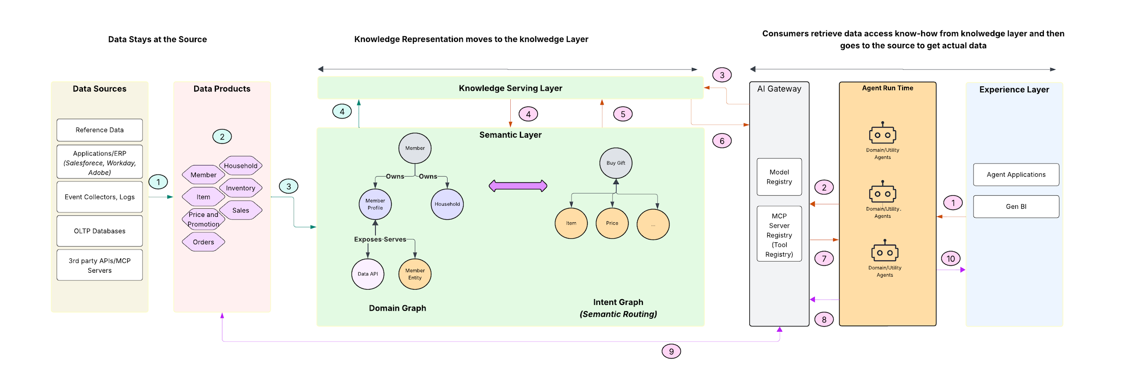
Knowledge Layer | Knowledge to Data : Logical Architecture
From the experience layer Agentic Applications or Users send a request to the Agents running in Agent run time
1
Agents connect to the knowledge serving layer to access intent and domain graph through the AI gateway
2
The knowledge serving layer exposes the services to connect to the semantic layer
3
Knowledge layer connects to the semantic layer to read the intent graph and then connect to domain graph
4
Go to Lucid Charts
Data from system of records are pushed into the data lake
The semantic layer is created by extracting the relationships between the data products.
The information on how to access and retrieve data from domain data products is sent to the serving layer
Serving layer sends the information to the agent layer through AI gateway
1
3
5
6
The data from source data goes through data transformation to create the data products
The semantic layer is exposed via the knowledge serving layer
The information on how to access the data products is sent to the agents
Agents use the information to access the data from the data products
2
4
7
8
The required data is retrieved and sent to the agents as context to create the response
Generated response is sent back to the agentic applications running in the experience layer
9
10

Slide 56
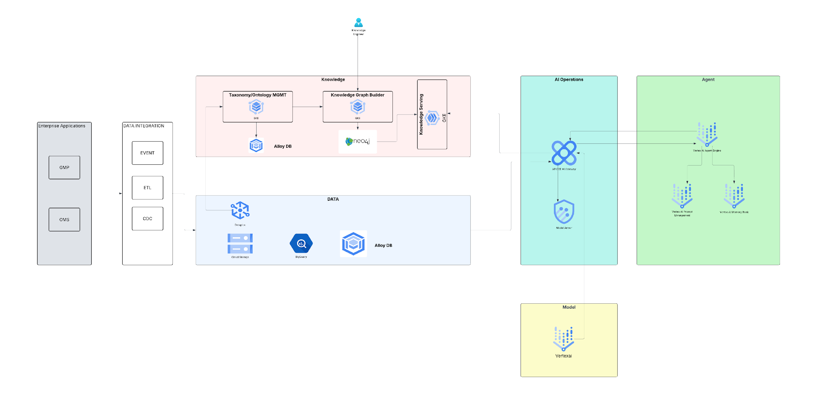
Knowledge Layer | Knowledge to Data : Technical Architecture
Knowledge Hydration
Knowledge Consumption
Go to Lucid Charts
The knowledge to data pattern requires the knowledge representation of the underlying data products to be extracted and brought to the knowledge layer as a graph. The semantic layer where the knowledge graph sits is semi-automated by providing taxonomy and ontology of the domain as input to the KG creation solution. The KG creation solution creates the initial graph which is tuned by knowledge manager and then persisted in a Knowledge Graph

Slide 57
Knowledge Graph Studio - Wireframe
Extraction Settings
Upload Data
Generate Graph
Select Domain
Member
Available Taxonomies
Data Products
Member Profile
Household
…
Entity Type
Member
Items
Selected Taxonomies
Data Products
Member profile
Entity Type
- Member
Available Ontologies
Personalized Search
Use case # 1
Use case # 2
Selected Ontologies
- Personalized Search
Notes:
(loud Documentation

Slide 58
Knowledge Graph Studio - Wireframe
Extraction Settings
Upload Data
Generate Graph
Drag and drop
Or browse
Documents, Images, unstructured text
File name | Upload Status | Size | Source/Type
service_chat.txt | Uploaded | 132 KB | GCS
From GCS
Other Connectors
Notes:
(loud Documentation

Slide 59
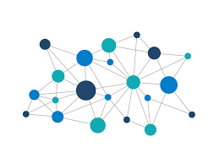

Knowledge Graph Studio - Wireframe
Extraction Settings
Upload Data
Generate Graph
Knowledge Graph Studio
XX nodes
XX edges
Navigate
Zoom
Add Node
Node name
Description
Add
Add Edge
Source Node
Connects
Target Node
Connect
Edit Node
Select Node name
Description
Add
Edit Relationship
AI Assistant – Conversational Graph Editor
Source -> Target
Try: “Add node <node name>
Send
Clear
Description
Add
Persist Graph in Neo4J
Notes:
(loud Documentation

Slide 60
Model Deployment
> Return To Catalog

Slide 61
Model Deployment Patterns
Public Deployment
Private Deployment
Cloud hosted services
API based access
Managed infrastructure
Scalable on-demand
On-premises infrastructure
VPC/isolated networks
Self-hosted models
Full control
When to Use?
When to Use?
1
Cost-effective scaling
1
Sensitive/regulated data
2
Quick deployment
2
Strict compliance(HIPAA, GDPR)
3
Non-sensitive data
3
Data sovereignty requirements
4
Standard compliance needs
Notes:
(loud Documentation

Slide 62
Context Caching
> Return To Catalog

Slide 63
Context Caching Patterns
Implicit Caching
Explicit Caching
Enabled by default on most Gemini models; cache hits reduce cost, but caching is not guaranteed for implicit caching
Explicit caching is enabled through Gemini explicit caching feature which allows to pass some content to the model once, cache the input tokens and then refer to the cached tokens for subsequent requests
Scenarios when Explicit Caching is recommended
1
Chatbots have extensive system instructions
2
There is a need to repetitive analysis of lengthy video files
3
Recurring queries against large document sets
Context caching overview | Generative AI on Vertex AI | Google Cloud Documentation
4
Frequent code repository analysis or bug fixing
Notes:
(loud Documentation

Slide 64
Orchestration
Design Patterns
> Return To Catalog

Slide 65
Narrow Vs Generative Vs Agentic AI
Feature | Narrow AI | Generative AI | Agentic AI
Primary Goal | Predictive/Prescriptive | Content Creation(discrete, single tasks) | Act and Execute
Action Type | Recommendation only | Generative | Controlled Autonomy
Adaptability | Low(needs a retraining loop) | Medium(prompt engineering) | High(Context Engineering)
Workflow | Single Step | Prompt chaining | Multi-step
Example | Fraud detection, Recommender system | Summarization, Q&A Chatbot | Employee Onboarding, IT Incident management, Personalized Search, Call Center

Slide 66

How do these three AIs come together
Agents
(Generative AI)
Narrow AI
Business/IT Process Automation
Planning
Reasoning
Predictive
Contact Center
Memory
Prompts
Tools
Prescriptive
Personalized Search
Agentic AI
Agency
(Orchestration)
Employee Onboarding
Coordination
Delegation
Human in the loop

Slide 67
Agentic AI Orchestration | Orchestration Patterns
Determinism
Autonomy
RPA Based workflow
Scripted, rule-based bots that follow predefined steps and assume structured and consistent input and output. It is best for repetitive, high-volume work with little ambiguity, but becomes brittle when anything changes
RPA Based Workflow
Controlled flow engineering
Human defines the adaptive flow of the agents. The flow is pre-defined, but within the flow, agents can decide the next step based on predefined conditional paths
Controlled Flow Engineering
Controlled Autonomy
Controlled autonomy
In this pattern, the root or the supervisor agent determines the next state or step in the flow, however its autonomy is still constrained using a defined knowledge model, prompt and set of purpose driven tools
1
2
ADK has two types of agents to realize controlled flow and controlled Autonomy patterns
Workflow agents are specialized components in ADK designed purely for orchestrating the execution flow of sub-agents. Their primary role is to manage how and when other agents run, defining the control flow of a process.
The LlmAgent (often aliased simply as Agent) is a core component in ADK, acting as the "thinking" part of your application. It leverages the power of a Large Language Model (LLM) for reasoning, understanding natural language, making decisions, generating responses, and interacting with tools.
Note:
Favor deterministic behavior, where possible
Avoid leveraging fully autonomous agents

Slide 68
Agent Orchestration | Workflow patterns
Sequential
Parallel
Loop
Nested/Custom
User Input
User Input
User Input
User Input
Agent 1
Parallel Agent
Loop Agent
Sequential Agent
Agent 2
Agent 1
Agent 2
Agent n
Yes
Iteration <Max?
No
Parallel Agent
Loop Agent
Agent n
Merged Results
Agent 1
Response
Response
Agent 2
Response
Response
No
Exit
Iterate?
Final Summarization
Yes
Response
Final response
Executes sub-agents one after another in a defined order. Each agent completes before the next starts
Executes multiple sub-agents concurrently with isolated contexts. Each agent works independently and cannot see others output
Executes sub-agents repeatedly in a loop until termination condition is met
(escalation or max iterations)
Combines multiple orchestration hierarchically to create sophisticated multi-stage workflows. Any pattern can contain other patterns as sub-agents, enabling complex logic

Slide 69


Agent Orchestration | Macros Vs Micro Agent Pattern
Macro Agent Pattern
Micro Agent Pattern
Enterprise Apps
Channels and Consumers
Enterprise Apps
Channels and Consumers
Web/Mobile
Contact Center
Partner/3rd Party
Experience
Web/Mobile
Contact Center
Partner/3rd Party
OMS
OMS
AI Gateway
(AuthZ/N, Resource Policies, Telemetry, Routing)
API
AI Gateway
(AuthZ/N, Resource Policies, Telemetry, Routing)
WMS
WMS
Orchestration
Orchestration
Return Management Agent
Service
Eligibility Check Agent
Label Creation Agent
Refund Agent
Eligibility Check Agent
Label Creation Agent
Refund Agent
Stable contract : Consumers integrate to one outcome-driven API, so we can change internal decomposition without breaking clients
Efficient Governance: Easier to enforce least privilege, policy guardrails, audit logs and telemetry instead of replicating controls across many endpoints
Better reliability and debugging: End to end tracing is simpler, reduces hand-offs, improves latency
Endpoint Sprawl: Clients must chain multiple micro calls, increasing coupling and chattiness across the network
Inefficient controls: Guardrails, auth, rate limits, and logging drift across services, expanding attack surface and weakening compliance policies
Higher latency/more failure points: Each hop adds latency, small changes cascade across handoffs, making the system brittle.

Slide 70
Prompt Patterns
> Return To Catalog

Slide 71
Anatomy of a Prompt
Role/Persona
Defines who the AI should act as(e.g., a data analyst) to establish the tone and expertise
Role/Persona sets the expertise level
Context
Provide background information, relevant details, target audience, or the ‘why’ behind the request to guide the Ais’ understanding
Context provides necessary background
Task/Instruction
Clearly state the primary goal or action required(e.g. “Write a blog post”, “Analyze the dataset”). Be specific and direct
Task is the clear instruction
Constraints
Set limitations, rules, or boundaries, such as word count, specific keywords to include or exclude, tone to avoid
Constraints define boundaries
Format
Specify the desired output structure (e.g.; bullet points, a structured report, a code snippet, a table , a script, or a specific file format)
Format structures the output
Examples
Offer concrete examples of the desired output style, structure, or content to give the AI a clear pattern to follow, enhancing accuracy
Examples provide guidance

Slide 72
Prompt Patterns
Basic Patterns
Reasoning Patterns
Interactive Patterns
Zero-Shot
Chain of thought
ReAct
Few-Shot
Tree of thought
Flipped interaction
Structural Patterns
Quality Patterns
Output Patterns
Template
Self consistency
Automator
Persona
Refinement
Context Manager

Slide 73
Prompt Patterns
Zero Shot Prompting
Translate this into French: “Hello how are you”
Chain of Thought
Solve this problem step by step:
If a train travels at 60 mph for 2.5 hours, how far does it go?
Let’s think through this:
Few Shot Prompting
Classify the given sentiment. Here are few examples to follow:
## Examples
“I love this product” – Positive
“This is terrible” – Negative
“Best purchase ever” - ?
Tree of Thought
Consider three different approaches to solve X:
Approach 1: …
Approach 2: …
Approach 3: …
Evaluate each approach and choose the best one

Slide 74
Prompt Patterns
ReAct
Task: Find the population of the capital of France
Thought: I need to identify France’s capital first
Action: Search for “capital of France”
Observation: Paris
Thought: Now I need Paris population
Action: Search for “Paris Population”
Template
Analyze [TOPIC] from the perspective of [ROLE]
Focus on [ASPECT 1], [ASPECT 2] and [ASPECT 3]
Flipped interaction
I want to learn about machine learning.
Ask me question to understand my background and goals, then create a personalized learning path.
Persona Pattern
You are a senior security engineer with 15 years of experience.
Review this code for vulnerabilities…

Slide 75
Prompt Patterns
Self Consistency
Solve this problem in 3 different ways and verify if they agree
Note: This ensemble method can also be leveraged by asking the question to three different models and use majority vote
Automator
Generate a Python script that I can run directly. Include all imports and make it executable.
No explanations, just the code.
Refinement
Generate a marketing email.
Now make it more concise.
Now make it more persuasive.
Now add urgency.
Context Manager
Context: I am building a React app with Typescript.
I will ask multiple questions. Keep this context in mind.
Question 1: How do I create a custom hook?
Question 2: How do I test it?

Slide 76
Agent Memory Management
> Return To Catalog

Slide 77
Agent Memory | Types of Memory
01
02
03
SEMANTIC
Semantic memory captures durable facts and their relationships that anchor an agent’s response
It helps the agent retain important context that is not baked into the model from pre-training, and that cannot reliably be pulled from the web or a generic retrieval system
EPISODIC
Episodic memory preserves records or past interactions so an agent can recall specific experiences. Unlike procedural memory, it does not encode general rules of behavior
It captures “cases” the agent lived through. And unlike semantic memory, it is not about timeless facts or general knowledge. It is about what happened and how the agent handled it, answering “how did we solve this?” rather that only “what is the answer?”
In practice, episodic memory is often stored as distilled few shot examples extracted from long conversations
PROCEDURAL
Captures “how to do things” – the internalized know-how an agent uses to carry out tasks
Unlike episodic memory, which recalls specific past experiences, procedural memory encodes generalized skills, rules, and behavioral routines that apply across situations
Purpose: Facts and Knowledge
Purpose: Past Experience
Purpose: System Behavior
Storage Pattern: Profile or collection
Storage Pattern: Collection
Storage Pattern: Collection
Semantic and Episodic memory are the most used memory

Slide 78
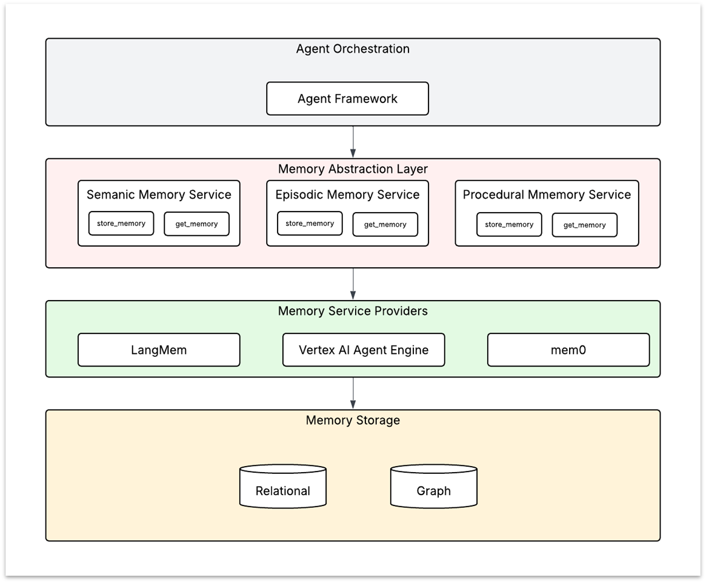
Agent Memory | Logical Architecture
This architecture separates agent orchestration form memory implementation so teams can evolve memory capabilities without rewriting the agents. By introducing a memory abstraction layer, we standardize how semantic, episodic and procedural memory are stored and retrieved in the organization. This will drive common standards and governance for the memory layer. The architecture has the below layers
Agent Orchestration
This is the run time where agents live and where the orchestration framework coordinates planning, tool calls, retries and multi agent collaboration. It decides when memory is needed, what context to request, and how memories influence the agent’s reasoning and actions
Memory Abstraction Layer
This layer exposes standard and consistent API for memory operations, so agents don't depend on any specific vendor or storage design. It provides purpose-built services for semantic, episodic and procedural memory – each with clear “store” and “get” primitives, plus optional policies like TTL and scoping. The abstraction layer also standardizes memory schemas
Memory Service Provider Layer
This is the adapter/integration layer that plugs the abstraction APIs into specific memory frameworks or managed services like Vertex AI Memory Bank. It translates standardized memory calls into the provider specific capabilities and constraints
Memory Storage Layer
This is where memories persist over time. Depending on the memory type and retrieval needs, storage may be relational(strong structure and constraints), graph(relationships and traversals)
Go to Lucidchart

Slide 79
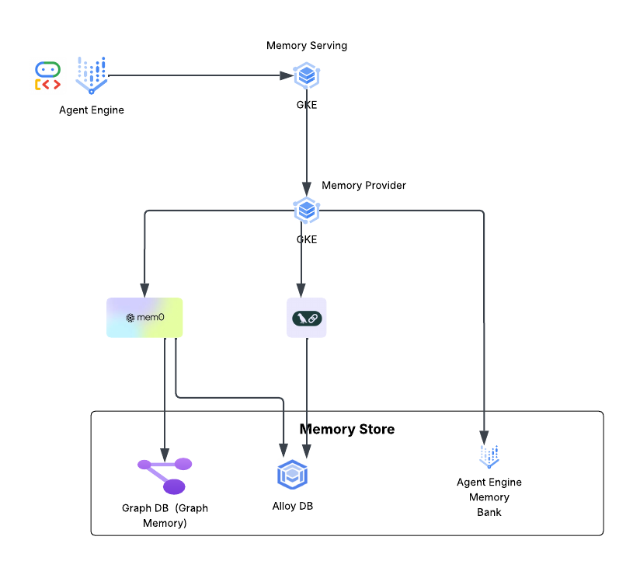
Agent Memory | Technical Architecture
Go to Lucidchart

Slide 80
Agent Memory | Examples
Memory Type | Purpose | Examples | Storage Pattern
Semantic | Facts and Knowledge | Customer prefers eco-friendly brands and avoids leather Shipping preference: always choose the fastest option under $10 | Profile or Collection
Episodic | Past Experiences | Episode: Customer chatted on Jan 5 about a delayed package(Order # 48392). Agent issued a $10 credit after carrier delay was confirmed; customer was satisfied | Collection
Procedural | System Behavior | Returns workflow : confirm item eligibility -> offer exchange/refund options-> generate label->summarize next steps | Collection

Slide 81
Gateway Patterns
Design Patterns
> Return To Catalog

Slide 82
Gateway Pattern | MCP Deployment Strategy (1/2)
Template
Example(Template Instantiation)
Data Classification
PUBLIC
PCI
PII
Internal
Domain
Merchandising
E-commerce
Member Services
Member Services
Supply Chain
Internal Facing
External Facing
Internal Facing
Inventory Ops
External Facing
External Facing
Internal Facing
External Facing
MCP Servers
Catalog
Promotions
Payments
Customer profile
MCP Servers
Merchandising
Loyalty
Internal Facing
Pricing Ops

Slide 83
Gateway Pattern | MCP Deployment Strategy (2/2)
Channels
Web
Mobile
Contact Center
API Gateway
(Inbound Authentication, Gateway Routing, Throttling)
AI Gateway
(Outbound Authentication, MCP server Routing, Rate Limiting)
PUBLIC/MERCH/EXT
(MCP Server)
INTERNAL/SUPPLY CHAIN/INT
(MCP Server)
INTERNAL/MERCH/INT
(MCP Server)
PII/MEMBER SERVICES/INT
(MCP Server)
PCI/MEMBER SERVICES/INT
(MCP Server)
Catalog
(tools)
Inventory Ops
(tools)
Pricing Ops
(tools)
Customer Profile
(Tools)
Loyalty
(tools)
Payments
(tools)
Product Search
Tool 1
Tool 5
Tool 1
Tool 5
Tool 1
…
Tool 2
Tool 6
Tool 2
Tool 6
Tool 2
…
…
…
…
…

Slide 84
Gateway Pattern | MCP Transports
STDIO
The stdio transport is the most straightforward way to connect MCP hosts and servers locally. It relies on the standard system streams - stdin for sending messages and stdout for receiving them- to facilitate full-duplex communication. Because it operates via command line execution, it is ideal for local integrations where the server runs as a child process of the host. It is highly efficient for development because it requires no network configuration or port management; however, it is strictly limited to local environments where the host has direct execution access to the servers binary or script
Streamable HTTP
In streamable http transport, the server runs as an independent process that can handle multiple client connections via a single HTTP endpoint path that supports both POST and GET. Clients send each JSON-RPC message as a new HTTP POST to the MCP endpoint, and the server can reply either with a single JSON response or by opening an optional Server Sent Events(SSE) stream to deliver multiple server to client messages
While using streamable HTTP, it is recommended to use stateless streamable http approach. If we keep the server stateless, we get much easier horizontal scaling(no sticky session) , simpler load balancing, better resilience

Slide 85
Agent Registry
> Return To Catalog

Slide 86


Agent Registry | Need for a registry
Organization
Siloed Agentic Capabilities
Organization
Distributed Intelligence governed and consolidated with registry
BU#1
BU#2
BU#3
BU#1
BU#2
BU#3
BU#4
BU#5
BU#6
Agent Registry enables discoverability, reuse and a centralized governance for responsible use of agentic capabilities
BU#4
Agentic Registry
(Agent Profile
Agent Policies
Agent Access)
BU#6
BU#7
BU#8
BU#9
BU#7
BU#9
BU#10
BU#11
BU#12
BU#10
BU#11
BU#12
Lead to agentic proliferation
Limited or no reuse of capabilities
Limited or no governance of capabilities
Rationalization of agentic capabilities and skills
Promotes reuse of capabilities and skills
Agentic capabilities governed through a common registry

Slide 87
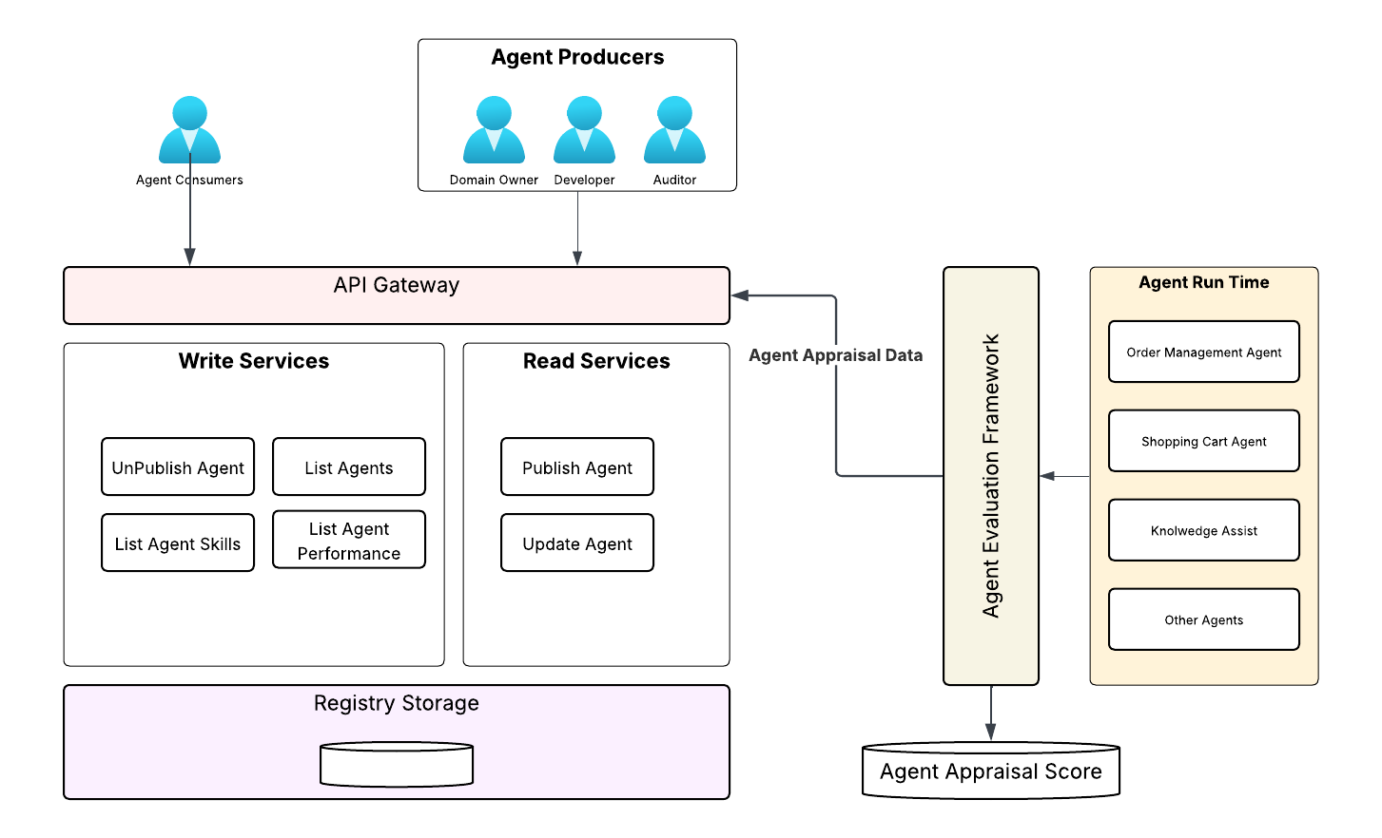
Agent Registry | Logical Architecture
Agent registry enables both consumption and management of agents
Agent management ensures a governed way of designing, development, deploying and continuous monitoring of agents
Four Core Roles
1
  Domain Owner – The agent steward who sets the agent profile, agent policy and agent access details
2
  Developer/Architects – Designs and develops based on the specification
3
  Auditor – MRM (model risk management) team certifies for compliance and deployment
4
  Agent Observability – Continuously appraises the deployed agents in production
Notes:
publish/unpublish - technical arch

Slide 88

Agent Certification-Onboarding Flow
Human User
Agent Lifecycle Stage
Activity
Approved Agentic Use cases
Domain owner is responsible for the agentic capability who updates the registry with the capabilities and description of the agents or tools
Agent Description
Agent Store
(Agent Registry)
Agent Control Policies
Domain Owner
Agent Access
Agent Development Complete
Agent developer updates the registry with all the relevant artifacts; design, git location, test and evaluation details
Agent Design
Agent Store
(Agent Registry)
Agent Validation details
Agent Developer
Agent Repo
Agent Hub
Agent Development Review
Agent auditor audits the information on the registry to ensure it is compliant with all the specifications initially agreed and approved upon with respect to tool, data access and usage
Agent Store
(Agent Registry)
Read only Access
Agent Auditor(MRM)
Agent Deployment complete
Once the agents and agencies are deployed in production, agentOps continuously collects telemetry data, aggregates performance data and populates the agent appraisal stroe
Agent Appraisal Store
Agent Observability
Agent Activity
Rating
Notes:
Add 3rd party
Atish - RAI controls - Lan Guan

Slide 89
Agent Evaluation
> Return To Catalog

Slide 90

Agent Evaluation | Types of Grading
1. Code Based
2. Model Based
3. Human Graders
Deterministic programs that score an agent run by checking objective signals like exact outputs, tests, constraints, logs, tool-call schemas, or end-state invariants
They return repeatable, deterministic results and are best when you can define clear correctness checks
Another model (often an LLM) that evaluates the agents output and/or full trajectory using a rubric, checklist, reference answer, or pairwise comparison producing a score or preference
They are useful for open-ended tasks where “correctness” is nuanced, but they can be noisy and should be calibrated/validated periodically
People( SMEs or end users) who evaluate agent behavior and results using rubrics, preference judgements, or real-world A/B testing
They are the highest fidelity signal for subjective or high stakes domains, but slower and more expensive – often used for calibration and spot-checking

Slide 91
Agent Evaluation | Code Base : Pattern Catalogs
Pattern | Name | Description
P01 | String Match Checks | Compares the agent’s output to expected text patterns-exact quality, regex rules, or approximate(fuzzy) similarity
P02 | Binary tests | Run automated tests against the agent-produced artifact or the system state it changed; grade is pass/failed
P03 | Static analysis | Analyze produced code/config without(or before) running it –style linting, type checking, dependency check, security scanners
P04 | Outcome verification | Check whether the agent achieved the intended end result by verifying the final state of the environment (not the exact wording of the response)
P05 | Tool call verification | Validate the agent used the correct tools(or avoided forbidden ones) and that tool parameters are well formed within allowed bounds
P06 | Transcript analysis | Score the agents behavior using telemetry from the interaction tarce-how long it took, how much steps, how much it spent and how often it retried

Slide 92
Agent Evaluation | Model Based | Pattern Catalogs
Pattern | Name | Description
P01 | Rubric based scoring | An LLM grades an agents output against a defined rubric with criteria like correctness, completeness, reasoning quality, tone, safety, and tool use. It returns per-criterion scores and an overall pass/fail or weighted score
P02 | Natural Language assertions | An LLM evaluates a checklist of yes/no statements about the output or transcript, such as “mentions key risks”, “cites sources”
P03 | Pairwise comparison | An LLM is shown two candidate outputs for the same task and chooses the better one based on a rubric
P04 | Reference based evaluation | An LLM compares the candidate outputs to a provided reference(gold answers) and score similarity/correctness with semantic similarity
P05 | Multi judge consensus | Run multiple LLM grading passes(ensemble) and combine them to reduce variance and single-judge bias

Slide 93
Agent Evaluation | Human Graders | Pattern Catalogs
Pattern | Name | Description
P01 | SME Review | Subject matter experts evaluate agent outputs and/or full transcripts using a rubric, often adding qualitative notes on correctness, risk and domain appropriateness
P02 | Crowdsourced judgement | Trained crowd workers rate outputs using simplified rubrics or preference tests; quality is maintained with training, gold questions and audits
P03 | Spot check sampling | Humans review a strategically selected subset of runs to validate automated graders, catch new failure modes and monitor drift over time
P04 | A/B testing | Real users are split between two agent variants (A and B) in production (or a pilot). Compare outcome metrics such as task completion rate, time to resolution, escalations, user satisfaction, error rates

Slide 94
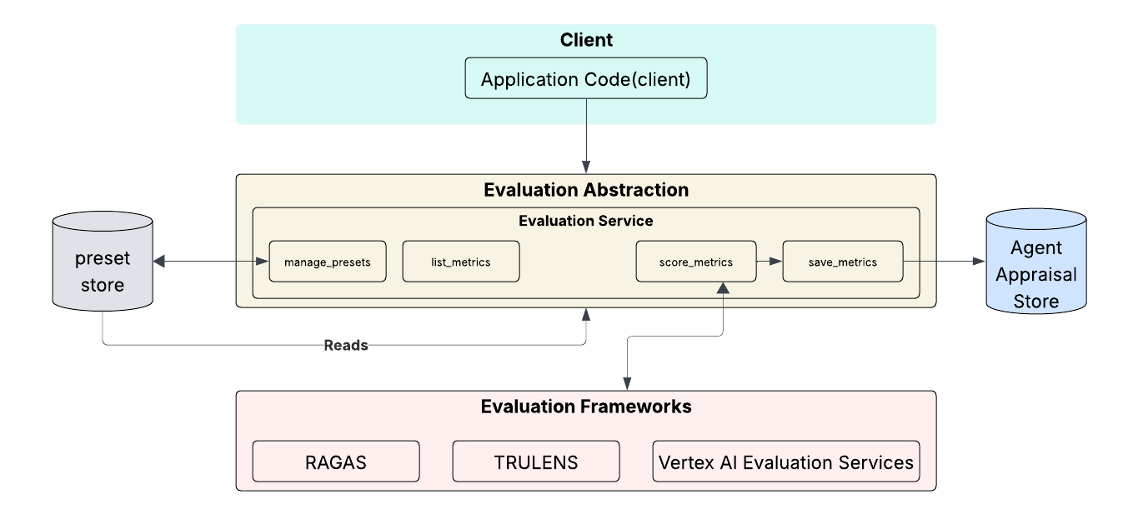
Agent Evaluation | Evaluation Framework
Evaluation Abstraction - The evaluation abstract layer abstracts the functionalities of the underlying evaluation frameworks and exposes a standard set of evaluation services
manage_presets - This function helps create,update and manage a set of metrics for a particular use case
list_metrics - This function will list all available metrics in this layer
score_metrics - This function will instantiate the respective evaluation framework and will calculate the score of the given metrics
save_metrics - The calculated metrics is stored in the metrics store
Evaluation frameworks - This layer will have the actual implementation of the evaluation metrics which will be exposed in a standard way in the evaluation abstraction layer
Link

Slide 95
Agentic AI System Performance Metrics*
Multi Agent System Metrics
Number of steps to complete a workflow
Number of conversation turns between agents
Agent Planning Accuracy
Agent Metrics
Successful task completion rate
Time to complete task
Number of turns/steps to complete a task
Tool invocation accuracy
Token usage per task
Model Metrics
Number of rate limiting errors(429)
Total number of model API access errors errors(4xx)
RAG Metrics
Context relevance
Answer Relevance
Groundedness
Query, context and response token count
* Non functional metrics related to Agentic AI system performance.

Slide 96
Agentic AI Evaluation Best Practices
Eval Preset for each Agentic System
A pre-packaged set of evaluations specific to the agentic system that ships with the system and gets automatically executed as part of CI/CD and also on a continuous basis as the agentic system executes in production. For example, for a summarization agent, an eval preset will include adherence_score, coverage_score
Use a mix of Code, Model and Human grading
Leverage a layered evaluation stack-code based checks for deterministic failures(schemas, tool-call validity, safety rules), model-based judges for rubric scoring at scale(helpfulness, reasoning, quality, trajectory quality) and targeted human review to calibrate the rubric and audit high-impact edge cases. This mix provides fast CI gates, broad coverage and human aligned trust in scores
Prefer deterministic over non-deterministic judge
Prefer deterministic code-based grading and human review over LLM-judging whenever the criterion can be measured objectively
Drift watch per agentic system
Continuously track each agentic system’s responses and behavior over time using a fixed set of “golden” scenarios plus live sample traffic. Alert on semantic and output changes so that silent regressions for model updates, prompt tweaks, toll/schema changes can be caught before users do
Sampling Based LLM-Judge evaluation
Leverage sampling-based evaluation for LLM or Model graded evaluation to reduce the cost of evaluation. Samples can be based on high-risk intents, key workflows.
Independent Judge Model
It is recommended to use a different model than the one powering the agent to act as LLM-as-judge. This reduces self-grading bias and model blind spots

Slide 97
Agent Observability
> Return To Catalog

Slide 98
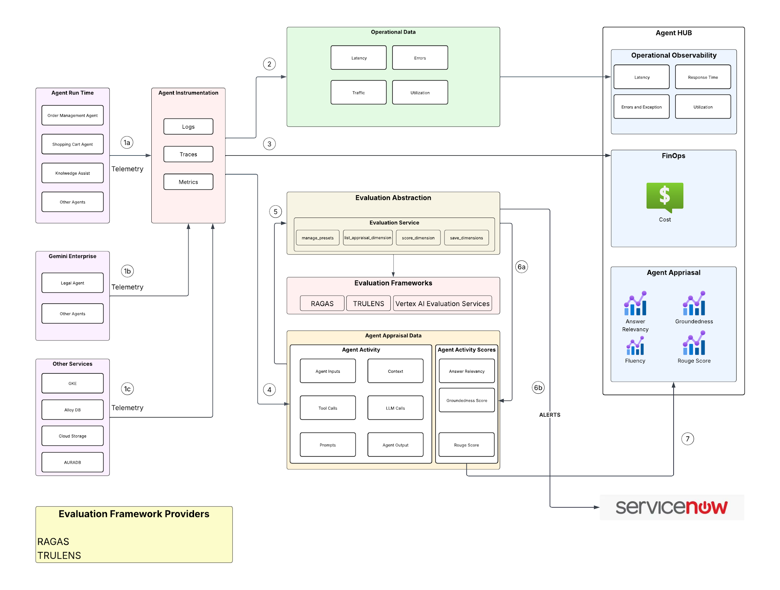
Agent Observability | Logical Architecture
Agents running in agent run time and other services pushes agent activity details to the Agent Activity Layer(Telemetry)
1
Operational metrics from the Agent Activity layer is collected and pushed to operational observability portal
2
Token usage and cost related information is pushed to FinOps Hub
3
Agent appraisal data in the form of agent input, output, prompt etc is collected
4
Evaluation framework leverages the appraisal data to calculate the appraisal scores
5
Agent Appraisal scores are calculated and stored in Agent Aprraisal store
Any alerts notification is sent to service now
6
Agent Appraisal scores are visualized through the Agent Appraisal dashboard within the Hub
7
Go to Lucid Charts

Slide 99
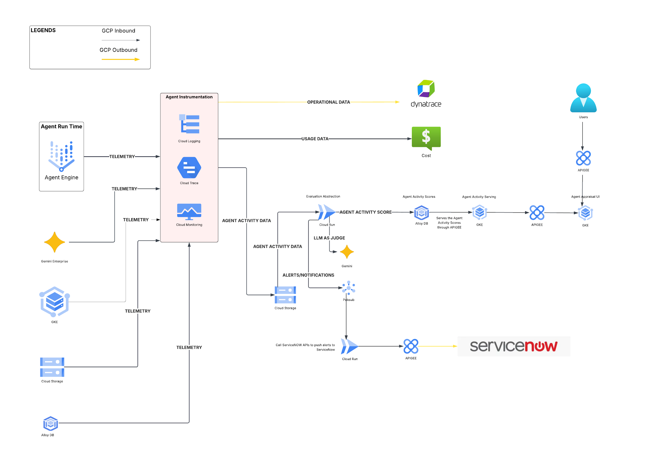
Agent Observability | Technical Architecture
Go to Lucidchart

Slide 100
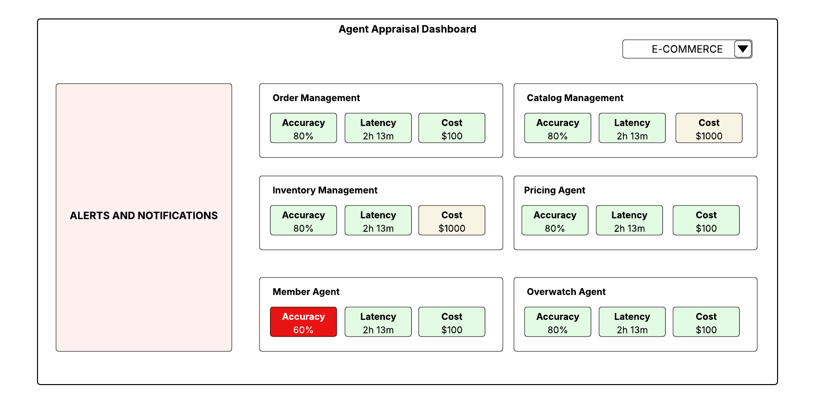
Agent Observability | Illustrative Wireframes
A consolidated view of all the active Agentic flows running in the organization

Slide 101
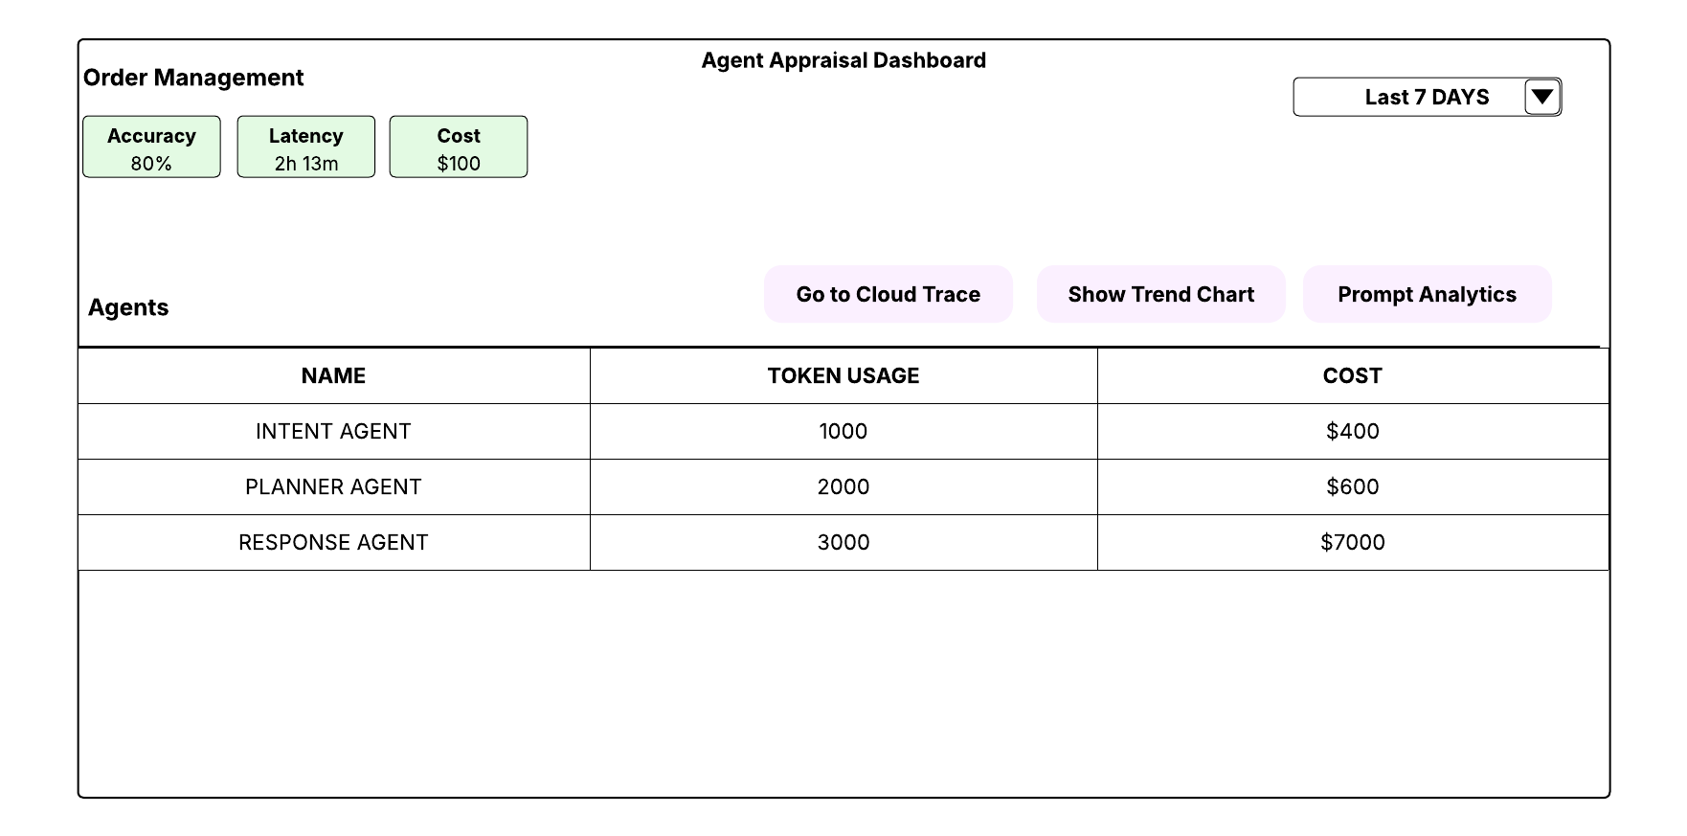
Agent Observability | Illustrative Wireframes
A Drill down view of a particular agentic workflow

Slide 102
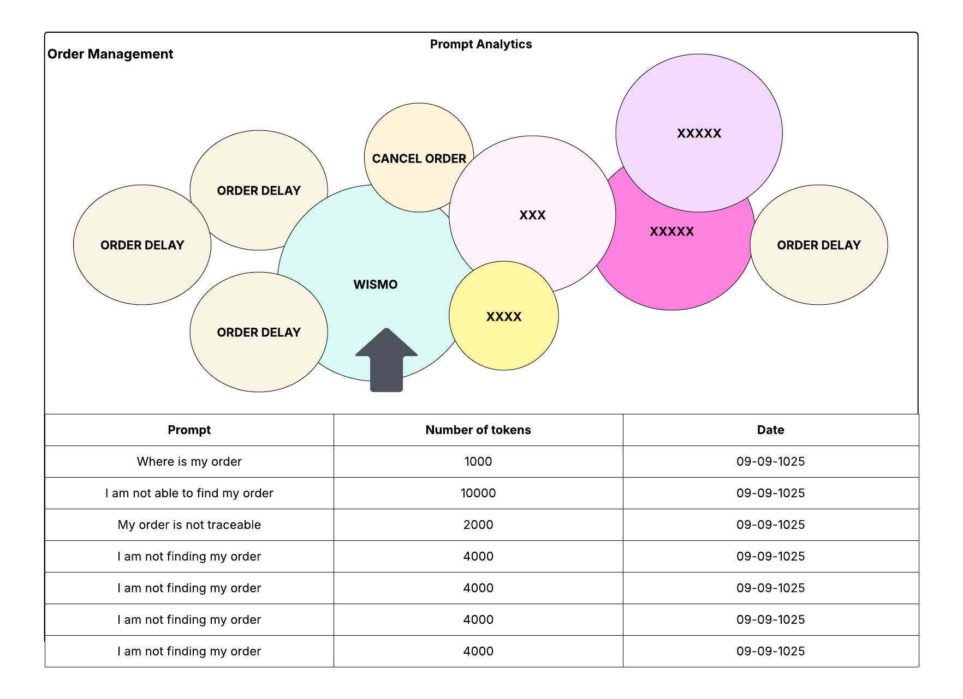
Agent Observability | Illustrative Wireframes
Prompt Analytics for a particular Agentic flow

Slide 103
Agent Security
> Return To Catalog

Slide 104
Agent Security | Risk Patterns
Risk Patterns
Agentic Applications
Prompt Injection
Insecure Model output
Inaccurate Model output
Direct Control
This risks can be directly controlled by the consumers through secure application development
Application Layer
Agents
Organization Knowledge and Data
Sensitive Data Disclosure
Denial of Service
Privilege Escalation
Rogue Actions
Insecure Integration
Input Guardrails
Output Guardrails
Model
Model Source Tampering
Model Reverse Engineering
Model Exfiltration
Indirect Control
Consumers do not have direct control on these risks since the models are not trained by consumers. Providers train and expose the models as hosted services. These types of risks are mitigated through adversarial testing
Model Layer
Model Artifact Storage
Model Serving
Model Deployment tampering
Evaluate
Train and Tune
Training data
Unauthorized Training Data
Data Poisoning
Data Layer
Data Acquisition, processing, engineering
Data Sources

Slide 105
Risk Patterns
Application Layer

Slide 106
Agent Security | Risk Patterns & Mitigations (1/2)
Risk | Description | Mitigation
Prompt Injection | Prompt Injection occurs when a user(external content) manipulates an agent’s instructions so that it ignores its original goals, rules or safety boundaries. There are primarily three types of prompt injection pattern Direct Prompt Injection : Malicious instructions are directly entered into the prompt Indirect Prompt Injection: Malicious instructions read from external data sources(e.g. documents, web pages) Jailbreaks : Malicious instructions cause models to act in ways they were trained to avoid | This risk can be mitigated through following prompt engineering best practices and leveraging input guardrails. Input Guardrails: Configure input guardrails to detect and de-identify sensitive data. Use Model Armor to configure prompt injection and jail break detection Separate Instructions from Inputs : Separate System Prompt from user prompt. Avoid to add any PLACEHOLDERs within system prompt Human in the loop for high impact actions : High impact actions should not be auto approved, those should implement human in the loop Explain-before-Act: Use chain of thought prompting to be able to monitor the agents’ thought traces. Source Attribution: Always engineer the system to show source attributions for response provided by agents
Sensitive Data Disclosure | This risk occurs when an agent exposes private, confidential, or regulated information to the wrong person, system or context | Mitigate this risk by following: Data minimization by default : The agent is provided access to data sources following least privilege principle Data Sensitivity Classification: Capture data classification as metadata and use the metadata to filter relevant context for the agents Output Guardrails: Configure output guardrails to detect and de-identify sensitive data. Use Model Armor templates with Advance detection type to detect sensitive data and prevent accidental sensitive data disclosure
Rogue Actions | Rogue actions occur when an agent takes actions that were not explicitly authorized, expected, or intended by the user, even if the action appears logical from the agent’s internal reasoning | Explicit permission boundaries: The agent is enabled with an approved set of tools following least privilege principle Preview before execute workflow: For any high-risk actions, the agent should show the plan and list of tasks before executing them.

Slide 107
Agent Security | Risk Patterns & Mitigations (2/2)
Risk | Description | Mitigation
Insecure Model Output | Insecure model output occurs when an agent produces responses, recommendations, or actions that are unsafe, misleading or inappropriate for the user’s context, even though the system itself has not been directly compromised | Content Filters: All the foundation models can be enabled with content filters. Content filters must be enabled before using any foundation models. Output Guardrails: Implement output guardrails to ensure any domain specific insecure data is detected by the guardrails before sharing the response/output with stakeholders.
Denial of service | Denial of service occurs when an agent or agentic system becomes unavailable, unresponsive or degraded due to attackers either overwhelm the model with excessive calls or use carefully crafted “sponge examples” that take advantage of model weakness to degrade performance | Mitigation must be applied at the application level using input guardrails and employing rate limiting and load balancing mechanisms to control the volume of calls to the agents
Insecure Integration | This risk occurs when an agent is integrated with tools/plugins that are not authorized and approved which them permits manipulation of inputs and outputs | This risk must be mitigated through use of only approved and authorized tools from the tool registry. Any tool access is routed through AI gateway
Inaccurate Model output | This risk occurs when the agent responds with output that are not grounded to the context of the use case. It provides hallucinated response | This risk must be mitigated at both knowledge and application engineering stages. The agent must be constrained to a decision boundary through a domain specific knowledge model, optimized prompt and fit-for-purpose tools
Privilege Escalation | This risk occurs when an agent gains or exercises permissions beyond what the users or system explicitly granted, allowing it to access data, tools or actions it should not be able to perform | Least privilege by default: The agent is provided minimal access to data sources and tools based on its role boundaries Time bound and task bound privilege: All agents are provided an identity and the permissions to those identities are managed through IAM. In addition, enable time bound privileges

Slide 108
Risk Patterns
Model Layer

Slide 109
Agent Security | Risk Patterns & Mitigations (1/1)
Risk | Description | Mitigation
Model Source Tampering | This risk occurs when the model code, training frameworks, or model weights are not hardened against supply chain attacks and tampering | The direct mitigation needs to be at the model provider end. At the consumer end, deploy evaluations to monitor response drift from the models
Model reverse engineering | This risk occurs when attackers send excessive request to the model and leverage the responses to reverse engineer the weights | The direct mitigation needs to be at the model provider end. At the consumer end, control access through API and employing rate limiting
Model exfiltration | This risk occurs when storage or serving infrastructure does not have adequate security against attacks which lets attackers target vulnerabilities in serving or storage systems to steal model code or weights | The control need to be at the provider end
Model Deployment Tampering | This risk is introduced when the model serving infrastructure is vulnerable to manipulations | The control need to be at the provider end

Slide 110
Risk Patterns
Data Layer

Slide 111
Agent Security | Risk Patterns & Mitigations (1/1)
Risk | Description | Mitigation
Unauthorized training data | This risk is introduced during model development when training data is not properly filtered out during data ingestion, processing and model evaluation during training | The control need to be at the provider end
Data poisoning | This risk occurs when the data intentionally contaminated causing the model to behave incorrectly, unfairly or unsafely after deployment | At the consumer end, this risk needs to be controlled through extensive adversarial testing and evaluation

Slide 112
Multi Tenancy
> Return To Catalog

Slide 113
Multi Tenancy Approach
Data Classification
Multi-tenancy Approach will follow the below hierarchy
Data Classification - There will be a physical isolation at data classification level
Domain
Application
Domain - There will be a physical isolation of the set of services at the domain level
Application - Within a particular data classification and domain, services will be further logically isolated using schema-based separation
Notes:
Isolate by data classification (by DB) - physical isolation . Within that we will do schema
embedding metadata(jsonb)
DOMAIN(PHYSICAL)-DATA CLASSIFICATION(PHYSCIAL)- SCHEMA(APP)
DOMAIN, COMPLIANCE, SCALE, CHARGEBACK
data classification - domain - application

Slide 114
Multi Tenancy Approach | Vector Stores
PII
PCI
PUBLIC
E-COMMERCE
INVENTORY
E-COMMERCE
INVENTORY
E-COMMERCE
INVENTORY
App 1 Schema
App 1 Schema
App 1 Schema
App 1 Schema
App 1 Schema
App 1 Schema
App 2 Schema
App 2 Schema
App 2 Schema
App 2 Schema
App 2 Schema
App 2 Schema
Each data classification has vector stores that are physically isolated. Within the data classification vector stores are physically isolated by domain. With a given domain, vector stores are logically isolated per application
Notes:
Isolate by data classification (by DB) - physical isolation . Within that we will do schema
embedding metadata(jsonb)
DOMAIN(PHYSICAL)-DATA CLASSIFICATION(PHYSCIAL)- SCHEMA(APP)
DOMAIN, COMPLIANCE, SCALE, CHARGEBACK

Slide 115
Multi Tenancy Approach | Knowledge Stores
PII
PCI
PUBLIC
E-COMMERCE
INVENTORY
E-COMMERCE
INVENTORY
E-COMMERCE
INVENTORY
App 1 RBAC
App 1 RBAC
App 1 RBAC
App 1 RBAC
App 1 RBAC
App 1 RBAC
App 2 RBAC
App 2 RBAC
App 2 RBAC
App 2 RBAC
App 2 RBAC
App 2 RBAC
Aura DB can have one DB per Instance. For MVP, we plan to create one Instance for each data classification and domain group. Multi DB creation feature within an instance will be available end of June or September. We will consider moving to multi-DB pattern when the feature will be available in Aura DB
Notes:
Isolate by data classification (by DB) - physical isolation . Within that we will do schema
embedding metadata(jsonb)
DOMAIN(PHYSICAL)-DATA CLASSIFICATION(PHYSCIAL)- SCHEMA(APP)
DOMAIN, COMPLIANCE, SCALE, CHARGEBACK

Slide 116
Multi Tenancy Approach | AI Gateway
APIGEE ORGANIZATION
A dedicated AI gateway will be stood up for Agentic A
Environment groups will be used for physically isolate production and non-production
Within each environment group, logical isolation will be achieved through proxy and base path for isolation based on data classification and domain
ENVIRONMENT GROUP-1
(Non Prod)
ENVIRONMENT GROUP-2
(Prod)
Data Classification
Data Classification
Domain
Domain
Notes:
Isolate by data classification (by DB) - physical isolation . Within that we will do schema
embedding metadata(jsonb)
DOMAIN(PHYSICAL)-DATA CLASSIFICATION(PHYSCIAL)- SCHEMA(APP)
DOMAIN, COMPLIANCE, SCALE, CHARGEBACK

Slide 117
Defensive UI
Interface Patterns
> Return To Catalog

Slide 118
Defensive UI | Where does it fit?
Conversational Agentic Applications need an experience layer that mediates autonomy, risk and user control
Users
(Conversational Interface)
Conversational Agentic Experience layer is the product surface that translates intent into safe action, by making it explicit, setting its boundaries, asking for confirmation at the right moments to ensure safe, secure and guided conversation with agents.
We are now building experience layer on top of non-deterministic systems.
Experience Layer
(Defensive Patterns)
Agent Layer
(Reasoning, Planning, Generation)
Tools and Systems
(APIs, RPA, DB, SaaA)
Design Goal: Minimize the cost of being wrong without sacrificing the speed and advantage of agent autonomy

Slide 119
Defensive UI | Failure Modes
Failure Modes
Consequences
Hallucinated Facts
Incorrect Decisions
Over-confident Tone
User over-trust
Wrong tool and(or) Target
Unintended changes and edits
Hidden side effects
Surprise automation
Slow or stuck loops
Repeated Action
Privilege Creep
Access beyond intent

Slide 120
Defensive UI | Failure Mode Examples
Hallucinated facts – Incorrect Decisions
A replenishment agent tells a merchandising manager “ Vendor lead time for Kirkland paper towel is 5 days” and recommends lowering safety stock. Actual lead time is 12-14 days due to port congestion. This results in shelves going empty in multiple warehouses
Over-confident tone – user over-trust
A returns/refunds agent says, “Refund processes and completed”, but it only created a pending case waiting for manager override (high-dollar refund threshold). The customer is told to expect money in 24 hours; it does not arrive and escalations spike.
Wrong tool/target – unintended edits
The agent is asked to “update the item description for the 2-pack AA batteries”. It updates the single-pack listing instead(similar names/SKUs), creating customer confusion and returns(“I ordered 2-pack, got 1”).
Hidden side effects – Surprise Automation
A customer care agent asks, “Draft a response to this complaint”. The system also(without making it obvious) triggers a goodwill $25 e-gift card
Slow or stuck loops – repeated actions
A “cancel order” action times out due to OMS latency. The agent tries repeatedly, generating multiple cancellation tickets
Privilege Creep – Access beyond intent
A customer asks, “Set Up a 15% off promo for SKU 123 for next weekend”. The agent pulls chain-wide pricing rules, MAP* exceptions, and executive-approved guardrails for other categories, then displays them in the UI. The user needed eligibility for the SKU only; the agent exposed sensitive pricing strategy beyond role and task.

Slide 121
Defensive UI | Design Principles
Safe defaults
Configure only safe data sources and tools as “defaults” in the UI
Explicit intent
Capture goals, constraints, success criteria, rephrase prompt
Scoped Autonomy
Bound what scopes and permissions the agent will have to act on an input
1
2
3
Continuous Control
Pause, cancel, edit or take over at any time by the user
Explain-before-action
Show plan of action, tools, and expected impact before agent takes action
Explicit trust controls
Show source citations, chain of thought traces for a given response
4
5
6

Slide 122
Defensive UI | Pattern Catalog
Pattern | Name | Description
P01 | Plan Preview | Capture objective, constraints, and definition of done, get user approval before working on the user query. Suggest refined prompts if needed
P02 | Bounding controls | Ability to bound what systems/data/actions the agent may use; block unapproved scope expansion. User explicitly provides access to any tool if required in addition to default ones
P03 | Auto-Pause checkpoints | Automatically pauses at milestone or high-risk steps and ask for a go/no-go confirmation
P04 | Evidence Chips and Citations | Attach sources/provenance to claims and recommendations; enable quick drill-down to supporting evidence
P05 | Live thought trace | Show a live, readable thought trace during execution
P06 | Interruptible Generation | Control that lets user interrupt the agent’s response generation(or long running reasoning) at any time and immediately receive the best available partial answer. It acts as a human controlled “circuit breaker” for slow responses, suspected loops, or runaway verbosity
P07 | Turn Lock (Single In-Flight request) | Prevent users from submitting a new prompt while the agent is generating, reducing race conditions, conflicting instructions, and overlapping tool actions; users should instead interrupt, edit, or cancel the current run before issuing the next request

Slide 123
Defensive UI | Failure Modes Vs Principles Vs Pattern
Failure Modes | Design Principles | Defensive UI Patterns
Hallucinated facts – Incorrect Decisions
Over-confident tone – user over-trust
Wrong tool/target – unintended edits
Hidden side effects – Surprise Automation
Slow or stuck loops – repeated actions
Privilege Creep – Access beyond intent
1
Safe Defaults
2
Explicit Intent
P01
Plan
Preview
P02
Bounded Controls
P04
Evidence Chips and Citations
Explicit
Trust controls
5
Explain-before-action
6
Explicit
Trust controls
Evidence Chips and Citations
6
P04
1
2
Explicit Intent
Safe Defaults
P01
Plan
Preview
P02
Bounded Controls
P05
Live Thought Trace
P03
Auto Pause checkpoints
P07
Turn lock
5
3
Explain-before-action
Scoped Autonomy
1
2
Explicit Intent
Safe Defaults
P01
Plan
Preview
P02
Bounded Controls
P05
Live Thought Trace
P03
Auto Pause checkpoints
P07
Turn lock
5
3
Scoped Autonomy
Explain-before-action
4
Continuous Control
P06
Interruptible Generation
P07
Turn lock
1
2
Explicit Intent
Safe Defaults
Plan
Preview
Bounded Controls
P01
P02
3
Scoped Autonomy

Slide 124
RAI Controls
> Return To Catalog

Slide 125
RAI Controls - Dimensions
Accountability
Ensures that there is always a clearly responsible owner for what an agent does, including the ability to prove who approved actions, who operated the system, and who must respond when something goes wrong
Transparency
Makes the agent’s behavior understandable and inspectable to the right audience by clearly communicating when AI is involved, what the agent can/can’t do, what data and tools influenced an outcome, and providing traceable “why” and “how” explanations
Privacy
Protects personal and sensitive information across the full agent lifecycle by limiting what data is collected and shared, controlling how it’s stored(including memory), preventing leakage through prompts/tools/logs
Inclusiveness
Ensures the agent works well for diverse users and contexts, including different languages, literacy levels, abilities, and access needs, so the experience does not unintentionally exclude or disadvantage certain groups
Fairness
Reduces the risk of biased or unequal outcomes across groups by preventing the agent from amplifying historical skews, avoiding proxy discrimination, evaluating performance across subpopulations and ensuring decisions don’t systematically harm protected or vulnerable groups
Reliability
Ensures the agent performs consistently and safely under real world conditions-handling edge cases, uncertainty, tool failures, and attacks-while meeting defined quality, accuracy, uptime, and recovery expectations
Notes:
Isolate by data classification (by DB) - physical isolation . Within that we will do schema
embedding metadata(jsonb)
DOMAIN(PHYSICAL)-DATA CLASSIFICATION(PHYSCIAL)- SCHEMA(APP)
DOMAIN, COMPLIANCE, SCALE, CHARGEBACK
data classification - domain - application

Slide 126
RAI Controls (Prevent, Detect, respond)
Dimension | RAI Controls
 | Prevent | Detect | Respond
Accountability | Named control owner per agent/workflow Human in the loop as approval gates for high-impact actions Least Privilege tool access | End to end traceability Policy compliance checks Regular access reviews | Incident runbooks and escalation paths Evidence pack generation(logs, decisions, versions, approvals)
Transparency | Mandatory disclosure UX(agent identity, autonomy level, when it takes action) Model/Agent cards(purpose, limits, tool access, data sources) Versioning discipline(agent config, prompts, policies, tool schemas) | Provenance capture(sources used, retrieval snippets, tool outputs, references) Explanation hooks(Reasoning, thought traces) Change monitoring(alerts on prompt/policy/tool schema changes) | User feedback(request explanation, request human review) Content retract/refactor workflows(update incorrect outputs, notify impacted users) Transparency audit reviews(periodic sampling of traces)
Privacy | Data minimization(only required fields; structured inputs over raw text) PII redaction/tokenization before inferences and before logging Memory governance(opt-in, TTL/expiry) | DLP scanning(inputs/outputs for PII/secrets) Prompt and tool -injection detection Privacy audit logging(who accessed what personal data and when) | Secret rotation Credential revocation for suspected leakage Privacy incident response(user notification, containment, postmortem)
Inclusiveness | Multi-lingual support Inclusive UX patterns(clear error recovery, non-stigmatizing copy) | Coverage testing across user personas Disparity monitoring in user success metrics(completion rate, drop-off) Feedback channels for inclusion harms | Human hand-off path(when user can’t proceed or need accommodation) Content style remediation(inclusive language updates)
Fairness | Bias risk assessment per use case Dataset/RAG governance(source quality, representativeness) Policy rules: no sensitive trait inference, restricted decisions in high stake areas) | Output monitoring for protected-class references and harmful stereotypes Periodic third-party/independent bias audits | Escalation and human review for contested decisions/outcomes Remediation documentation
Reliability | Pre-deploy evaluation gates(task success, hallucination rates, tool correctness) Action guardrails(allow/deny list, rate limits, sandboxing, dry-run) Robust fallback design(safe defaults, circuit breaker, manual mode) | Runtime monitoring (quality, latency, cost, tool failure rate) Drift detection(response/context drift) Red team and chaos testing(prompt injection, tool misuse) | Automated rollback to last known-good Degraded model-operations(read only, advisory-only, limited tools) Post incident learning loops

Slide 127
Architecture Recommendation for priority use cases

Slide 128
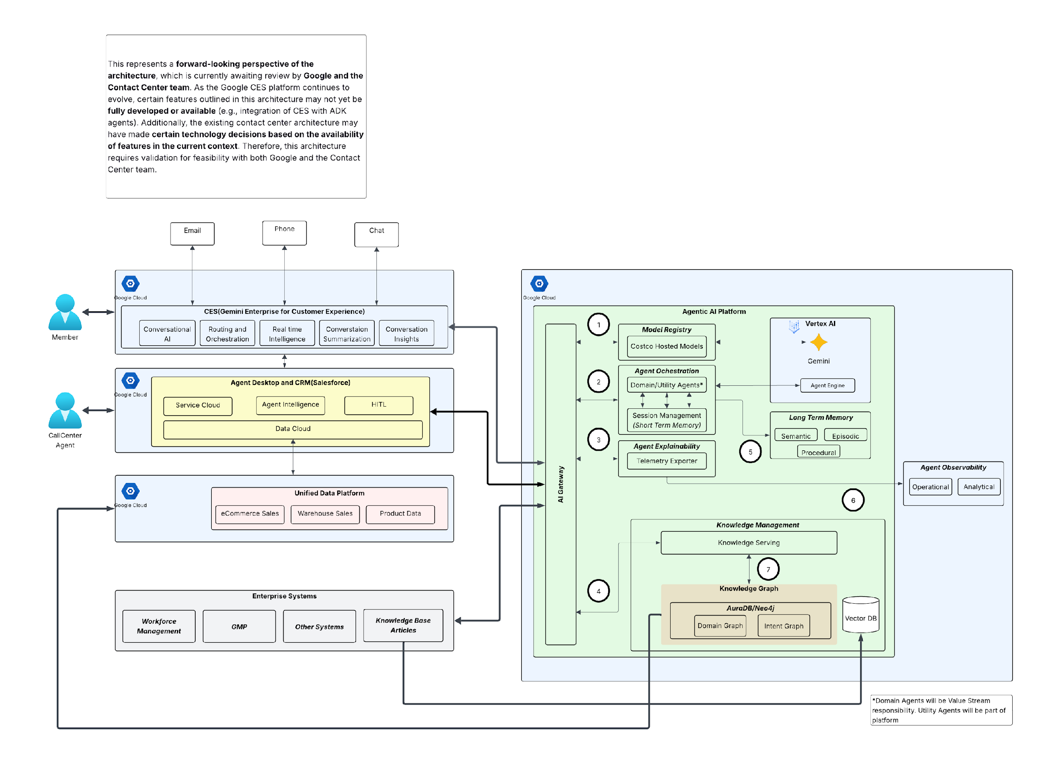
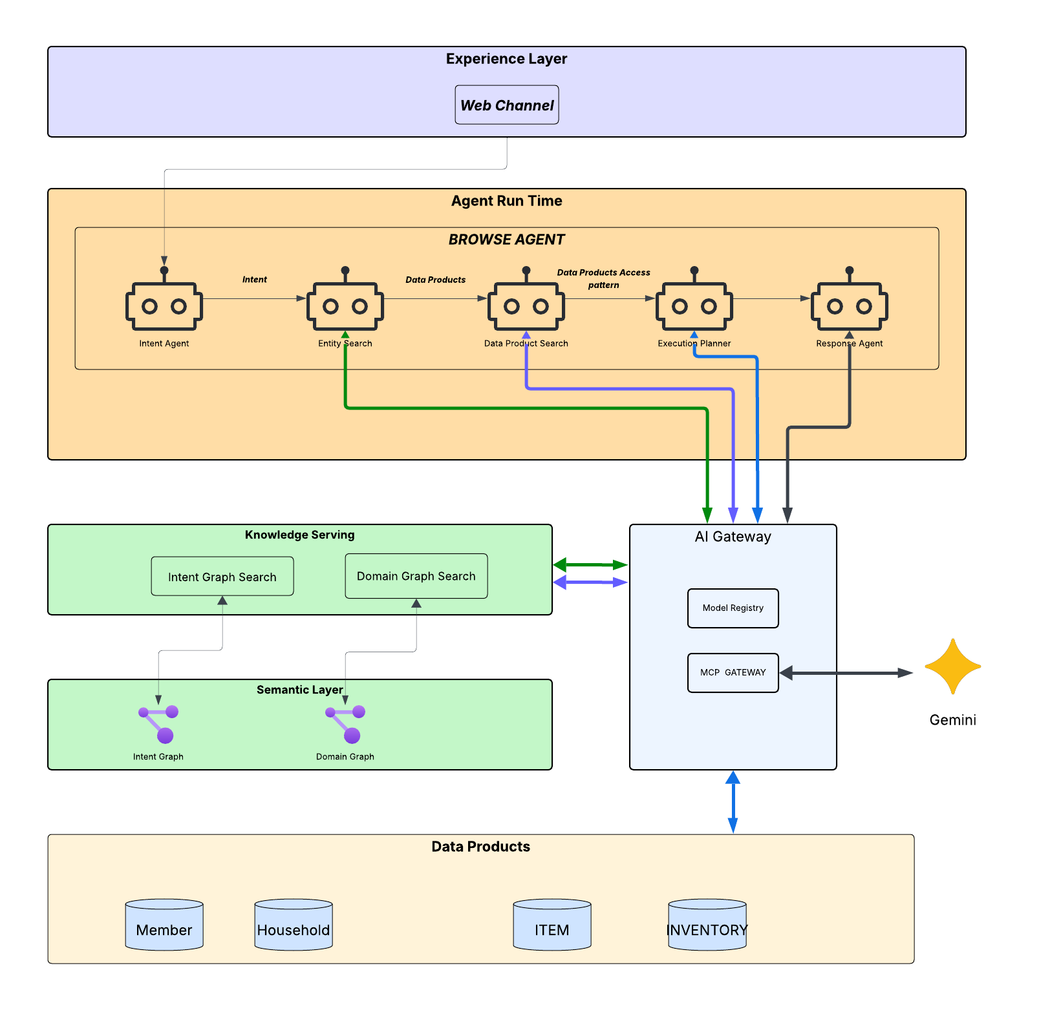
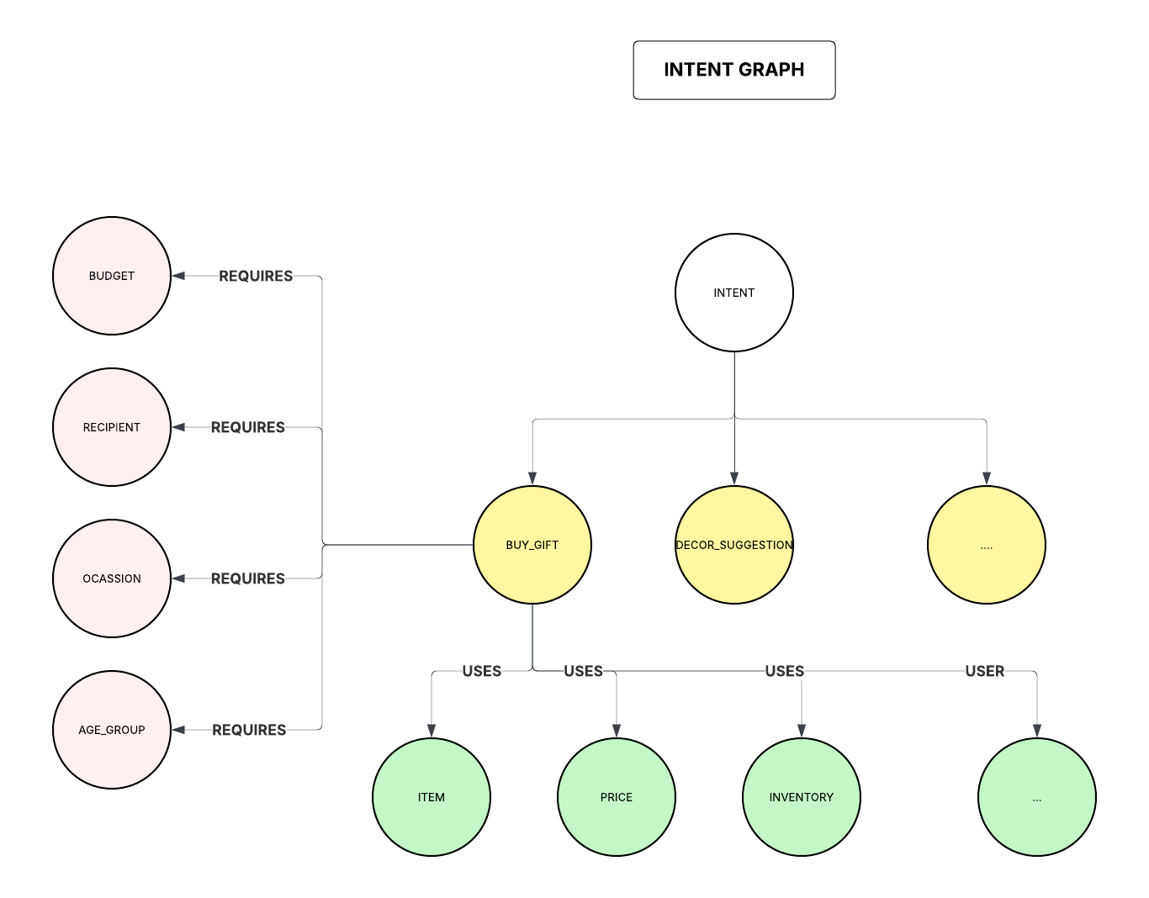
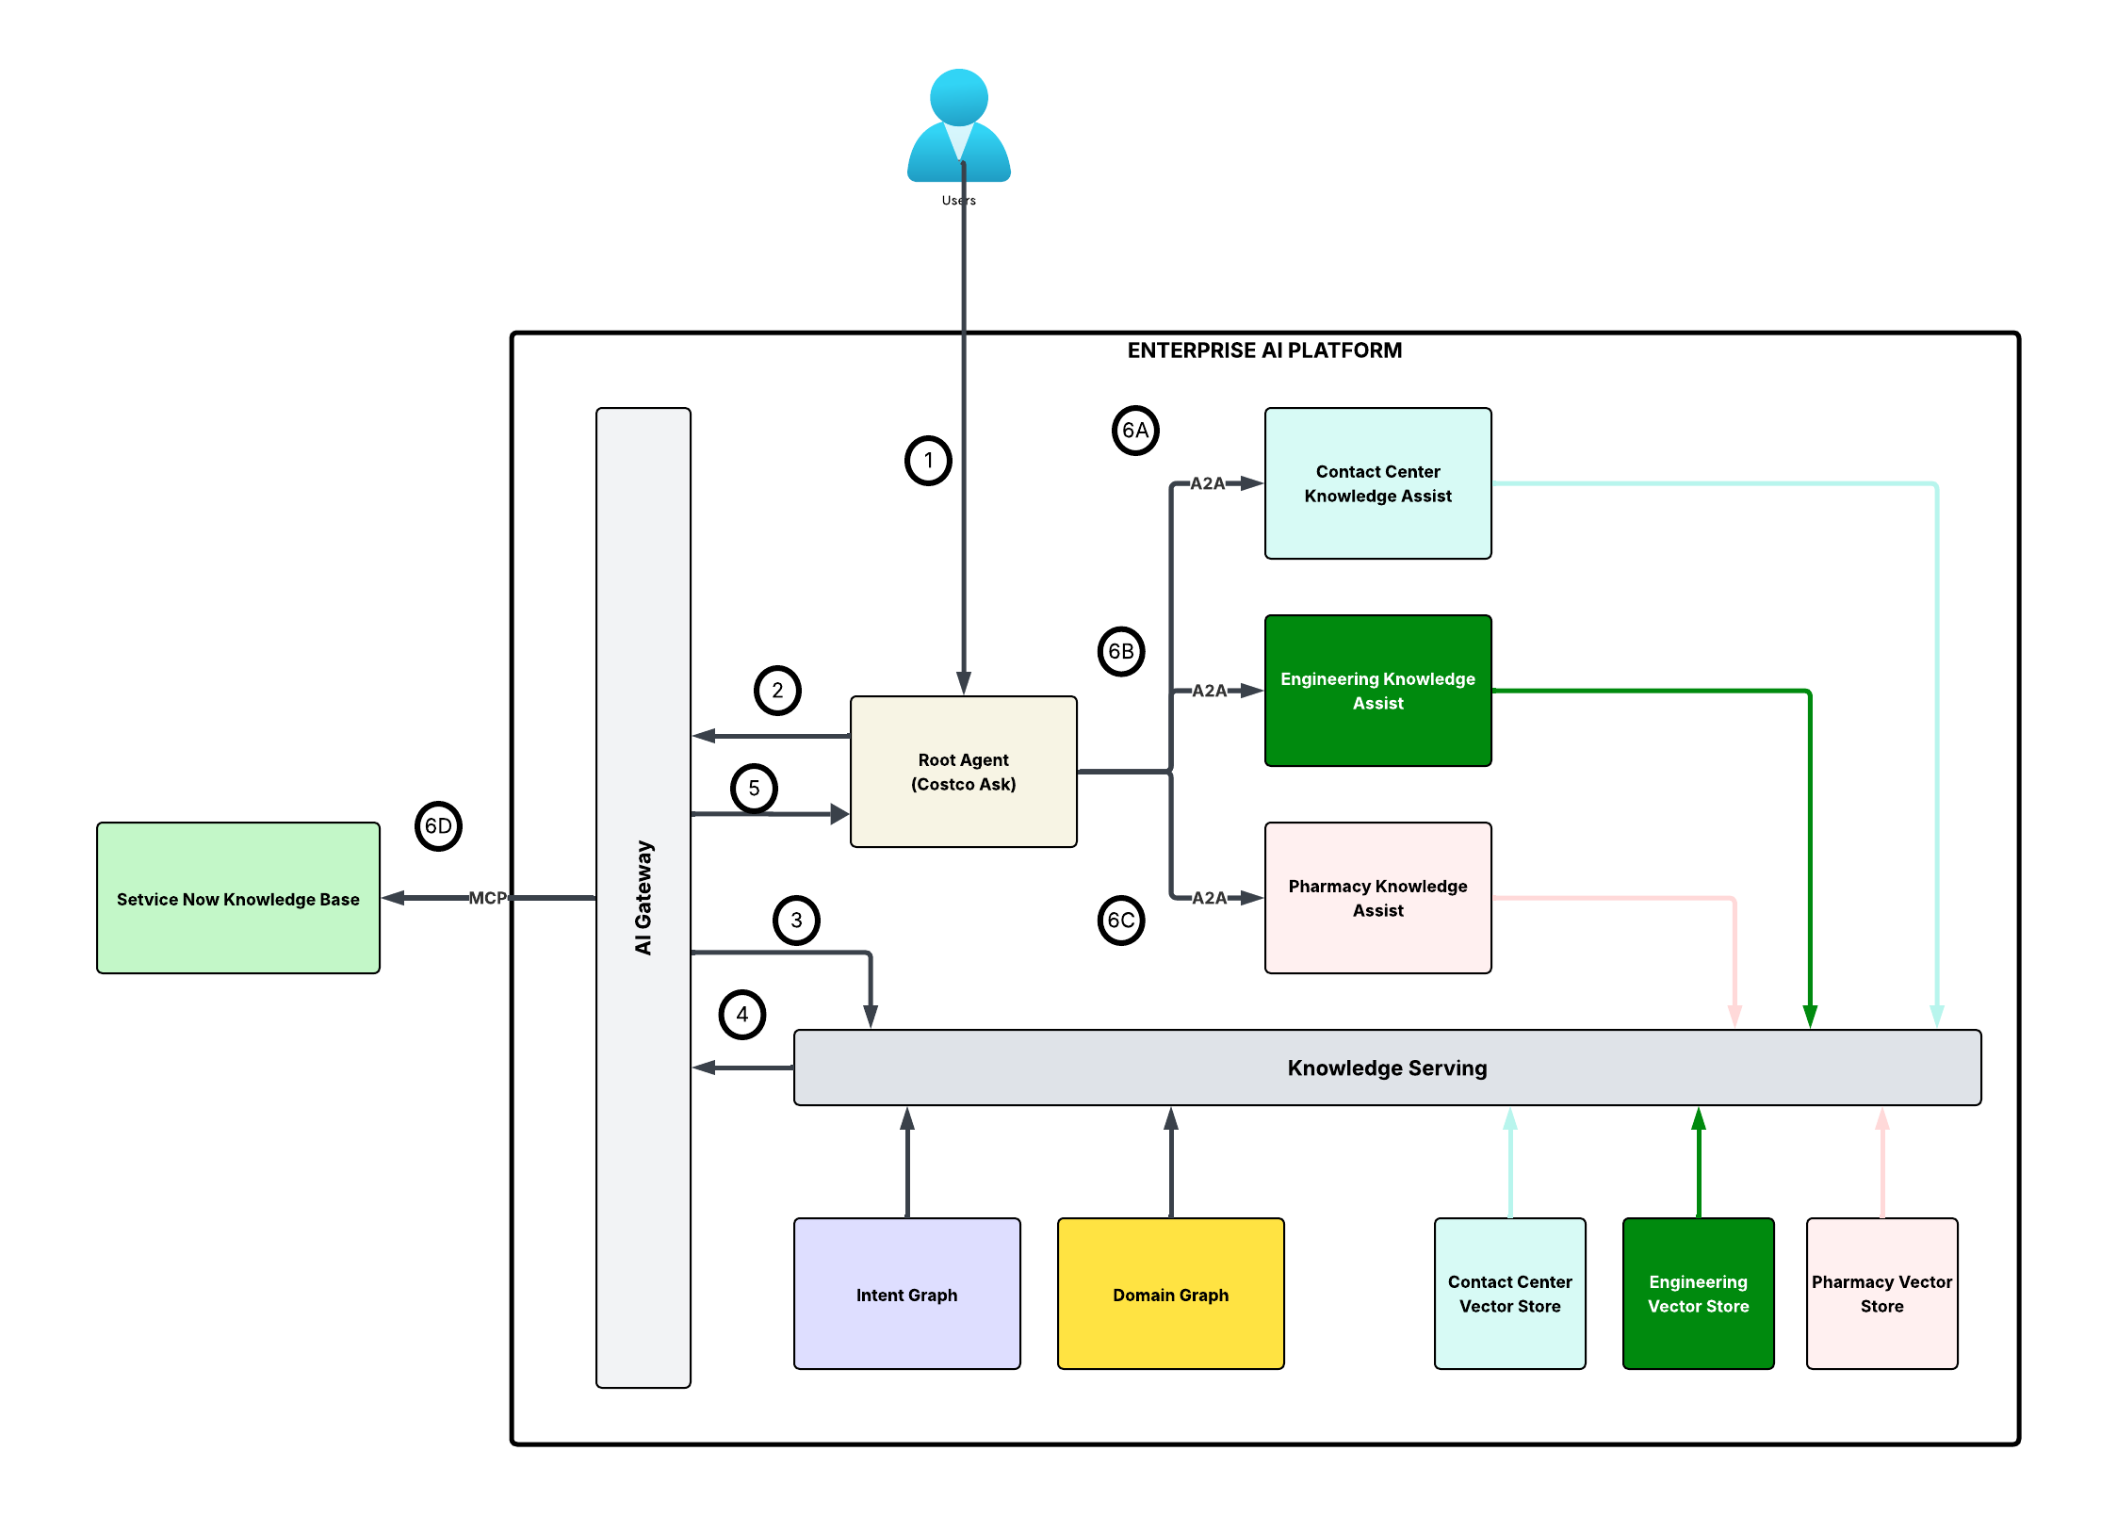
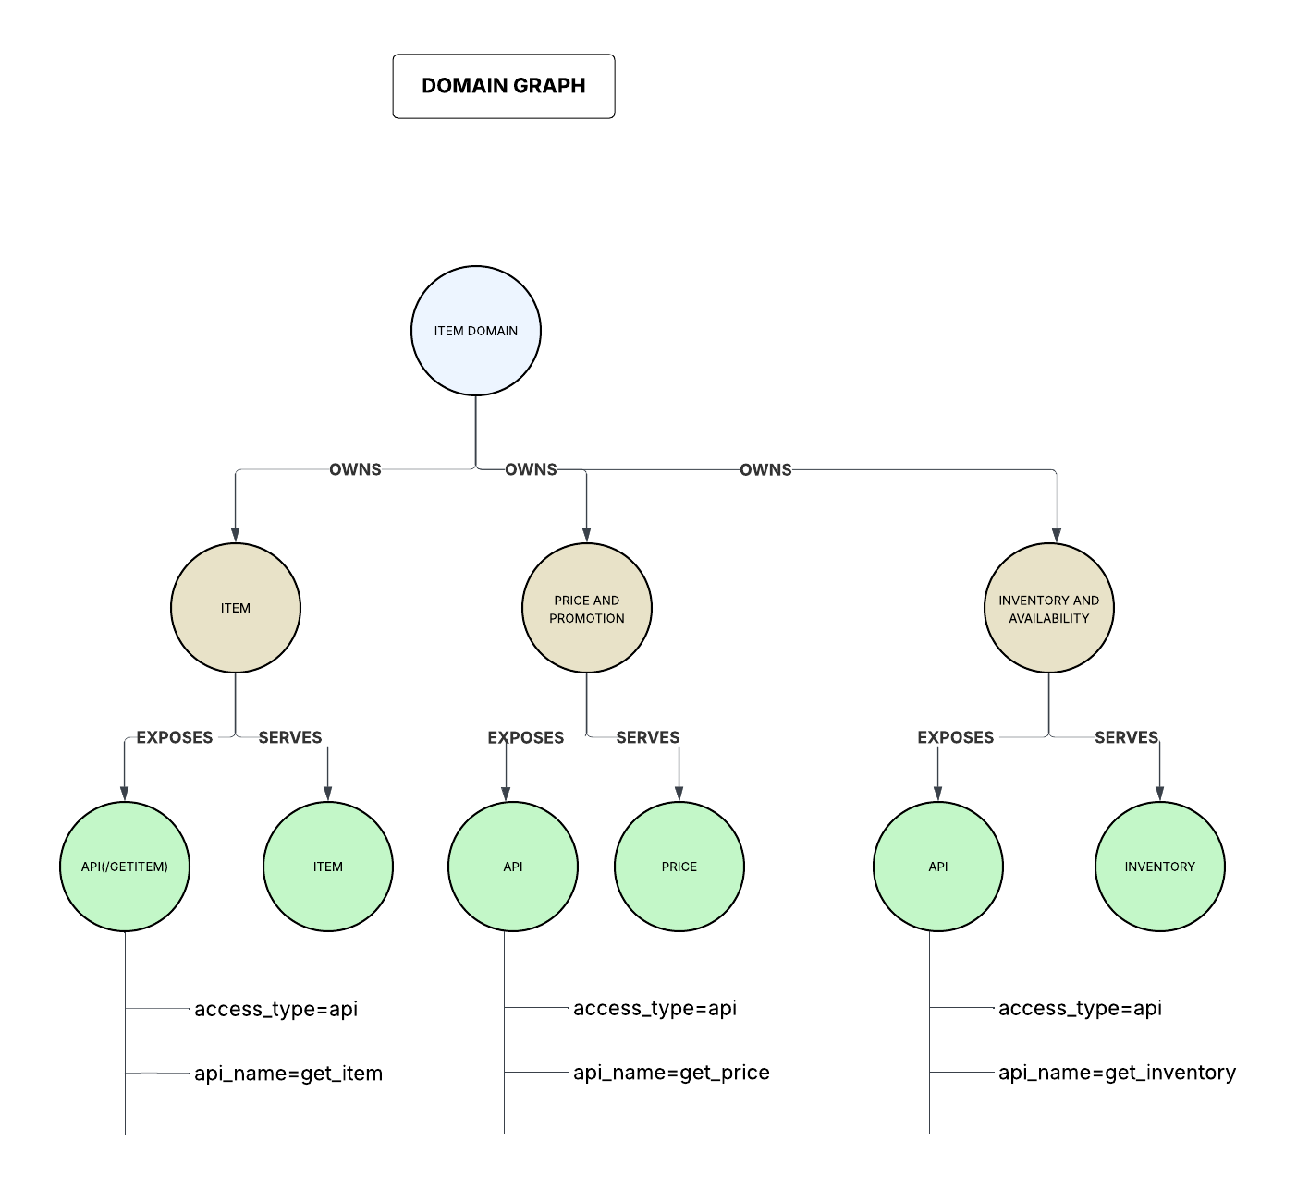
Architecture Recommendation
Contact Center
Personalized Search
Knowledge Assist
Go to Lucid Charts
Go to Lucid Charts
Go to Lucid Charts

Slide 129
MVP Scoping and implementation plan

Slide 130
AI Platform MVP Definition & Options
LOW
Increasing in Scope of MVP as you move to the right
HIGH
MVP – Small
(No Regret Foundational Capabilities)
MVP-Medium
(Utility Agents with Agent Appraisal)
MVP-Large
Proof of Concept to validate the capability of APIGEE, Aura DB, Dataplex and Dynatrace(Integration for Operational Metrics)
Cloud and Infrastructure foundation to provision cloud services including GCP onboarding, IAM foundation, IaaC, Containers etc.
Platform foundation services for provisioning services required for Agentic Development e.g., Alloy DB, Agent Engine, Aura DB
Knowledge Layer capabilities to enable data to knowledge patterns for RAG based use cases
Configuration of approved Language Models in AI Gateway(APIGEE) to govern model access by the Agentic Layer
Agent Governance to enable capabilities to collect and process human feedback, collect and process operational metrics and integration with Dynatrace
Provide Semantic Memory As A Service to improve consistency and reduce cost for Agentic operations
MVP-Small +
Enhance knowledge layer to include management of taxonomy in Dataplex and manual build of intent graph(without Knowledge Graph Studio)
Utility Agents(Intent and Knowledge Assist) to provide foundational capabilities that help agentic systems retrieves, synthesizes, and contextualizes trusted enterprise knowledge to support users
Enhance Agent Governance to include design and development of Evaluation framework and build of Agent Appraisal framework and dashboard
MVP Medium +
Enable Prompt Analytics for to track and monitor interaction patterns with agentic systems and leverage the insight for agent performance and security improvement
Enable Knowledge Graph builder Service to enable users to manage and maintain domain graphs leveraging the domain ontology and taxonomy
Scope Definition
Deliverables
Completion of Cloud Foundation Setup
Completion of AI Platform Foundation Setup
Completion of PoC of required Agentic components
Ingestion as a service for RAG enablement
Knowledge Serving Layer (Hybrid Search and Semantic Search)
Human Feedback Service to capture human feedback
Semantic Memory as a service
Operational Metrics Dashboard
AI Platform Testing and documentation
Intent Graph model created for Knowledge Assist
Knowledge Serving Layer enhancement to serve the intent graph
Knowledge Assist (Utility Agent)
  Intent Resolver (Utility Agent)
Agentic AI Evaluation Framework and Agent Appraisal Dashboard
Prompt Analytics Dashboard
Knowledge Graph Builder Service

Slide 131
Platform MVP - Road Map (Scope Options)
Month 1
Month 2
Month 3
Month 4
Month 5
Month 6
Cloud Foundation Setup
Non prod platform setup
Platform Foundation Setup
POCs complete
AI platform Foundation complete
POC Execution
Architecture
Conceptual SA, KAD, ADR complete
Model configurations and Armor template
Model Armor template setup
Approved Models Configured
Use case onboarding
Crawl for GEO use case
Data to Knowledge (Ingestion and Retrieval as a service)
Knowledge to data with Dataplex as the taxonomy store
Knowledge to data (without the KG builder)
Knowledge Assist framework ready with Pharmacy FAQ
Intent Resolver
Knowledge Graph builder
Knowledge Assist (Utility Agent)
Intent Agent(Utility Agent)
Semantic Memory
Human feedback service
Explicit human feedback
Operational metrics tracking
Evaluation Framework
Prompt Analytics
Observatory layer for operational and Agent Appraisal
Operational metrics integrated with Dynatrace
Agent Appraisal Dashboard
Platform testing
Platform Documentation
Platform Documentation
Platform Documentation
Small
Medium
Large

Slide 132
Platform Capabilities Roadmap
Agentic capabilities with repeatable patterns go into the platform
Milestones
FY26
FY27
FY28
FY29
FY30
FY31
Q3 | Q4
Q1 | Q2
Q3 | Q4
Q1 | Q2
Q3 | Q4
Q1 | Q2
Q3 | Q4
Q1 | Q2
Q3 | Q4
Q1 | Q2
MVP Build 1.0
MVP Build 2.0
Platform Maturity – Operational excellence
Strategic Differentiation
Platform Testing(Pen Testing, Vulnerability testing)
KAD,POCs and Testing
AI Gateway, Observability, Graph DB
AI for BI
Platform Operations. Maintenance and enhancements(Vector Store, Agent Engine provisioning)
AI Operations
Agent Commerce (UCP)
Agent Deploy
AI Gateway Setup Enhancements(A2A integration, Integrate with other 3rd party models like OpenAI, Anthropic)
MCP Gateway setup
Chargeback model
AI Gateway Setup
Fine tuning workbench
Agent Explainability/ Observability
Agent Certification
(Process)
AI Governance
Agent Certification
(Implement)
Agent Onboarding
Agent Security
Agent Registry
Agent Evaluation
Agent and Model
Prompt Registry
Publishing Costco Specific Agents for external marketplace integration (e.g., Generative Engine Optimization(GEO), instant checkout from ChatGPT)
Pre-built pre-built utility Agents
Agent Memory
Adaptive Learning Framework
POCs for strategic differentiation
(Agent Commerce, Agent Marketplace, Agent ECONOMY)
Model Security(Model Armor)
Model Benchmarking
Autonomous agents – Controlled Autonomy
(Continuous Sensing of the environment and perform IT/Business operation actions)
Model Registry Setup
Agent Improvement
(RL Models, Cross Encoder re-rankers)
Agent Pattern Catalog
Knowledge
Taxonomy and Ontology Management
Mind of Costco Ecosystem
(Organizational Knowledge Graph,
Organization Memory Graph)
Knowledge Graph Builder
Vector Stores
Metadata Management
Knowledge Graph Builder Enhancements
Knowledge Retrieval
(Semantic, Hybrid, Graph RAG)
Knowledge Operations
Knowledge Ingestion
(D2K pipeline)
Certify D2K with Knowledge Assist
Cloud and Infrastructure
Cloud Foundation setup for Agentic AI
Ongoing Support and Maintenance
KNowledge Assist
Platform consumption
AI for BI

Slide 133
Agentic AI Platform Capabilities – Contact Center
*Existing capabilities will need enhancements during use case enablement
Agent
Governance
Agent Certification
(Certified 1P and 3p Agents)
Agent Registry
(Agent registration – 1P and 3P agents)
Agent Evaluation
(LLM as judge, statistical metrics)
AI Operations
Human Feedback
(Thumbs up/down, structured feedback)
Agent Security
(Identity management, Data and Tool controls)
Agent
Agent Orchestration
(no code, low code, pro-code)
Agent Explainability
(Telemetry)
Agent Tools and Protocols
(MCP, A2A, connectors)
Agent Memory
(Memory management)
Prompt Registry
(Prompt Management)
Experimentation
(ML model experiment, Build, deploy, monitor)
E
Model
E
Model Registry
(Registry of approved Foundation models)
Model Fine Tuning
(Domain Adaptation of foundation models)
Model Security
(Guardrails, Content Filter)
Model Benchmarking
(Identifying the right-fit model for the use case)
Serving
(ML Inferencing)
Knowledge
Knowledge Ingestion
(Semi structured, Unstructured and Structured data)
Knowledge Retrieval
(Retrieval strategies)
Knowledge Synthesis
(Synthetic data generation)
Metadata Management
(metadata for unstructured content)
Agent Deploy
(Agentic Application development and operations)
Taxonomy Management
(Create, curate and manage taxonomy)
Ontology Management
(Create, curate and manage ontologies)
Knowledge Graph
(KG creation using taxonomy and ontology)
Vector Stores
(Embedding Persistence)
Agent Observability
(Model, Application, Agent, Prompts, Ingestion pipelines)
Data
Enterprise Data Governance
(Data Catalog)
Analytical Data Stores
(Analytical Data Product)
Operational Data Stores
(Near | Real time Data Product)
Object Storage
Agent Improvement
(Feedback Integration)
E
E
E
E
Data Security Management
(Masking, Encryption)
Data Integration Management
(ETL, Pub/Sub, CDC)
E
E
AI Gateway
(Model, Agent)
Cloud and Infrastructure
Server, Container
(Agent Run Time)
Cost Control
(Tagging, Budgets and Alerts)
Observability
(Telemetry)
Standards and Policy Management
(NIST Controls)
E
E
E
E
MCP Gateway
(Tools)
Identity and Access Management
(Identity Access Management)
Network Management
(VPC,Subnets, Routes)
API Management
(API access)
Vulnerability Management
E
E
E
E
Level 2 Capability
Level 3 Capability
EXISTING CAPABILITY
CLOUD & INFRA
PLATFORM
DATA
MVP Level 3 Capabilities

Slide 134
Agentic AI Platform Capabilities – Knowledge Assist
*Existing capabilities will need enhancements during use case enablement
Agent
Governance
Agent Certification
(Certified 1P and 3p Agents)
Agent Registry
(Agent registration – 1P and 3P agents)
Agent Evaluation
(LLM as judge, statistical metrics)
AI Operations
Human Feedback
(Thumbs up/down, structured feedback)
Agent Security
(Identity management, Data and Tool controls)
Agent
Agent Orchestration
(no code, low code, pro-code)
Agent Explainability
(Telemetry)
Agent Tools and Protocols
(MCP, A2A, connectors)
Agent Memory
(Memory management)
Prompt Registry
(Prompt Management)
Experimentation
(ML model experiment, Build, deploy, monitor)
E
Model
E
Model Registry
(Registry of approved Foundation models)
Model Fine Tuning
(Domain Adaptation of foundation models)
Model Security
(Guardrails, Content Filter)
Model Benchmarking
(Identifying the right-fit model for the use case)
Serving
(ML Inferencing)
Knowledge
Knowledge Ingestion
(Semi structured, Unstructured and Structured data)
Knowledge Retrieval
(Retrieval strategies)
Knowledge Synthesis
(Synthetic data generation)
Metadata Management
(metadata for unstructured content)
Agent Deploy
(Agentic Application development and operations)
Taxonomy Management
(Create, curate and manage taxonomy)
Ontology Management
(Create, curate and manage ontologies)
Knowledge Graph
(KG creation using taxonomy and ontology)
Vector Stores
(Embedding Persistence)
Agent Observability
(Model, Application, Agent, Prompts, Ingestion pipelines)
Data
Enterprise Data Governance
(Data Catalog)
Analytical Data Stores
(Analytical Data Product)
Operational Data Stores
(Near | Real time Data Product)
Object Storage
Agent Improvement
(Feedback Integration)
E
E
E
E
Data Security Management
(Masking, Encryption)
Data Integration Management
(ETL, Pub/Sub, CDC)
E
E
AI Gateway
(Model, Agent)
Cloud and Infrastructure
Server, Container
(Agent Run Time)
Cost Control
(Tagging, Budgets and Alerts)
Observability
(Telemetry)
Standards and Policy Management
(NIST Controls)
E
E
E
E
MCP Gateway
(Tools)
Identity and Access Management
(Identity Access Management)
Network Management
(VPC,Subnets, Routes)
API Management
(API access)
Vulnerability Management
E
E
E
E
Level 2 Capability
Level 3 Capability
EXISTING CAPABILITY
CLOUD & INFRA
PLATFORM
DATA
MVP Level 3 Capabilities

Slide 135
Agentic AI Platform Capabilities – GEO
*Existing capabilities will need enhancements during use case enablement
Agent
Governance
Agent Certification
(Certified 1P and 3p Agents)
Agent Registry
(Agent registration – 1P and 3P agents)
Agent Evaluation
(LLM as judge, statistical metrics)
AI Operations
Human Feedback
(Thumbs up/down, structured feedback)
Agent Security
(Identity management, Data and Tool controls)
Agent
Agent Orchestration
(no code, low code, pro-code)
Agent Explainability
(Telemetry)
Agent Tools and Protocols
(MCP, A2A, connectors)
Agent Memory
(Memory management)
Prompt Registry
(Prompt Management)
Experimentation
(ML model experiment, Build, deploy, monitor)
E
Model
E
Model Registry
(Registry of approved Foundation models)
Model Fine Tuning
(Domain Adaptation of foundation models)
Model Security
(Guardrails, Content Filter)
Model Benchmarking
(Identifying the right-fit model for the use case)
Serving
(ML Inferencing)
Knowledge
Knowledge Ingestion
(Semi structured, Unstructured and Structured data)
Knowledge Retrieval
(Retrieval strategies)
Knowledge Synthesis
(Synthetic data generation)
Metadata Management
(metadata for unstructured content)
Agent Deploy
(Agentic Application development and operations)
Taxonomy Management
(Create, curate and manage taxonomy)
Ontology Management
(Create, curate and manage ontologies)
Knowledge Graph
(KG creation using taxonomy and ontology)
Vector Stores
(Embedding Persistence)
Agent Observability
(Model, Application, Agent, Prompts, Ingestion pipelines)
Data
Enterprise Data Governance
(Data Catalog)
Analytical Data Stores
(Analytical Data Product)
Operational Data Stores
(Near | Real time Data Product)
Object Storage
Agent Improvement
(Feedback Integration)
E
E
E
E
Data Security Management
(Masking, Encryption)
Data Integration Management
(ETL, Pub/Sub, CDC)
E
E
AI Gateway
(Model, Agent)
Cloud and Infrastructure
Server, Container
(Agent Run Time)
Cost Control
(Tagging, Budgets and Alerts)
Observability
(Telemetry)
Standards and Policy Management
(NIST Controls)
E
E
E
E
MCP Gateway
(Tools)
Identity and Access Management
(Identity Access Management)
Network Management
(VPC,Subnets, Routes)
API Management
(API access)
Vulnerability Management
E
E
E
E
Level 2 Capability
Level 3 Capability
EXISTING CAPABILITY
CLOUD & INFRA
PLATFORM
DATA
MVP Level 3 Capabilities

Slide 136
Thank You

Slide 137
Appendix

Slide 138
Knowledge Layer Design principles
Return to design principles

Slide 139
Knowledge | Design Principles
Design Considerations | Design Principles | Why this principles | Anti-patterns/Not recommended (if any)
Controlled Vocabulary | Agentic Systems need to operate on a controlled vocabulary – a standardized, domain-aligned set of terms, definitions and semantic boundaries that describes the concepts, relationships and constraints of the concepts for a particular problem domain | Most of the organizations exhibit terminology drift; teams use different terms for the same concept. AI systems amplify this inconsistency-leading to retrieval errors, misaligned context, reasoning mistakes. A controlled vocabulary mitigates this by providing a standardized and canonical lexicon | Vocabulary must not be technology aligned names but business terminologies which is understood commonly across the organization (e.g Return Orchestration Service vs Return Management)
Context Building – Small World Approach | Agents need to operate on scoped world models – compact, goal-aligned representations of the specific problem space they are designed to solve-rather than relying on a large, all-encompassing world model. | Large monolithic world models will introduce noise and more context overlaps. Those will also be difficult to manage and scale. In order to effectively ground the agents, it is important to enable them with a tightly bound knowledge structure tailored to the domain and the problem space | Knowledge model should not be all-encompassing. We should develop use case aligned knowledge models bounded by the domain’s rules, tools and the data sources.
Metadata curation and management | As part of context engineering, metadata must be curated, standardized and governed across knowledge assets with “domain experts(knowledge managers)” in loop | High-quality and high precision context retrieval is possible only when we can reduce the surface area of search through search optimization. Metadata filtering enables efficient filtering of the search space for precise context retrieval | Unstructured knowledge items must not be without metadata. Every unstructured knowledge item must accompany a business verified metadata information which will make the knowledge item AI consumable
Context isolation and retrieval | Once the scoped world model is defined, the retrieval layer must be designed to deliver precise, high-relevance context to the agents – selecting and tuning retrieval mechanisms that best match the domain and the knowledge structure. This layer will also enable a controlled Knowledge caching - enforcing TTLs, provenance, and invalidation rules so cached context remains accurate, auditable, and aligned to the domain’s knowledge structure | A well-structured world model is only valuable if the agent can retrieve the right slice of it based on the provided input. Different problem spaces require different retrieval strategies. There is no single “perfect” retrieval mechanism; optimizing requires deliberate experimentation, evaluation and tuning

Slide 140
Knowledge | Design Principles
Design Considerations | Design Principles | Why this principles | Anti-patterns/Not recommended (if any)
Context Shaping (Prompt Engineering) | The context served to the agents must be shaped-filtered, structured and reformatted, so that the final context window reflects only the most relevant tools, conversation history, memory fragments. The context window should not be overloaded with information that may cause context poisoning | Although the newer language models have large context window real estate, but that does not help much as language models can only attend to precise and structured context. The “lost in the middle” effect ignores middle portion of large context. Structuring of the context is also important because well structured context can leverage the prompt caching feature of language models | see slide
Knowledge Management Lifecycle | Enterprise knowledge(a major portion is unstructured) need to follow a knowledge management lifecycle – transforming human aligned content into AI aligned assets through systematic curation, metadata enrichment, normalization and context-overlap reduction before making it available for agentic systems | The existing unstructured knowledge content in PDFs, PPTs and word documents are authored for human consumption. That knowledge corpus is verbose, redundant, inconsistently structured, and often lack semantic metadata required for precise retrieval. Without a structured knowledge management lifecycle, the raw content flows directly into AI systems causing context overlap, retrieval drift and poor response quality | Not cleansing the knowledge corpus from distractors - As part of the knowledge ingestion distractor contents(disclaimers, foot notes etc, which are not relevant content should be removed) Not including the layout tags of the content- While storing the knowledge content in vector DB, store it along with the layout tags (e.g; tags for header, list, tables)
Incremental Knowledge ingestion | While developing Agentic systems, it is critical to design for incremental knowledge. The system must intercept change triggers and re-ingest the modified knowledge into vector stores. It is also important to log and version such changes for auditability | If an incremental ingestion pipeline is not designed, knowledge will soon become stale. Also, without proper logging and versioning, auditability of past responses and interactions will be lost | The knowledge ingestion pipeline should not be designed without a reconciliation mechanism. A reconciliation mechanism ensures that the knowledge is not lost when the knowledge is chunked and embedded in the vector DB. see slide

Slide 141
Knowledge | Design Principles
Design Considerations | Design Principles | Why this principles | Anti-patterns/Not recommended (if any)
Evaluation, Guardrails & Feedback Loops | Agentic systems must include guardrails, evaluation pipelines, and human/automated feedback loops to continuously refine reasoning, detect drift, and enforce safety & compliance. | Without evaluation and guardrails, agents degrade over time, hallucinate more, and produce unsafe behavior. | It is not recommended to use the same LLM which generated the output as the evaluator of the output. When using LLM as a Judge, choose the Judge LLM different from the LLM which created the output

Slide 142
Knowledge | Design Principles | Context shaping (Prompt Engineering)
Anti-Pattern | Description
Stuffing the context with arbitrary few shot examples | The context window of LLM should not be loaded with arbitrary examples. Selecting exemplars that are similar to the prompt is beneficial for performance. This is where we integrate the system with human feedback. As part of human feedback, we collect good set of prompt/response pair. At run time, based on prompt similarity, we bring in the similar examples in the context window
Free flow text within prompt | The content of the context should not be a free flow text. It is recommended to use delimiters to indicate distinct parts of the input. For example PROMPT = f””” Answer the question based on the provided rules and context ## Rules ## 1.Rule#1 2.Rule#2 3…. ## Context ## {context} “””
Context overloading with entire conversation history | The context window should not be loaded with all previous conversation summary. This will lead to hallucination and context limit exceptions. There are different strategies that we should follow to load the previous conversation summary. Those strategies are Sliding Window - Keeps a fixed number of recent messages (based on window_size), when the limit is exceeded, the oldest conversation is dropped Compaction - This strategy compresses older messages into summaries while keeping the most recent messages intact Semantic retrieval - This strategy allows to match the new input with older conversation history to bring only the relevant chain of past messages
Mixing dynamic and static part of the prompt | Inappropriate structuring of the prompt will lead to no use of the KV cache. In order to leverage PROMPT(KV) cache, static content of the prompt should be at the beginning of the prompt. Note: Different model providers have different limits on when KV cache can be used. Minimum cacheable prompt length: Open AI models - 1024 tokens Claude Opus 4.5 - 4096 tokens Claude Opus 4.1, 4, Sonnet 4.5, 4 - 1024 tokems Claude Haiku 4.5 - 4096 tokens Claude Haiku 3 - 2048 tokens

Slide 143
Model Layer Design principles
Return to design principles

Slide 144
Model
Model layer provides controlled, governed and secure access to foundation models including embedding, test, image and video generation models. This layer adds the access constraint policies based on team/user role
Model Registry
Model registry refers to the set of approved models from different providers which are approved to be used by the organization. The models in this registry are exposed via the AI gateway. Model registry provides scoped access to the approved models.
Model Registry
Model Fine Tuning
Model Fine Tuning
Capability to train or adapt foundation models with domain-specific Costco data so the model internalizes the vocabulary, semantics, and constraints of the problem space.
Model Safety & Guardrails
Mechanisms to enforce safety constraints, prohibited topics, refusal behavior, and output filtering at the model level
Model Security
Model Benchmarking
Model Benchmarking
Suite of services for testing and evaluating base models and custom models against a well- defined set of metrics and create benchmarks for business related functional areas.

Slide 145
Model | Design Principles
Design Considerations | Design Principles | Why this principles | Anti-patterns/Not recommended (if any)
Model selection based on use case (xLM) | Design must consider model routing that routes tasks to the most appropriate model based on domain, task complexity, language, and performance constraints. | Ensures the right model is chosen for the task, domain, modality, and business constraint; improves accuracy and cost-efficiency.
Model inference acceleration | Uses quantization, batching to reduce latency and compute cost. | Reduces latency and cost through quantization, batching, and compilation—critical for real-time and high-volume use cases.
Model distillation | Compresses large models into smaller ones without major loss in capability, improving performance and deployability. | Produces smaller, faster models without major performance loss; essential for scale, efficiency, and controlled deployment.
Quotas and rate limits | A governance layer that enforces execution boundaries such as quotas, rate limits, refusal behavior, and policy controls to keep model usage predictable, compliant, and safe. | Prevents system overload, ensures fair resource usage, and maintains stable, controlled model execution in production.
Benchmarking recipes | A structured evaluation framework with standardized metrics, datasets, and scorecards to assess model quality, performance, and safety before deployment. | Ensures consistent, repeatable measurement of model performance and protects against regressions during updates.

Slide 146
Agent Layer Design principles
Return to design principles

Slide 147
Agent
Agents are a semantic model(e.g a generative language model) at the core and the periphery makes it agentic. The peripheral capabilities are planning and reasoning, tool calling and memory usage.
Agent Orchestration
Agent Explainability
Agent tools and protocols
Agent Memory
Prompt Registry
A highly customizable, low-code and pro-code , scalable framework with chain-of-thought reasoning, dynamic task decomposition and management. Agents are designed to collaborate seamlessly through an integrated memory system, and multi-agent collaboration is facilitated via a 3-layer orchestrator/super/utility agent topology.
The continuous stream of spans and traces that captures agent interactions, prompts, tool usage, latency, cost, errors and action outcomes from execution of the agentic flows providing observability into agent execution. This helps in monitoring, tracking of the agents continuously to ensure that they are aligned the goals and objectives.
Agent tools and connectors provides pre-built services that allows the agents to integrate securely to enterprise data and systems ecosystem (CRM, ERP, ITSM tool etc.)
A secure, governed and persistent layer that allows agents to store specific episodes of its interactions which can later be retrieved so that it can learn from past interactions. It stores key facts, preferences, actions an outcomes – across semantic, episodic and entity dimensions
A prompt registry is a centralized, version-controlled catalog where all prompt templates are managed and stored. It ensures that prompts are treated as first class artifacts, which are reviewed, tested, tagged and versioned. It becomes the single source of truth that tracks the evolution of prompts as they mature through review, testing and optimization

Slide 148
Agent | Design Principles
Design Considerations | Design Principles | Why this principles? | Anti-patterns/Not recommended (if any)
Role Based Agents (Macro Vs Micro Agents) | When translating a traditional workflow into an agentic flow, agent boundaries must be defined around roles or sub-roles – not around individual tasks. Each agent should embody a coherent functional responsibility that mirrors how work is naturally partitioned among human or system roles | Agentic AI inherit the distributed-systems characteristics like microservices architectures. Decomposing too broadly creates cross-domain coupling, increase handshakes and constraints autonomy. Decomposing too narrowly introduces excessive coordination overhead or chattiness. Role based decomposition strikes the right balance. It minimizes inter-agent dependencies, maintains contextual integrity, and ensures each agent can act coherently and independently within its defined responsibility domain | Task based decomposition of agents should be avoided. Task based decomposition creates coordination overhead, fragmented context, and governance sprawl, turning the system into a brittle workflow graph than an outcome-driven agent with clear domain boundaries Refer to next slide
Agent Identity | Every agent with an agentic system must possess a verifiable identity-issued, signed, and managed through trusted identity infrastructure-to ensure that all interactions, delegations and executions can be authenticated and trusted end-to-end. Identity must reflect trust boundaries: intra-domain agents are first-party identities; inter-domain agents require explicit trust agreements and no implicit trust across domains | Agentic ecosystems are distributed and involve dynamic, autonomous interactions. Without secure, non-repudiable identity, the system becomes vulnerable to impersonation, unauthorized tool invocation, and integrity breaches. Cryptographic identity(verifiable credentials, signed attestations) establishes a secure foundation of trust, access control, and auditability | We should not provide 3rd party agents with the tool access or model access credentials. All 3rd party agents must go through AI Gateway to access any internal tools like ServiceNow, GitHub etc. If we provide direct tool credentials to 3rd party agents, there will be no control on what those agents can do with the tool access.
Input and output guardrails | Agents must operate within clearly defined input and output guardrails(or the constitution of work) – validating, constraining, and shaping data entering and leaving the agent. This is critical to ensure safe, predictable, and policy-aligned behavior across the agentic system. Guardrails should be applied based on agent risk tier | Agentic systems are inherently dynamic and probabilistic. Without structured input/output constraints, agents may propagate harmful or malformed context or information to downstream receivers | Avoid instrumenting guardrails within prompts, enforce guardrails outside prompts as a common control point. Avoid using only LLM based guardrails, have a combination of LLM and rule based guardrails Avoid having guardrails as the only source of security measure. For example, PII guardrail can be avoided if the data is already sanitized for PII. Every guardrail introduction adds to latency.

Slide 149
Agent | Design Principles
Design Considerations | Design Principles | Why this principles? | Anti-patterns/Not recommended (if any)
Stateless Agent Services with externalized memory management | Agent services should remain stateless delegating all forms of memory, transient state, checkpoints and conversational history externalized in a durable persistence layer. It is therefore critical to design the state model of the agents to ensure only relevant information is persisted | Unlike traditional stateless service calls, agentic systems rely on accumulated or shared context, intermediate reasoning to make accurate, contextual and policy aligned decisions | Anti-patterns for state design Do not store everything in the state. State should store only essential, relevant data Do not use complex objects for state persistence. Use simple data types(strings, numbers, booleans) that are serializable State should not be un-scoped. Use clearly named prefixes to scope the state(e.g user, app, temp) Avoid deep nesting of the states, when possible
Memory as a service | Agentic systems must externalize long term memory into a dedicated “Memory-as-Service” layer – providing standardized APIs for storing, retrieving and managing agent interactions, user preferences rather than embedding memory logic directly within individual agents | Memory is a foundational capability in an agentic architecture which enables every interaction to improved by leveraging experiences of past interactions. A centralized memory supporting semantic, episodic and procedural memory capabilities ensures consistency in governing, storing and retrieving of memory | Please see this slide
Own your prompts | Prompts must be treated as first-class, governable assets – authored, versioned, evaluated and maintained by the respective project team – rather than being embedded ad hoc within application code or use abstraction layers like DSPY | In an agentic system, prompts are the behavioral contract. They encode policies, role definitions, reasoning expectations, safety boundaries ad task logic. If prompts are scattered, un-versioned, or hidden within abstraction layers, it will be difficult to govern, scale the system. | It is not recommended to abstract the prompts. Owning the prompts enables: Better Control: Provides control to add precise instructions that agents need. Prompt Evaluation: Allows to test the prompts in a way we test code. Quick Iteration: Allows to do prompt iterations faster Better Transparency: Visibility into the decision boundary of the prompt(rules, few shot examples etc.)

Slide 150
Agent | Design Principles
Design Considerations | Design Principles | Why this principles? | Anti-patterns/Not recommended (if any)
Interoperability across multi-agent systems | Agentic applications must be designed to interoperate seamlessly across heterogenous multi-agent systems-supporting shared protocols, common schemas, standardized messaging patterns, and portable capability definitions to ensure agents can collaborate seamlessly across frameworks and platforms | Enterprises are going to take a polyglot approach while leveraging agent development frameworks(e.g. LangGraph, ADK, AG2). Without a standard interoperability protocol, it will be difficult to enable shared communication between the agentic systems
Integrated Telemetry | Telemetry must be a native, first-class capability of the agent framework – automatically capturing reasoning traces, tool calls, latency, cost and state transitions – so developers are not responsible for manually instrumenting agents through decorators. Manual instrumentation should be an exception when needed | Telemetry is a common concern or service within an agentic application. If left to developers, that may either forget or implement telemetry in an inconsistent way that may be difficult to manage for observability and analysis | Telemetry solutions must not use non-standard telemetry protocol. It should be OTEL compliant
Domain driven MCP development | MCP servers must be designed and deployed using Domain driven Design(DDD) principles – where capabilities are exposed along bounded contexts rather than as monolithic endpoints . This will enable multi-tenancy, capability isolation and seamless cross domain reuse | MCP is the kinetic core of the agents. If an MCP server exposes tools without domain boundaries, capabilities will blur resulting in duplication. It will also be difficult for agentic systems to discover authoritative capabilities within an organization | MCP server must not be one single monolith which hosts all the tools and capabilities in the organization. MCP server deployment strategy should follow Domain driven Trust boundary based and(or) Data classification-based approach see slide

Slide 151
Agent | Design Principles
Design Considerations | Design Principles | Why this principles? | Anti-patterns/Not recommended (if any)
Data to model and Model to Data | In Agentic Architecture, we must accommodate both “data to model” and “model to data” patterns. Data to model is when we ingest the data from source systems and vectorize them in vector stores. Model to Data is when the model retrieves the data from its source. | Data to model pattern requires additional overhead of developing reconciliation mechanism to ensure that information is lost when the data travels to the model | Model to data should be prioritized over data to model pattern
Configurable Agents | Agent behavior must be configurable – allowing prompts, tools , policies and underlying models to be externally defined and dynamically adjusted – so that the agent can evolve without significant code changes as the AI landscape and enterprise requirements continue to evolve | The AI stack is undergoing continuous innovation. Tight coupling of the agent ecosystem makes the system brittle and unable to adapt quickly to leverage newer innovations
Protocol aware agents | Agent frameworks must natively support standardized interaction protocols such as A2A, so that agents automatically produce protocol-compliant messages, actions, status and tasks without developers manually instrumenting the protocol logic. Where native support is not there, reusable protocol adapters to be provided. | As agent ecosystems expand, standardized protocols become essential for reliable cross-agent communication and orchestration. Making it part of the framework enables consistent implementation of the protocol standards

Slide 152
Agent | Design Principles | Macro Vs Micro Agents
Macro Agent Pattern
Micro Agent Pattern
Enterprise Apps
Channels and Consumers
Enterprise Apps
Channels and Consumers
Web/Mobile
Contact Center
Partner/3rd Party
Experience
Web/Mobile
Contact Center
Partner/3rd Party
OMS
OMS
AI Gateway
(AuthZ/N, Resource Policies, Telemetry, Routing)
API
AI Gateway
(AuthZ/N, Resource Policies, Telemetry, Routing)
WMS
WMS
Orchestration
Orchestration
Return Management Agent
Service
Eligibility Check Agent
Label Creation Agent
Refund Agent
Eligibility Check Agent
Label Creation Agent
Refund Agent
Stable contract : Consumers integrate to one outcome-driven API, so we can change internal decomposition without breaking clients
Efficient Governance: Easier to enforce least privilege, policy guardrails, audit logs and telemetry instead of replicating controls across many endpoints
Better reliability and debugging: End to end tracing is simpler, reduces hand-offs, improves latency
Endpoint Sprawl: Clients must chain multiple micro calls, increasing coupling and chattiness across the network
Inefficient controls: Guardrails, auth, rate limits, and logging drift across services, expanding attack surface and weakening compliance policies
Higher latency/more failure points: Each hop adds latency, small changes cascade across handoffs, making the system brittle.

Slide 153
Agent | Design Principles | Memory Service
Anti-Pattern | Description
Memory as dumping ground | Memory must not be a “dumping ground”. Everything in the session context must not be dumped into memory. Only relevant facts, user preferences and decisions based on use case should be part of the memory
Last write wins | New memory must not overwrite old memory.Memory must consolidate new information with existing memories which allows memories to evolve as new facts and information are extracted
Synchronous write path | Memory write must not be synchronous. It should enable generation of memories asynchronously in the background, so that agent does not have to wait till the memory is generated
Schema less memory extraction | Memory extraction must not be an unstructured text blob without a defined schema. It should be schema driven; every memory item must conform to a defined schema.
Single global memory | Memory must not have one shared namespace for all users/tenants/domains/projects. It must be scoped to a particular namespace schema (e.g /org/domain/app/user)
Tight coupling of memory storage and services | Memory services must not be tight coupled with the underlying memory storage. Memory storage should be decoupled so that right-fit storage can be used based on memory type
Unbounded retrieval | Memory retrieval must not be unbounded. It should be based on intent-aware read policy to only include relevant memory in the conversation window
Versionless memory | Memory must not be without a version. All memory writes must be versioned which is immutable. This enables visibility into how memory has evolved.
Retention-less memory | Memory must not be created without a retention policy. All memory records should have an explicit retention policy(TTL/expiry) and retrieval preference for fresh memory items

Slide 154
Governance Layer Design principles
Return to design principles

Slide 155
Agent Governance
Agent governance is the set of policies, controls and operating processes that ensure AI agents are safe, compliant, reliable and cost-managed throughout their lifecycle.
Agent Certification
Agent Registry
Agent Evaluation
Human Feedback
Agent Security
Agent Certification
Agent certification is the process of assessing agents against a capability maturity and agent readiness dimension. The capability maturity define the autonomy/agency level of the agent and the readiness dimension is measured by security, effectiveness and interoperability aspects.
(add lifecycle in design principle)
Agent Registry
Agent registry is SOR for all certified agents-capturing their identity, owner, purpose, versions, allowed tools/data, and policy constraints. Each agent is documented through a A2A compliant Agent Card, a standardized profile that captures the agent skills, capabilities, its hosting location etc.
Agent Evaluation
Measurement systems that evaluate how well an agent reasons, retrieves, and acts.
Evaluation frameworks (RAGAS, TruLens, custom scoring pipelines) assess:
Factual accuracy
Relevance & grounding of retrieved context
Coherence of reasoning steps
Correctness of tool use
Policy alignment
Overall task success
Evaluation ensures continuous reliability and tracks drift over time
Human Feedback
A structured human-in-the-loop (HITL) mechanism that guides agent behavior toward safe, aligned outcomes.
Human input—approvals, feedback, corrections, and reinforcement—helps:
Adjust agent decisions
Update or correct memory
Improve reasoning pathways
Strengthen compliance and business alignment
This creates a closed feedback loop for continuous refinement.
Agent Security
Agent security ensures every AI Agent treated like non-human entity with strong control over what it can access and what it can do. It starts with agent identity - each agent has a unique, verifiable identity used for authentication, authorization, and full audit logging of actions and tool calls. Access is governed by least privilege, granting only the minimum data, tools and permission required for the agents approved purpose, ideally with scoped and time bound credentials
Notes:
test and learn - add that as a principles

Slide 156
Agent Governance | Design Principles
Design Considerations | Design Principles | Why this principles | Anti-patterns/Not recommended (if any)
Certification as pipeline | Agent governance should be a pipeline (dev->stage->prod) with clear “promotion” criteria. Certification is the gate that confirms an agent met required security and evaluation thresholds for its risk tier | Ensures the right model is chosen for the task, domain, modality, and business constraint; improves accuracy and cost-efficiency.
Risk-tiered controls(policy profiles) | Not all agents need the same rigor. Define tiers and scale requirements for evaluation coverage, approval depth and security restrictions accordingly. | Treating all agents the same either slows delivery or increases risk; tiers focus rigor where impact and compliance exposures are highest.
Standardized artifacts via Agent Card | Every agent must ship with an Agent Card that document's purpose, intended users, tool/data access, guardrails, evaluation results, known | Agent cards make discoverability and agent interoperability efficient
Registry as the single source of truth with immutable versioning | The Agent registry should hold the canonical, versioned definition of each agent. Treat production agents as immutable releases-changes require a new version + recertification | Prevents agent sprawl , versioning enables auditability
Identity-first security with least privilege by default | Each agent has a unique agent identity used for authN/authZ, policy enforcement, and audit logs. Grant least privilege(scoped tools, minimal data, time bound credentials) and prefer just-in-time access for sensitive actions | Strong identity and least privilege minimizes blast radius, prevents data over reach and improves compliance posture.

Slide 157
Agent Governance | Design Principles
Design Considerations | Design Principles | Why this principles | Anti-patterns/Not recommended (if any)
Full traceability and auditability end-to-end | Every run should produce a trace: inputs, decisions, tool calls, outputs and policy decisions, linked to the agent version in the registry. | Traces provide explainability , support audits, and enable root-cause analysis and governance reporting
Operational guardrails + kill switches | Governance should include runtime controls, rate limits, spend/usage budgets, escalation rules and the ability to immediately disable an agent or revoke credentials if something goes wrong. | Because agentic workflows are iterative and autonomous, errors can compound across steps which can trigger run away costs or unintended side effects. A kill switch enables immediate containment to prevent runaway behavior.
Additional Security Controls

Slide 158
Agent Governance | Design Principles | Agent Security
Category | Description
Input/Output Level Security Implement validation and sanitization processes to prevent malicious inputs and outputs from exploiting vulnerabilities in the multi-agent system. | Prompt Injection Prevention Methodology enabling input validation and injection detection based on user input queries. Input/Output Content Filtering Methodology defining malicious input/output categories and policies, applying rule-based and LLM-based filters to sanitize user inputs and model outputs Rate Limiting & Throttling Methodology defining rate limits and quotas, and monitoring and alerting on potential abuse. Input Context Length Limiting Methodology enabling input context length limiting, ensuring compliance with specified limits and managing oversized inputs.
Model Level Security Secure the LLM models against adversarial attacks and unauthorized manipulations to maintain system integrity and performance | Hard/Soft Constraints Content constraint rules in an application or API middleware to ensure safe and compliant content generation. (define the constraint rules and categories, such as what content should never be generated, model output filtering) Secure Model and Monitoring Deploy the models via HTTPS-only endpoints and restricting model access to authorized users. Model Documentation All approved models should have a model card which should clearly explain the limitations and boundaries of the model
Identity and Access Management Utilize robust authentication and authorization mechanisms to manage the access of critical components and data | Fine-grained RBAC/ABAC Comprehensive access control system using role-based and attribute-based access control (RBAC/ABAC) principles. Least Privilege Assign least privilege roles based on identities and continuously monitor & alert for privilege escalation. Access Revocation & Expiry Controls Practices enabling the creation, rotation and revocation of user credentials.

Slide 159
Agent Governance | Design Principles | Agent Security
Category | Description
Data Protection Encrypt data at rest and detect and filter sensitive data with retention policies. | Sensitive Data Protection Detect and manage sensitive data based on usage requirements to ensure data privacy and compliance Data Formatting and Filtering Based on the use case, cleanse the data of any sensitive information before being used as input to agentic systems Incident Response Structured process for identifying, analyzing, and addressing security and privacy vulnerabilities discovered
Log monitoring and governance Continuously monitor and analyze logs for anomalies, ensuring compliance with security policies and regulatory requirements | Comprehensive Logging Architecture Dedicated logging system to enable runtime visibility and monitoring resource consumption of AI applications. User Activity Monitoring Log requests and responses per use and associate logs with session IDs or API tokens for auditing purposes.
Security testing and assurance Conduct regular security assessments, including penetration testing, to identify vulnerabilities and enhance overall system security posture | Security Testing in SDLC Regular security testing as part of SDLC, and findings must be documented and remediated. (testing strategy to include SAST, DAST, and OSS security assessments) Change Management in SDLC System changes and updates of critical components are documented, tested, reviewed and approved. System Integrity with Multiple Environment Controls and separated environment to protect the integrity of AI development and production environments.

Slide 160
Operations Layer Design principles
Return to design principles

Slide 161
AI Operations
AI Operations is the operational layer that keeps agentic systems reliable, governed and continuously improving in production. It combines an AI Gateway to standardize access across models/agents/tools, Agent Deploy to manage prompts and agent development with CI/CD discipline, agent observability to capture end-to-end telemetry and finally enable agent improvement through closed loop learning using human feedback
AI Gateway
MCP Gateway
Agent Deploy
Agent Observability
Agent Improvement
AI Gateway
AI Gateway is a centralized control plane that sits between agent applications, model providers and MCP servers. It enforces governance and operations at runtime - authentication, rate limits, policy checks, logging/tracing and spend/budget controls. It standardizes access to model and context which makes cost, security and reliability manageable at scale. In addition, it also enables semantic caching and usage analytics
A control plane or a proxy layer that manages how agents can securely access tools, data, and other resources through the MCP servers. It acts as the policy enforcing middle layer – validating requests, brokering capabilities, and ensuring that every tool invocation follows enterprise rules around safety, observability and authorization
LLMOPS
Agent Deploy enhances traditional DevOps practices by adding or enhancing checks and balances that are unique to developing Agentic systems. This includes adding prompt scanning, MCP tool scanning to the pipeline
Platform Observability
Ability to collect, analyze and observe how agents behave in production. It captures end-to-end telemetry across agent runs, model calls, and tool interactions-including latency, errors, quality signals, and cost
Agent Improvement
Continuous cycle of making agents more accurate , safe, and cost efficient based on real production signals. It uses evaluations, user/human feedback to facilitate reinforcement learning for continuous agent improvement

Slide 162
AI Operations | Design Principles
Design Considerations | Design Principles | Why this principles? | Anti-patterns/Not recommended (if any)
Prompt as code | Prompt templates must live in source control with change history | Prompt as code means treating prompts as first class software artifacts as they control agent behaviour and agentic system outcomes. Like code, Prompts can introduce bugs, regressions and security issues, so they must be versioned, tested and released through CI/CD principles | It is not recommended to hard code prompts within the agent code. Prompt and Code management should be decoupled
Model routing | Route by use-case and risk tier: cheaper models for low-risk tasks , stronger models for complex/high impact tasks with automatic fallback | Different tasks within an agentic system has different needs, some require deep reasoning, others need faster response, structured output etc. routing helps pick the right model for the right job to optimize cost, latency and quality
Cost controls | Budgets, rate limits, caching and unit cost tracking are built into platform observability so that spend scales predictably | Agents can generate unbounded work through multi step reasoning, tool loops, infinite retries, long context and silently multiply token spend and API calls. Resource and budget restraints helps to prevent runaway cost and brings cost predictability
Feedback driven iteration loops | Capture human feedback and production traces, convert them into test cases, and continuously improve prompts and agent output efficiency | It turns production usage into measurable improvements capturing user feedback, tool outcomes, and evaluation signals that identifies failure modes enabling shipping targeted fixes with confidence
Centralized policy enforcement | All model traffic flows through the gateway so auth, content/PII policies, tool/MCP allowlists, and tenant controls are enforced consistently | A centralized policy layer gives a single control point to enforce least privilege, data boundaries, tool permissions and action constraints across agentic systems, so that governance is consistent even as new agents are added

